Slide 1

Teaching with Sustainability
A course offered during IAP - January 2022
Instructors:
Liz Potter-Nelson and Sarah Meyers
Environmental Solutions Initiative at MIT

Slide 2
Overview of Topics
Week 1 - What is sustainability education?
Defining sustainability using the Brundtland Report & sustainability education
Brief timeline of education to accomplish sustainability initiatives
Explanation of a Jigsaw Activity
Jigsaw activity of foundational sustainability documents
Week 2 - What is effective teaching?
Effective teaching is complex
Learning theories provide a framework for how people learn
Theoretical perspectives used in sustainability education
Sustainability Learning Approaches
Positivism vs Postpositivism
Positivism and Postpositivism Activity
Practicality of Sustainability Education
Week 3 - How do we teach sustainably?
Asset vs Deficit Approaches
Criticism of US Education
Bloom’s Taxonomy
Sustainability education looks to paradigm shifts
Levels of implementing sustainability
Level 1, Level 2, Level 3
Transitioning through Sustainability Levels
Week 4 - What does this look like for me?
Explanation of Categories of Sustainability Literacy Competencies
Explanation of Sustainable Instructional Approaches
Overview of Understand by Design (UbD)
Modified UbD template
Sticking Points

Slide 3
What does this look like for me?
Week 4

Slide 4
Learning Objectives for Today
Participants will consider if they want to modify their content, their practices or both!
Participants will use a modified backwards design approach to start the planning process to (re)vision their activities

Slide 5
Opening Activity
What type of activity/lesson/course did you bring to work on today? What do you want students to know and be able to do after your modifications?

Slide 6
Where do I start?
Categories of Sustainability Competencies
Sustainability Knowledge
Systems Thinking
Social Justice
Futures Thinking
Active Citizenship
Content Knowledge
Sustainability Instructional Approaches
Collaborative, Small Group Learning
Inquiry-based Learning
Experiential Learning
Service Learning
Place-based Learning
Culturally Sustained Learning

Slide 7
Categories of Sustainability Literacy Competencies
Numerous different scholars have weighed in on the knowledge, skills, and dispositions necessary to be considered sustainability literate
Wide variety in what and how much is included in these lists
Each of these lists start to fall into the following categories:
  Sustainability Knowledge
  Systems Thinking
  Social Justice
  Futures Thinking
  Active Citizenship
  Content Knowledge
These categories help us think about the different ways that sustainability is present in the courses we teach.

Slide 8
Categories of Sustainability Literacy Competencies
Sustainability Knowledge
Explanation | Addresses the interconnection of environmental, social and economic perspectives Builds past the tradition of an environmental or ecological way of knowing Embracing and including the interplay between the social and economic perspectives.
Focus of this Category of Competency | Builds capacity for greater understanding of sustainability through environmental, social, human health, and/or economic perspectives Explicit connection to course content and sustainability perspectives
Examples | Drawdown Discussion Questions Reading Guide Homework 1 & 2 in the list
Notes:
Foley et. al., 2017; Hakovirta and Denuwara, 2020; Mintz & Tal, 2014; Nolet, 2009; Rieckmann, 2012; WCED, 1987; Yavetz et. al., 2009

Slide 9
Categories of Sustainability Literacy Competencies
Systems Thinking
Explanation | Encourages a return to thinking about the “whole” instead of individual “parts” of a system Looks at the links between systems and how one decision affects another system
Focus of this Category of Competency | Emphasizes how the content being taught is part of a larger system Encourages explanations or thinking about how the “part” is connected to the whole Incorporates at least two out of three perspectives of sustainability - environmental, social and/or economic
Examples | Paper 1 & Paper 2 Technology Critique Hometown Analysis Assignment 1 & 3
Notes:
Cabrera & Cabrera, 2015; Capra & Luisi, 2016; Cortese, 2003; Frisk & Larson, 2011; Meadows, 2008; Nolet, 2009; Wheeler et. al., 2008; Yavetz et. al, 2009

Slide 10
Categories of Sustainability Literacy Competencies
Social Justice
Explanation | Clearly articulates a need to provide equitable and inclusive opportunities to all Acknowledgement of, and action towards dismantling the deeply embedded systems that support and perpetuate inequality Empowers learners who have been underrepresented
Focus of this Category of Competency | Recognizes diversity within the context of the course material(s) Focus is on equity and identifying existing social barriers that may prevent equity Equity can be broad from equitable distribution of resources to gender-equity in decision making
Examples | Assignments 1, 2 & 4 Reading Guide What can a body do? Site Probes
Notes:
Alim & Paris, 2017; Grande, 2015; Holmes & González, 2017; Earth Charter Commission, 2000; Nolet, 2009; Santone, 2019; Thompson et. al., 2003;

Slide 11
Categories of Sustainability Literacy Competencies
Futures Thinking
Explanation | Often called anticipatory thinking or intergenerational thinking Encourages instructors and learners to think about how current choices will influence the long-term future Encourages reflections on how current decisions impact future generations
Focus of this Category of Competency | Emphasizes how choices now will impact future generations, 150+ years from now Focus is on meeting current needs without jeopardizing the needs of future generations Could use forecasting or backcasting to draw connections between here and then
Examples | Dream Project & Term Project Urban Plans Problem Set 1
Notes:
Brundier et. al.; , 2020; Foley et. al., 2017; Frisk & Larson, 2011; Lozano et. al., 2020; Merritt et. al.; UNECE, 2011; Wiek et. al., 2011

Slide 12
Categories of Sustainability Literacy Competencies
Active Citizenship
Explanation | Positions the learner to connect what they are learning to either their local place or as a global citizen Encourages the connections between content and positive action within the defined community
Focus of this Category of Competency | Emphasizes involvement in local and/or global community Involves learning about local and/or global community and ties content back to local/global community Learning and/or action about governments, policies, laws, norms, etc A reading or a lecture likely will not be active citizenship because students are not acting
Examples | Health Care Reform Famine Relief Big Plan Final Communication
Notes:
Brundiers et. al., 2020; Cortese, 2003; Gibson, 2006; Frisk & Larson, 2011; Lozano et. al., 2017; Nolet, 2009; Sipos et. al, 2008; Wheeler et. al., 2008; Wiek et. al., 2008

Slide 13
Sustainable Instructional Approaches
How we teach is almost as important as what we teach
Make sure our method mirrors our message (Widhalm, 2011)
Sustainability Instructional Approaches (Nolet, 2016)
  Collaborative, Small Group Learning
  Inquiry-based Learning
  Experiential Learning
  Service Learning
  Place-based Learning
  Culturally Sustained Learning
These approaches help us think about the different ways that our teaching practices can embody sustainability
Notes:
Researchers have identified how sustainability content is delivered is as important as the content itself (Christie et al., 2013; Mintz & Tal, 2018; Nolet, 2016; Redman, Wiek & Redman, 2018; Sipos et al., 2008; Widhalm, 2011). Identifying which instructional practices are used can assist instructors in moving to more of a postpositivist instructional model, making sure the “message matches the material.” All of the instructional approaches listed below show some common features. All of these experiences are learner-centered, where the instructor serves as the facilitator of the experience, instead of the direct deliverer of content. In addition, all of these approaches all have their origins of constructivism, where students construct their understanding by interacting with their prior knowledge. Finally, all of these approaches encourage applications of learning outside the walls of the classroom. In some cases the instructional materials evaluated do not match a support sustainability pedagogy.

Slide 14
Sustainable Instructional Approaches
Collaborative, Small Group Learning
Explanation | Working in groups of 2-6, students engage in a learning experience where the initial parameters are often defined by the instructor
Examples of this type of Learning | Think-Pair-Share Jigsaw Activity Roundtable Discussions
Examples | Discussion Prompts Case Write-up Questions Project of Change or Research Paper Final Project

Slide 15
Sustainable Instructional Approaches
Inquiry-based Learning
Explanation | Students engage in authentic, self-directed learning. Often, inquiry-based learning is collaborative In more guided inquiry experiences the instructor sets initial parameters and students follow a line of inquiry tied to the parameters
Examples of this type of Learning | Project-based learning Problem-based learning Design-based learning Labs
Examples | Papers 1-4 Term Project Tutorials; Drawdown; Dream Project Exercise; Dream Project Project

Slide 16
Sustainable Instructional Approaches
Experiential Learning
Explanation | Provides students with direct experiences, accompanied with critical reflection Instructors select experiences for students and then serve as the facilitator while the experience is occurring Commonly conducted in informal education settings, but also serve a valuable role in formal education settings
Examples of this type of Learning | Field trips Field Work Internships Hands-on Lessons
Examples | Shading Studies & Sun Path Diagrams Problem Set 1 Field Research and Report Personal Energy Consumption Field trip

Slide 17
Sustainable Instructional Approaches
Service Learning
Explanation | Students engage in learning through community-based service, where both the leaner and the community benefit More than just volunteering Often has components of inquiry-based, experiential, and collaborative learning Stages include: Investigation, Planning & Preparation; Action; Reflection; Demonstration/Celebration
Examples of this type of Learning | Experiences vary greatly Event to support local community Tutoring in a local school/after school program Conducting research with community members
Examples | Group Response to a Proposal Service-Learning Standards for Quality Practice

Slide 18
Sustainable Instructional Approaches
Place-based Learning
Explanation | Students interact with their local community Students are encouraged to ask questions and investigation their local place on topics of environmental, economic and or social equity Includes components of inquiry-based, experiential and/or service learning
Examples of this type of Learning | Field Trip Guest Speaker Primary source documents from community Questions/Dialogue about community
Examples | Elemental Case Study Re-designing Massachusetts Avenue Investigating a Site in the Past or Present Neighborhoods of MIT Hometown Analysis National Environmental Policy-making

Slide 19
Sustainable Instructional Approaches
Culturally Sustained Learning
Explanation | Affirms and sustains students’ cultural backgrounds Often takes place behind the scenes in the development of lessons, experiences, and conscious awareness of teaching behaviors Takes place throughout all of the other practices, but as been intentionally identified as its own approach to signify its importance
Examples of this type of Learning | Reflection on one’s own cultural lens Addressing biases in systems Utilization of students’ culture to guide instruction Removing barriers to access instruction
Examples | Culturally Sustaining Pedagogy: An Introduction A Conversation about Instructional Equity by Zaretta Hammond Culturally Sustaining Pedagogy from CA Dept. of Ed

Slide 20
Where do I start?
Backwards Design
Understanding by Design (UbD) is a curriculum design process commonly known as Backwards Design
Instructors start with their learning goals for students and design experiences, where students build their understanding and demonstrate their knowledge, working backwards, to support those goals
Works to answer the questions
  What do I want my students to know and be able to do?
  How will I support them in building the knowledge, skills and/or dispositions to accomplish those goals?
Backwards Design Resources by Jay McTighe
Notes:
Jay McTighe and Grant Wiggins

Slide 21
Where do I start?
Start here if you want to focus on the content that is taught
Start here if you want to focus on the way you are teaching
Categories of Sustainability Competencies
Sustainability Knowledge
Systems Thinking
Social Justice
Futures Thinking
Active Citizenship
Content Knowledge
Sustainability Instructional Approaches
Collaborative, Small Group Learning
Inquiry-based Learning
Experiential Learning
Service Learning
Place-based Learning
Culturally Sustained Learning

Slide 22
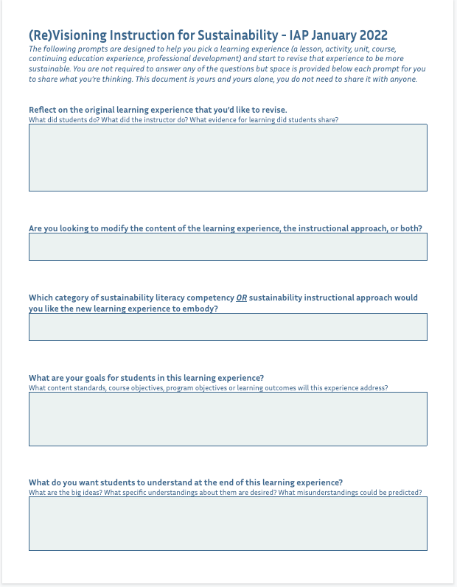
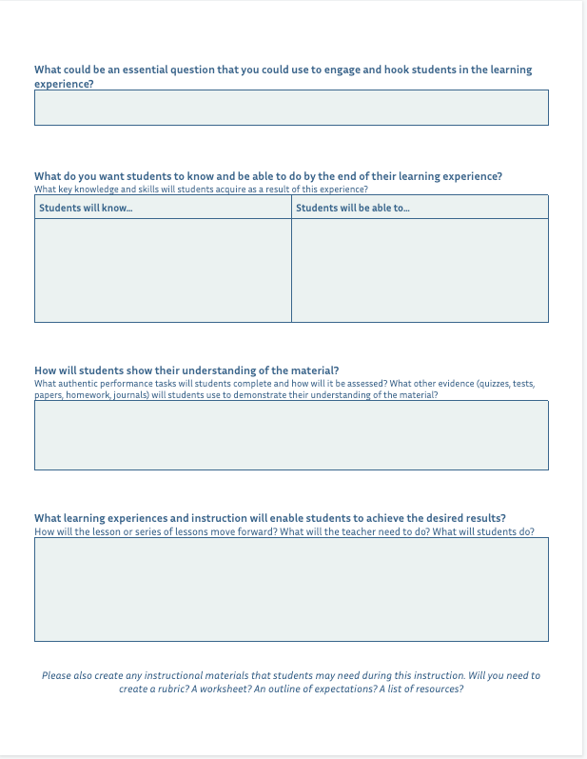
Where do I start?
Template

Slide 23
How do you want to work?
I want to work…
  individually.
  in a group, where discussions are frequent and we can dialogue about the progress we’re making, even if it is different.
  in a group for accountability; discussions are infrequent but could occur.

Slide 24
Workshop Time
The next 30 minutes are for you to workshop your ideas. We’ll be available to provide support if there are questions.
What do you hope to accomplish during your time?
We’ll briefly share out what we did and/or what we’re working on after our workshop time has concluded.

Slide 25
Sticking Points
You’re changing the norm for:
  Students
    Students are familiar with the status quo and they become more familiar the older they get. If you shake it up on them there is some inherent push back because they know the system and you’re changing the system.
  Colleagues
    Colleagues may bristle at you teaching differently than you have in the past.
  You
    Not everything you try will be a success the first time. That doesn’t mean you should give up!

Slide 26
Going Further
Articles that address topics from class today:
Brundiers, K., Barth, M., Cebrián, G., Cohen, M., Diaz, L., Douchette-Remington, S., Dripps, W., Habron, G., Harré, N., Jarchow, M., Losch, K., Michel, J., Mochizuki, Y., Rieckmann, M., Parnell, R., Walker, P., Zint, M., (2021). Key competencies in sustainability in higher education: Toward an agreed-upon reference framework. Sustainability Science, 16, 13-29. https://doi.org/10.1007/s11625-020-00838-2
Widhalm, B. (2011). Educators as architects of living systems: Designing vibrant learning experiences beyond sustainability and systems thinking. Journal of Sustainability Education, 2
Redman, E., Murphy, C., Mancilla, Y., Mallon, B., Kater-Wettstaedt, L., Barth, M., Ortiz M. G., Smith, G., & Kelly, O. (2021). International scaling of sustainability continuing professional development for in-service teachers. Interdisciplinary Journal of Environmental and Science Education, 17(3), e2243. https://doi.org/10.21601/ijese/10936

Slide 27
Review of Learning Objectives
Participants will consider if they want to modify their content, their practices or both!
Participants will use a modified backwards design approach to start the planning process to (re)vision their activities
What did you learn today?
How will people you interact with know and benefit?

Slide 28
Thank you!
Thank you for your time, energy and effort in our IAP course!

Slide 29
Creative Commons Licensing
Except where noted otherwise, the content on this website is licensed under a Creative Commons Attribution-NonCommercial-ShareAlike 4.0 International License (CC BY-NC-SA 4.0).
Please cite this work as:
Potter-Nelson, E. & Meyers, S. (2022, January). Teaching with Sustainability [MIT OpenCourseWare slides].

Slide 30
MIT OpenCourseWare
https://ocw.mit.edu
RES.ENV-006 Teaching with Sustainability IAP 2022
For more information about citing these materials or our Terms of Use, visit https://ocw.mit.edu/terms.

