Slide 1
日本のポップカルチャー
2023年、春学期
相川

Slide 2

日本のマンガ
マンガを読む:
https://comic-meteor.jp/read_comic/
© Flex Comix lnc. All rights reserved. This content is excluded from our Creative Commons license. For more information, see https://ocw.mit.edu/help/faq-fair-use/

Slide 3
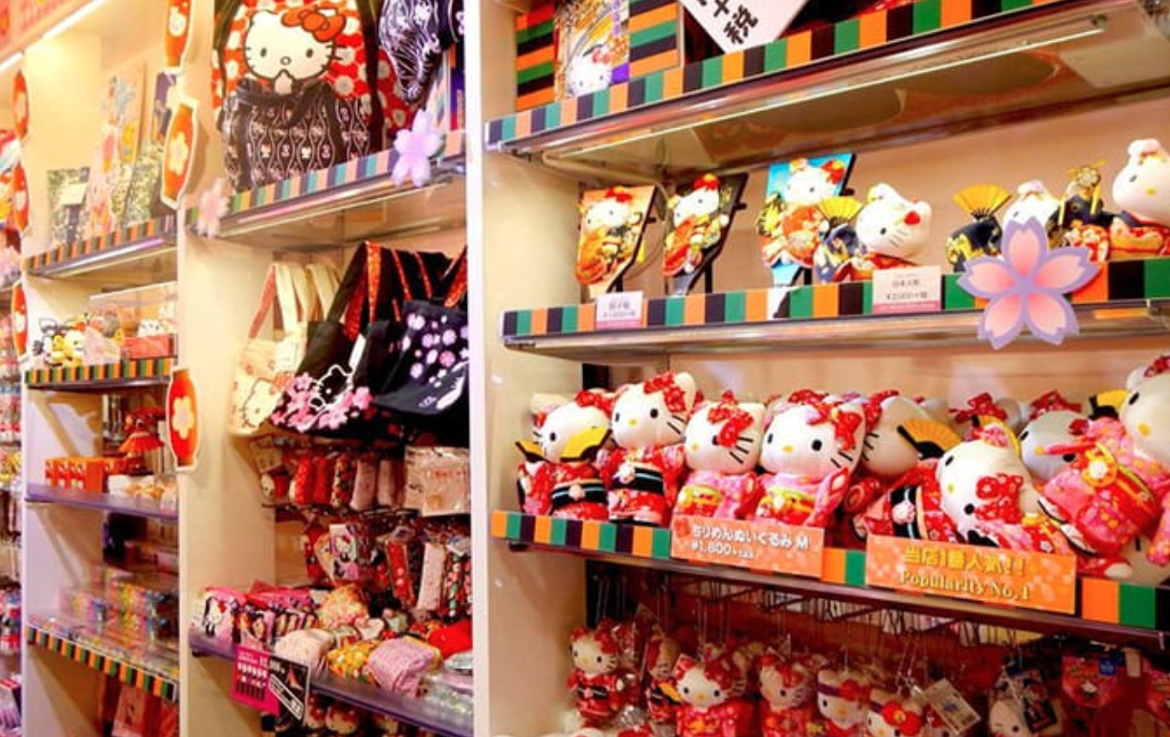
日本のかわいい文化 https://matcha-jp.com/jp/3081
© MATCHA, Inc. All rights reserved. This content is excluded from our Creative Commons license. For more information, see https://ocw.mit.edu/help/faq-fair-use/

Slide 4
手塚治虫（てづかおさむ）

Slide 5
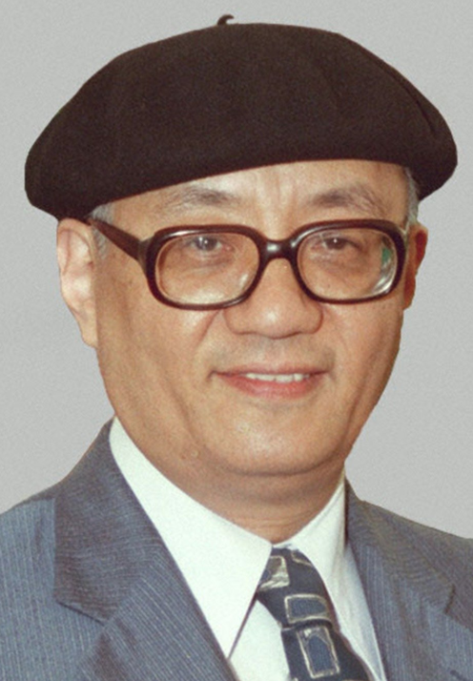

https://www.youtube.com/watch?v=yULt_h3E_Ag
© Tezuka Productions. All rights reserved. This content is excluded from our Creative Commons license. For more information, see https://ocw.mit.edu/help/faq-fair-use/

Slide 6
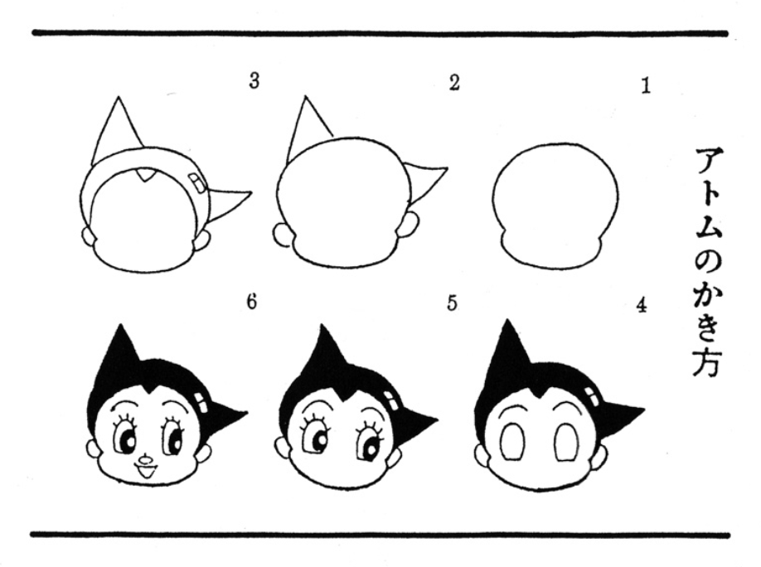
© Osamu Tezuka. All rights reserved. This content is excluded from our Creative Commons license. For more information, see https://ocw.mit.edu/help/faq-fair-use/

Slide 7
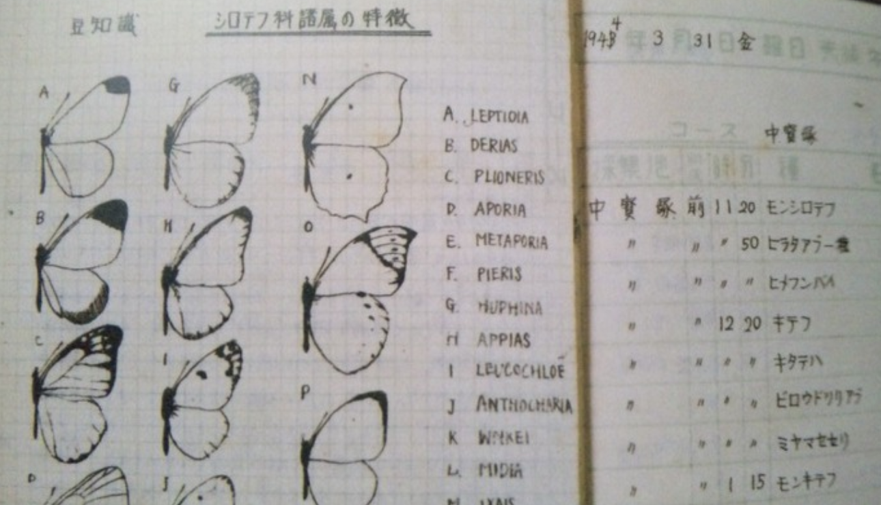
手塚治虫（てづかおさむ）の学生時代のノート
© Osamu Tezuka. All rights reserved. This content is excluded from our Creative Commons license. For more information, see https://ocw.mit.edu/help/faq-fair-use/

Slide 8
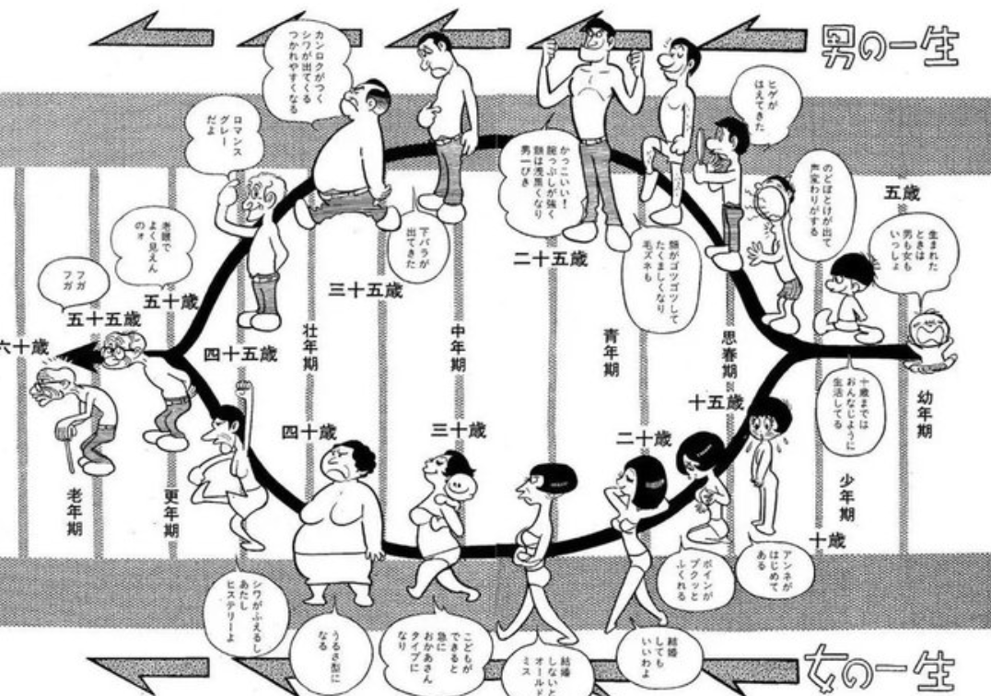
© Osamu Tezuka. All rights reserved. This content is excluded from our Creative Commons license. For more information, see https://ocw.mit.edu/help/faq-fair-use/

Slide 9
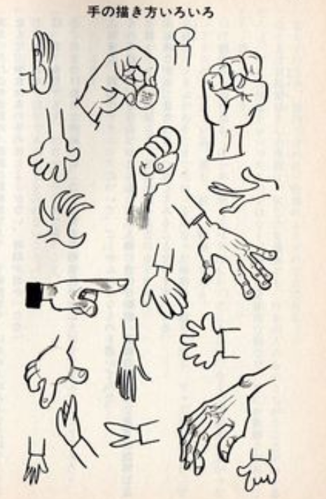
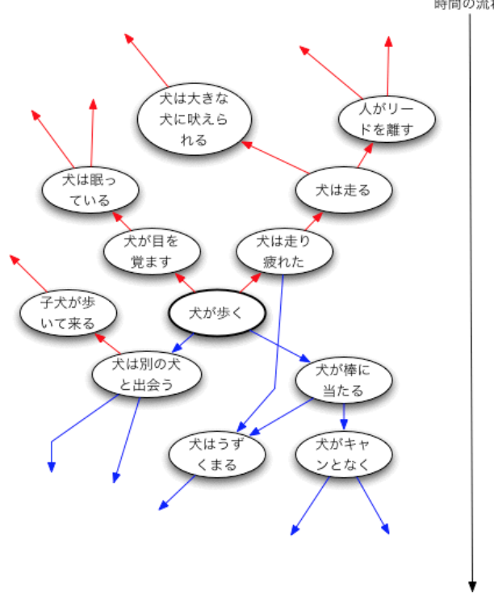
© Osamu Tezuka. All rights reserved. This content is excluded from our Creative Commons license. For more information, see https://ocw.mit.edu/help/faq-fair-use/

Slide 10
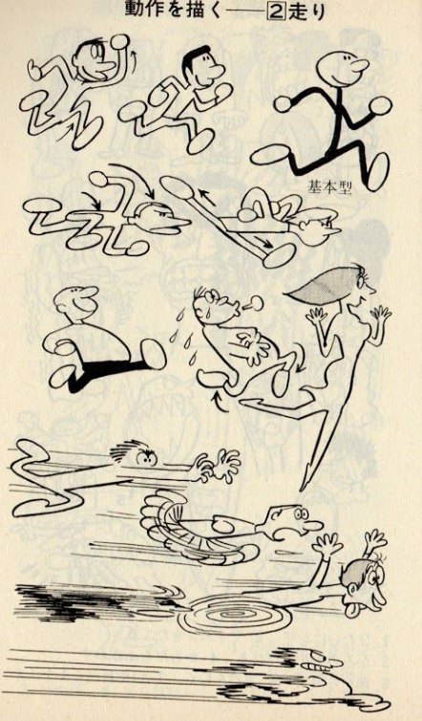
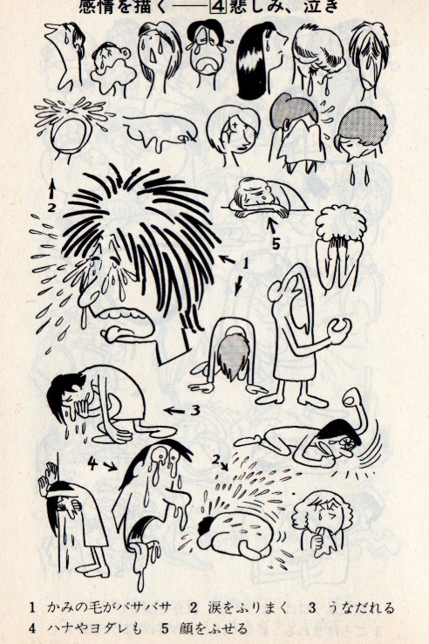
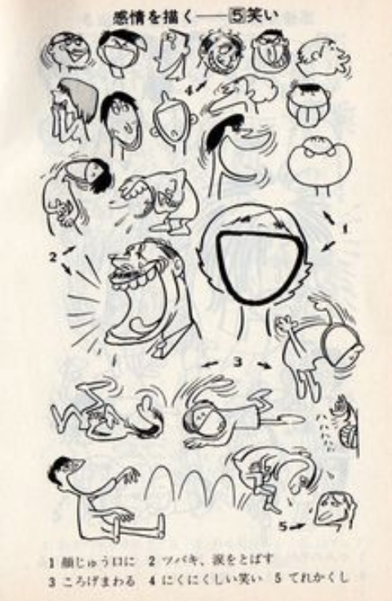
© Osamu Tezuka. All rights reserved. This content is excluded from our Creative Commons license. For more information, see https://ocw.mit.edu/help/faq-fair-use/

Slide 11
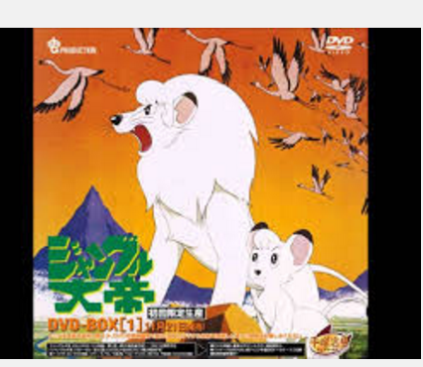
https://www.youtube.com/watch?v=s3T0KE1sCBA
© Osamu Tezuka. All rights reserved. This content is excluded from our Creative Commons license. For more information, see https://ocw.mit.edu/help/faq-fair-use/

Slide 12
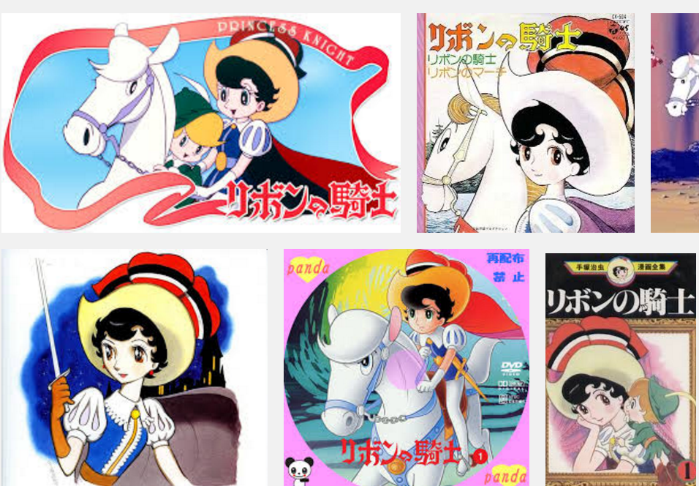
https://www.youtube.com/watch?v=lhFy4x97xYw
© Osamu Tezuka. All rights reserved. This content is excluded from our Creative Commons license. For more information, see https://ocw.mit.edu/help/faq-fair-use/

Slide 13
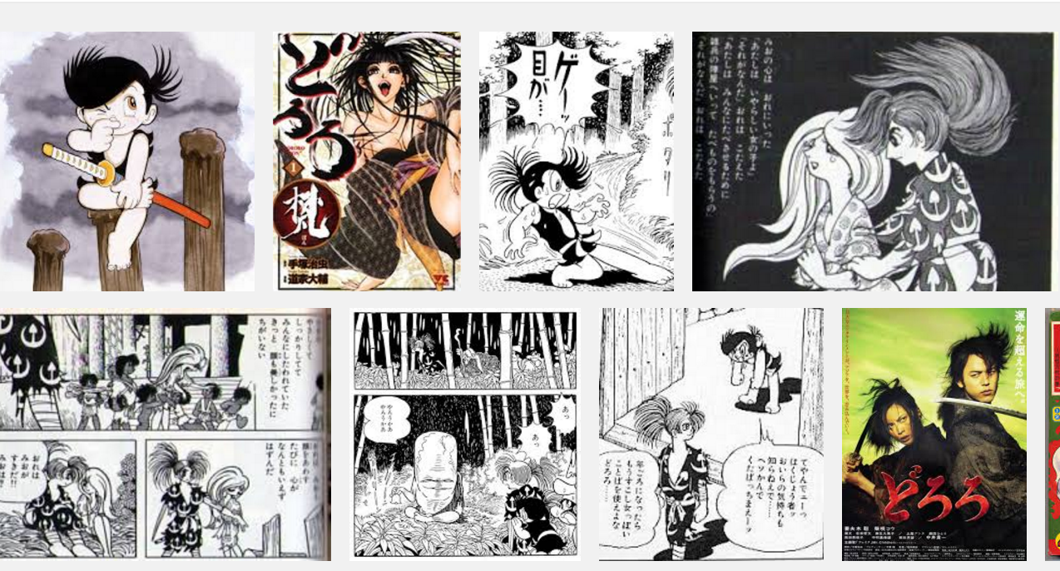
https://www.youtube.com/watch?v=mY3LDcP0PDQ
© Osamu Tezuka. All rights reserved. This content is excluded from our Creative Commons license. For more information, see https://ocw.mit.edu/help/faq-fair-use/

Slide 14
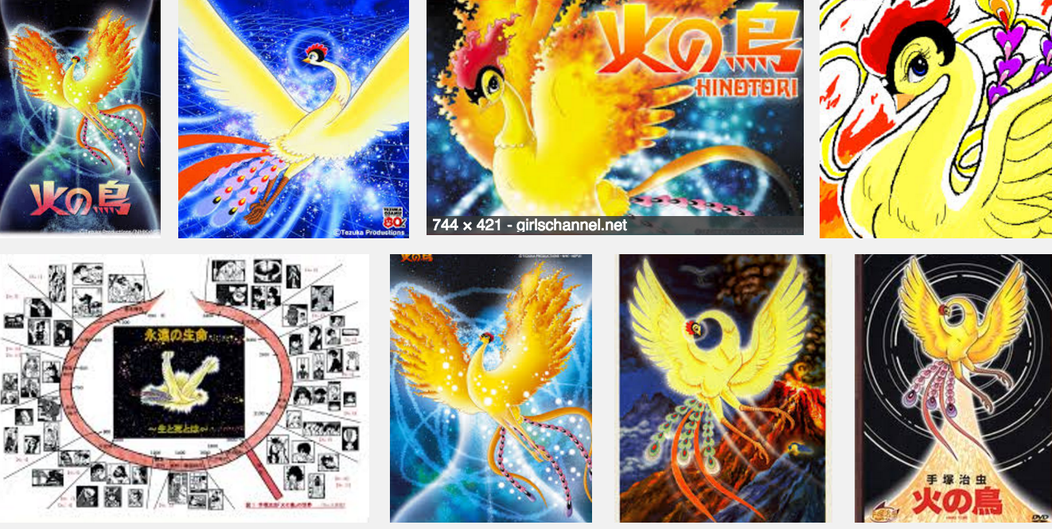
https://www.youtube.com/watch?v=jgw7qb-cRIs
© Osamu Tezuka. All rights reserved. This content is excluded from our Creative Commons license. For more information, see https://ocw.mit.edu/help/faq-fair-use/

Slide 15
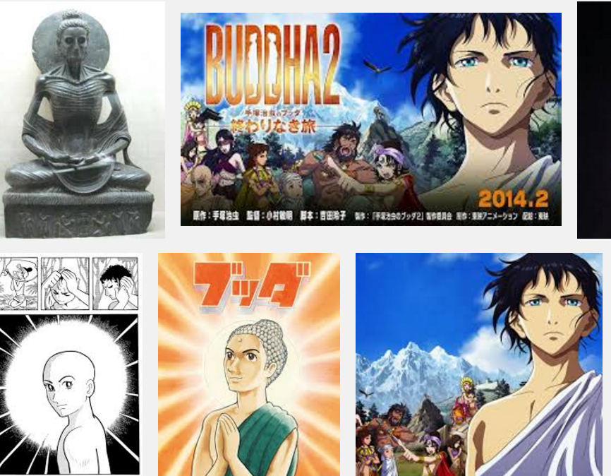
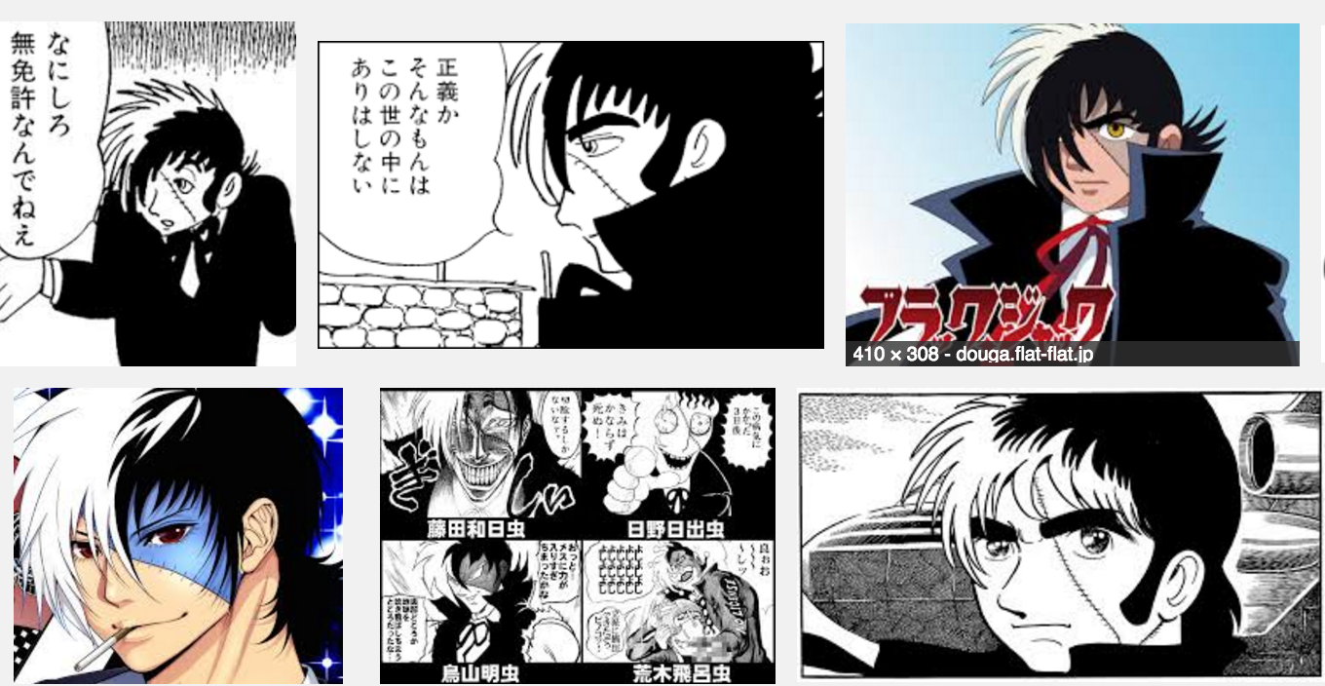
© Osamu Tezuka. All rights reserved. This content is excluded from our Creative Commons license. For more information, see https://ocw.mit.edu/help/faq-fair-use/

Slide 16
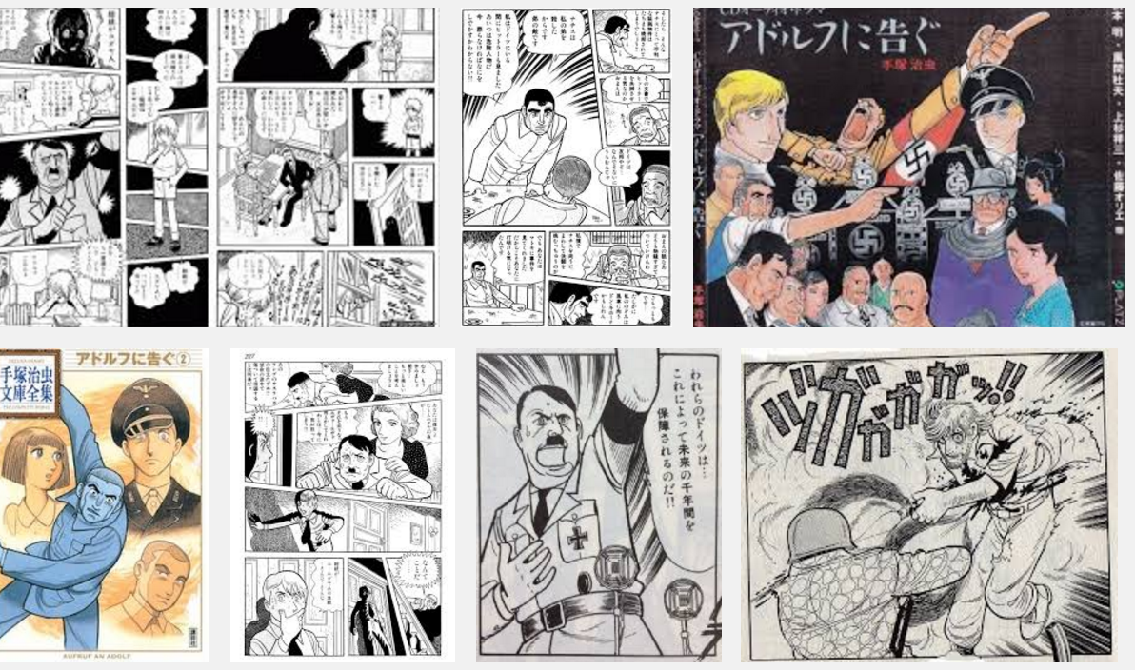
© Osamu Tezuka. All rights reserved. This content is excluded from our Creative Commons license. For more information, see https://ocw.mit.edu/help/faq-fair-use/

Slide 17
