Slide 1
12.010 Computational Methods of Scientific Programming 2021
Lecture 22: Version control and software management practices

Slide 2

Summary
Version control and related tools, motivation
Using “Git” and “Github”
  status, log, add, commit, fork, clone, push, remote, branch, pull request….
Adding automated testing
  CI/CD
Publishing
  Zenodo
  JOSS
  Containers
Note –
Some specific tools barely existed 5 years ago! They are useful, but the tools here are an area of frequent development.
The concepts are more durable.
http://dx.doi.org/10.3233/DS-190026

Slide 3
Version control
In software projects it is common for code to evolve through multiple “versions” this can result in potential for confusion. Programs may unexpectedly stop working when functions/data structures that depend on each other get out of sync etc…
Version control is used to
  keeping track of versions of files
  avoid confusion over what bits of code are being used to build a program or system

Slide 4
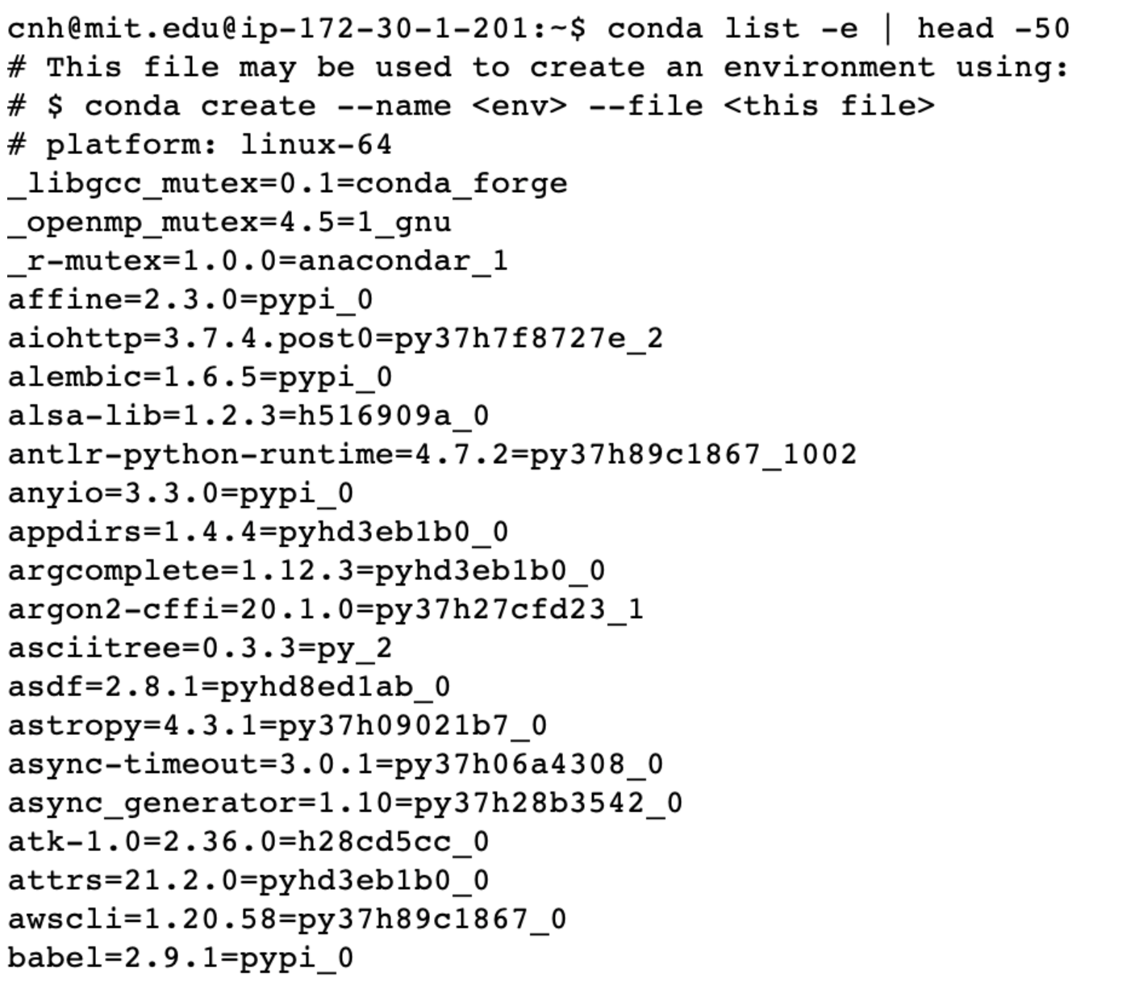
Versions of python packages on 12.010 cloud system.
About 450 packages in total, each with their own version.
Each package is made up of multiple python files (>60,000)
Keeping things like this all “consistent” is the origin of version control and related tools
For software used in research these sorts of tools are important for reproducibility, sharing, collaboration etc…

Slide 5
Modern version control/software reproducibility “tooling”
Git
  Git has become the standard tool for version control
  Free online services like “Github” and “Gitlab” provide a nice web interface and make Git easier to use
  Git itself is a software tool separate from Github/Gitlab. Github/Gitlab make collaborating using git easier.
Continuous Integration/Continuous Deployment (CI/CD)
  Fancy name for automated testing to avoid breaking things by mistake
  Online services like Github provide ways to integrate CI/CD into version control environment
Publishing
  Zenodo/JOSS – DOI to reference/cite/find software versions
  Containers - A system for capturing specification of a whole computer + application to help make things portable.

Slide 6
Git basics
The best way to understand git is to use it, following some tutorial. It makes a lot more sense in use, than on paper!
Git organizes collections of code in “repositories”
A repository is just a directory tree with files and some special information in a “.git” subdirectory

Slide 7
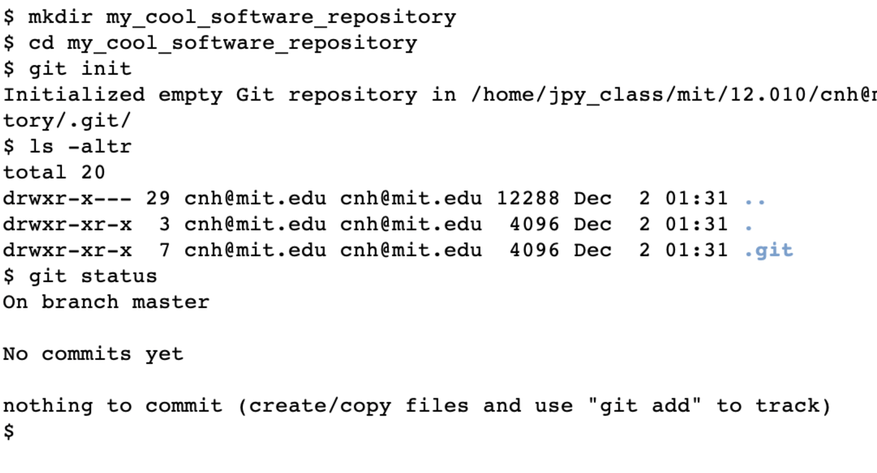
Creating a new repository by hand
A git repository has a special subdirectory “.git” at its “root”.
Files and directories can be added.
.git keeps track of history of “committed” adds/deletes and edits.

Slide 8
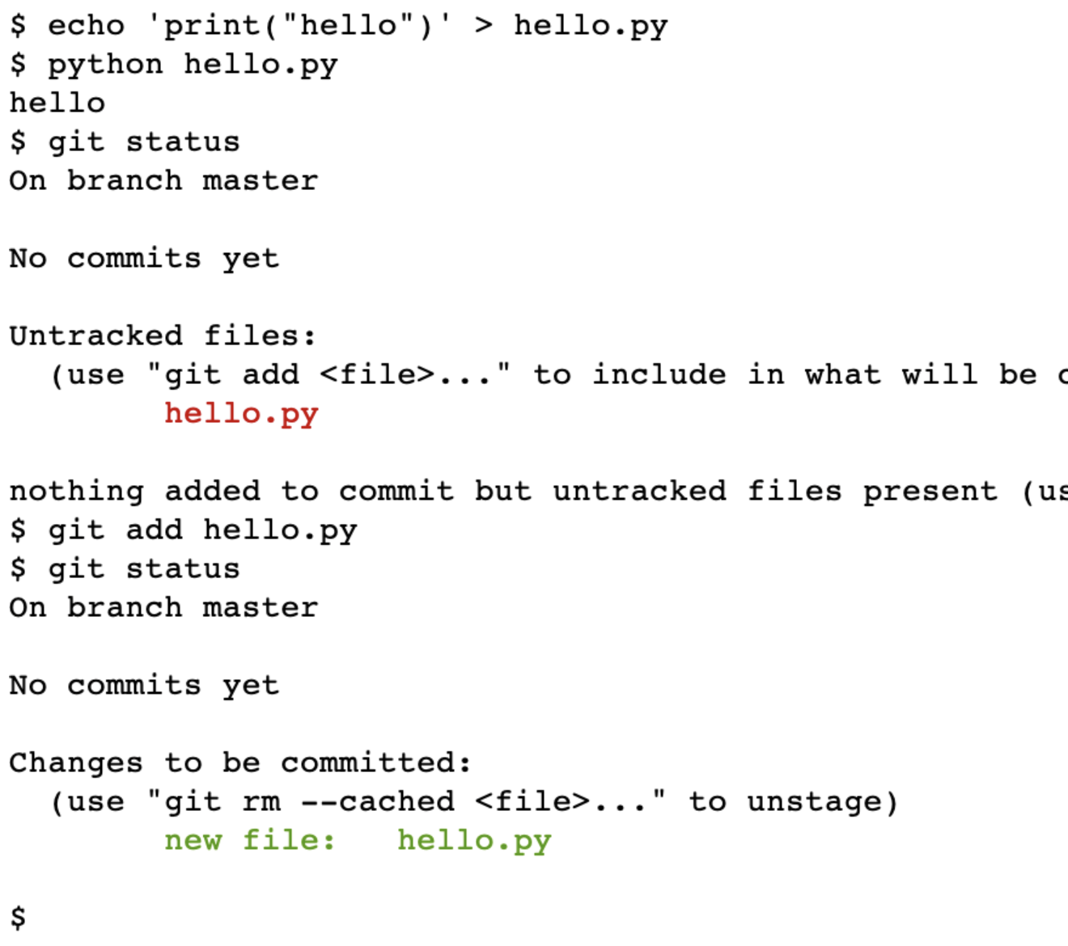
Add a file
Files and directories can be created in the repository directory tree.
Note:
Don’t do anything in .git
Git is designed for files of code and text files. It does not work well with images, binary files etc…
Here we created a file “hello.py” and added it to the current, active files tracked by git.
To make the change a permanent we must “commit” changed file.

Slide 9
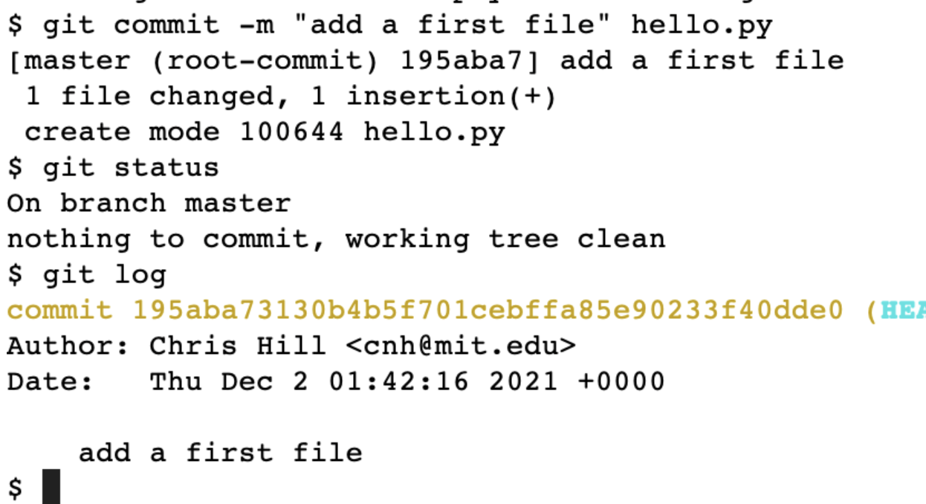
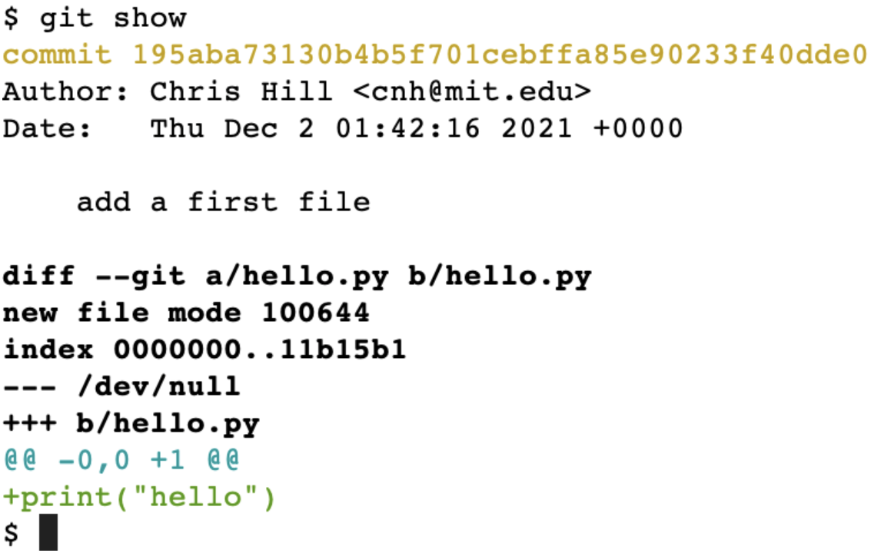
Commit the changes
In git, in addition to adding any new files, you ”commit” changes that you want to keep.
The sequence of commits and changes is stored in the .git directory so that you can compare different versions of files, directories of repositories.
The commit id number is unique, so you can compare any commit with another.

Slide 10


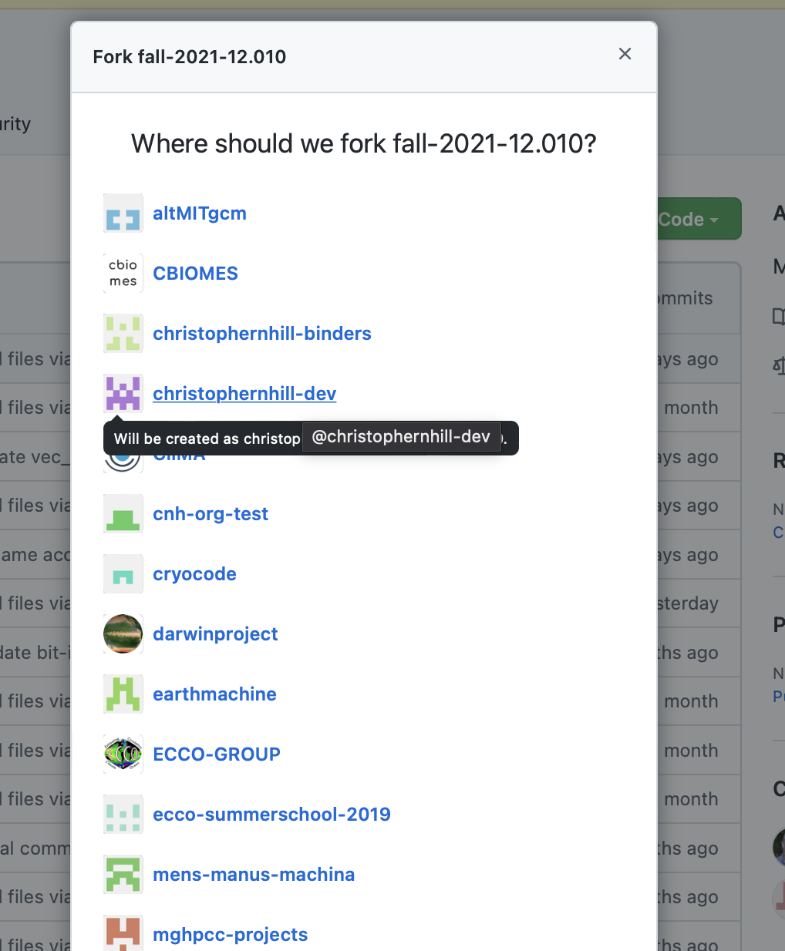
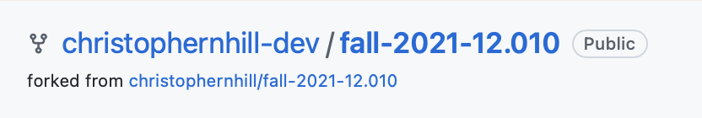
Working with Git via Github
Git on its own can be a bit fiddly to use, especially for sharing and publishing code and remote collaboration. Lots of projects use Github to streamline workflow.
Creating a copy of an existing repository, making a change and then submitting change back to original repository is a good way to start. In Github this starts with a “fork” of the existing repository.
Fork to your own Github account.

Slide 11
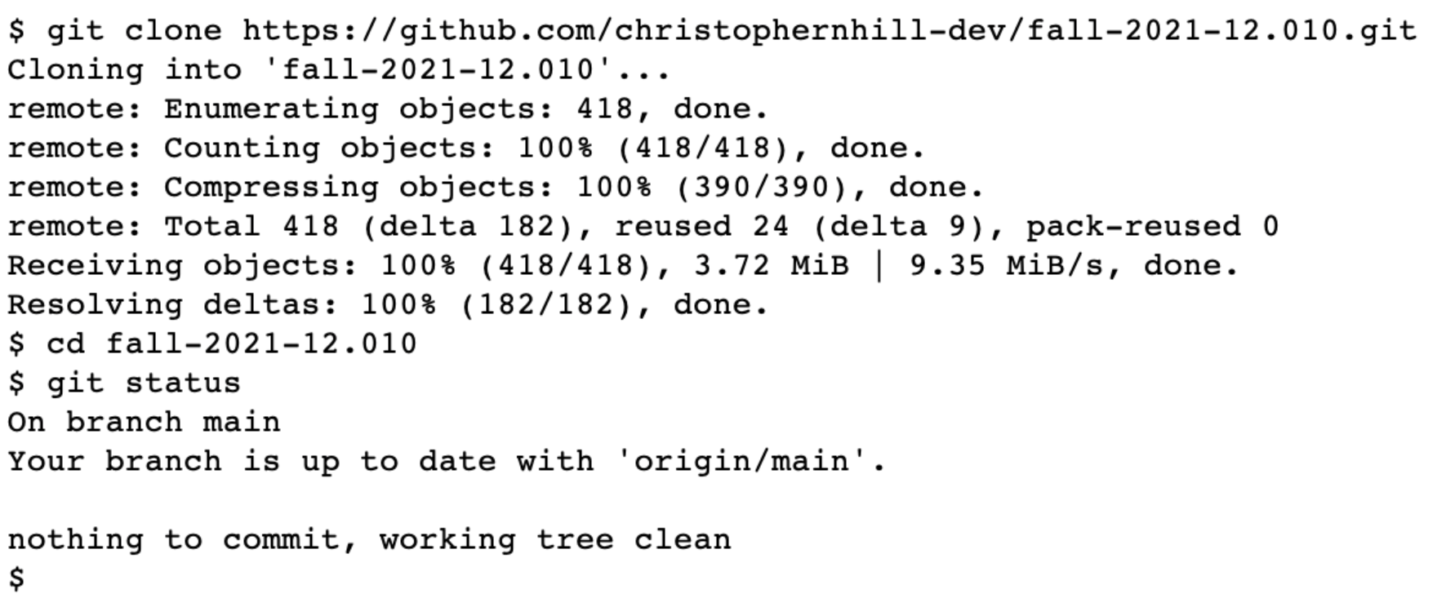
After creating a “fork”, download to local compute using “clone”.

Slide 12
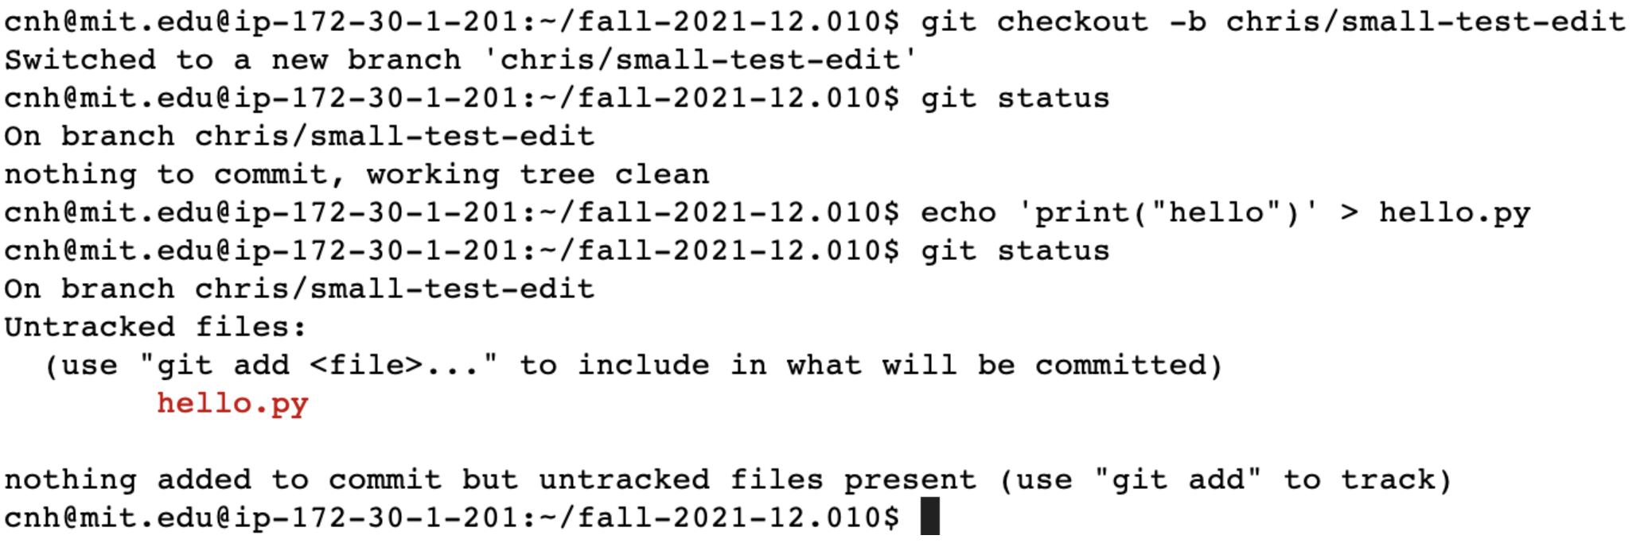
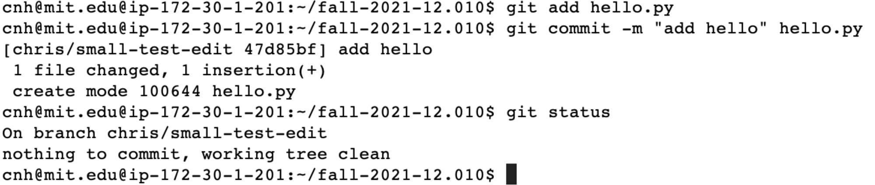
Now lets make a change – we do this on a “branch”
There are lots of ways to use Git.
A common practice is to create a “branch” for a set of edits.
The default branch is called master or main, here we create a branch with a name to remind us what it is for.
Once we have created our file we need to add and commit.
This records our new changes locally, associated with the branch.

Slide 13
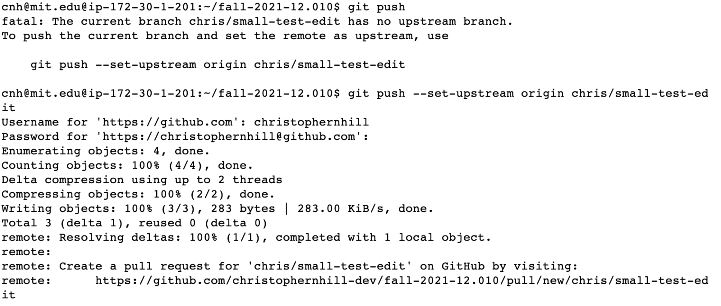
After we are happy with our local changes we can “push” them to our repository fork.
We use “git push” to send changes back to the repository we cloned.
Here we use
git push --set-upstream origin chris/small-test-edit
to “push” changes to our Github repository.

Slide 14
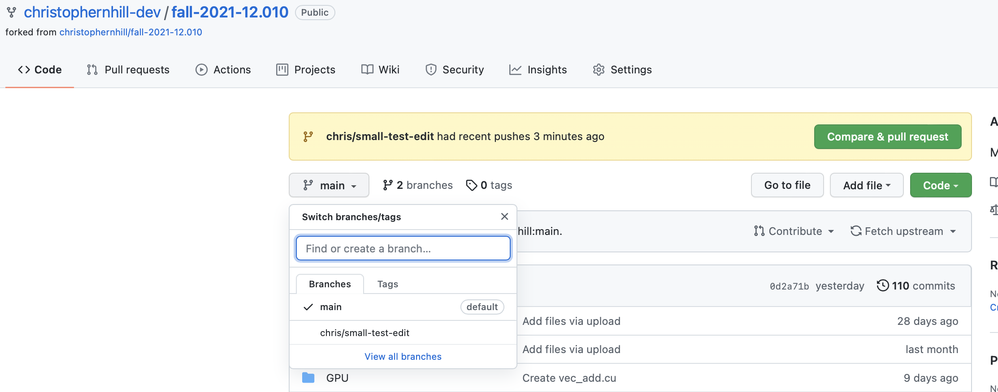
After push our online repo has changes
The online repo also has a “Compare & pull request “ button.

Slide 15
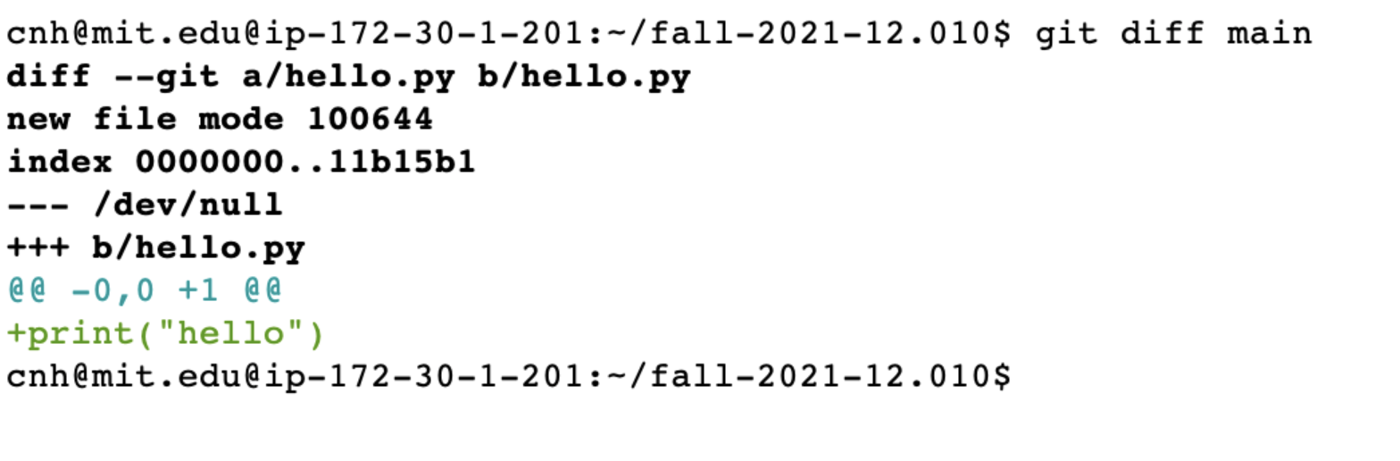
Current state
If we now want to update the official repository we create a ”pull request” (PR).
A PR is a way to ask the maintainer of the official repository to incorporate your changes (i.e. pull them into the official repository).
Note –
This workflow can seem somewhat complicated. It is does allow people all over the planet to collaborate on large software.
Git does not know which is the “official” repository. That is a choice of a project. All repositories are peers to Git.
Official repository unchanged
Fork of official repository has a “branch” with changes that we made on a local machine and “pushed” to Github.
Local machine has clone of our fork. It has branch and main

Slide 16
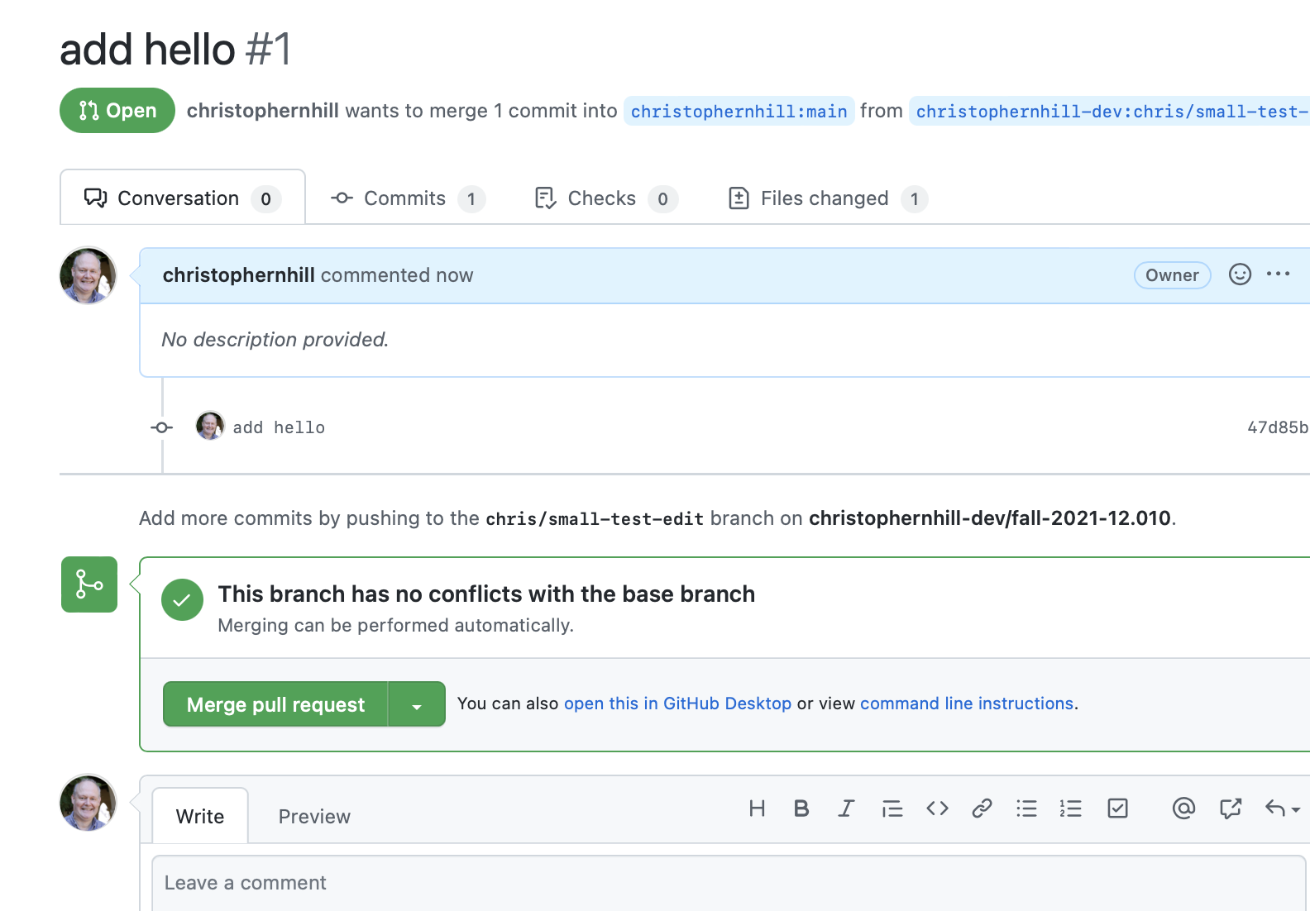
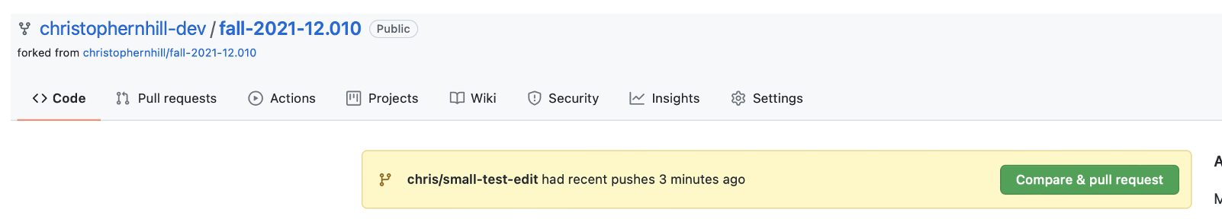
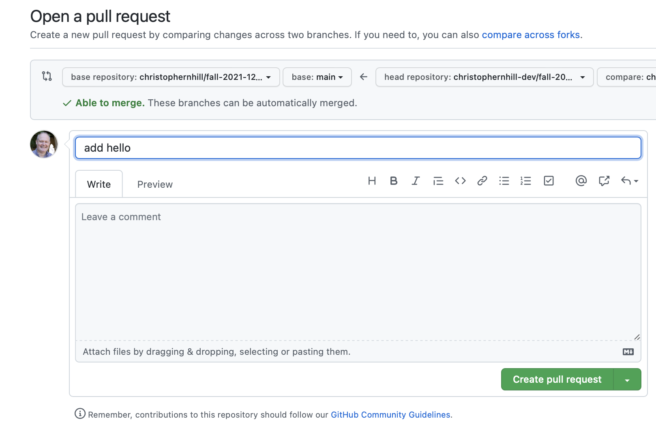
Creating a pull request
Creating a PR results in a request being queued at the official repository.
The maintainers of the official repository can then review the new code, request changes and/or merge the PR into the official repo.

Slide 17
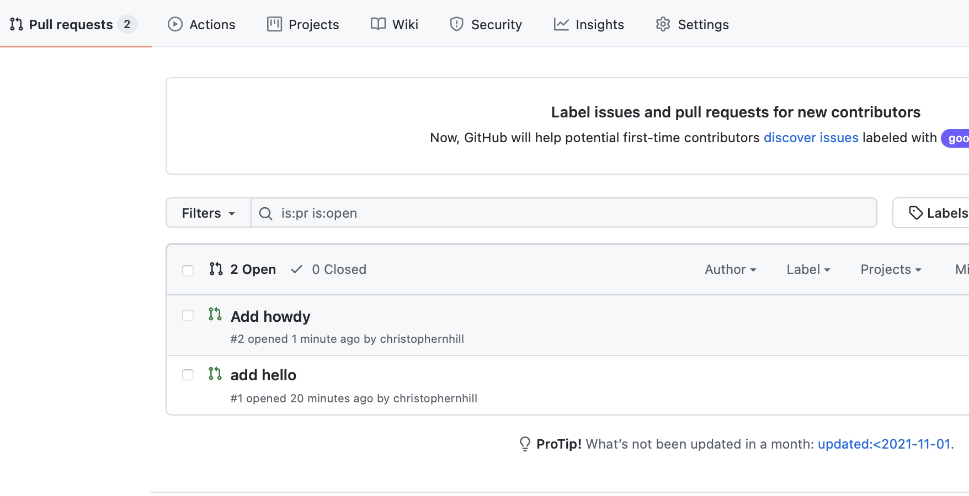
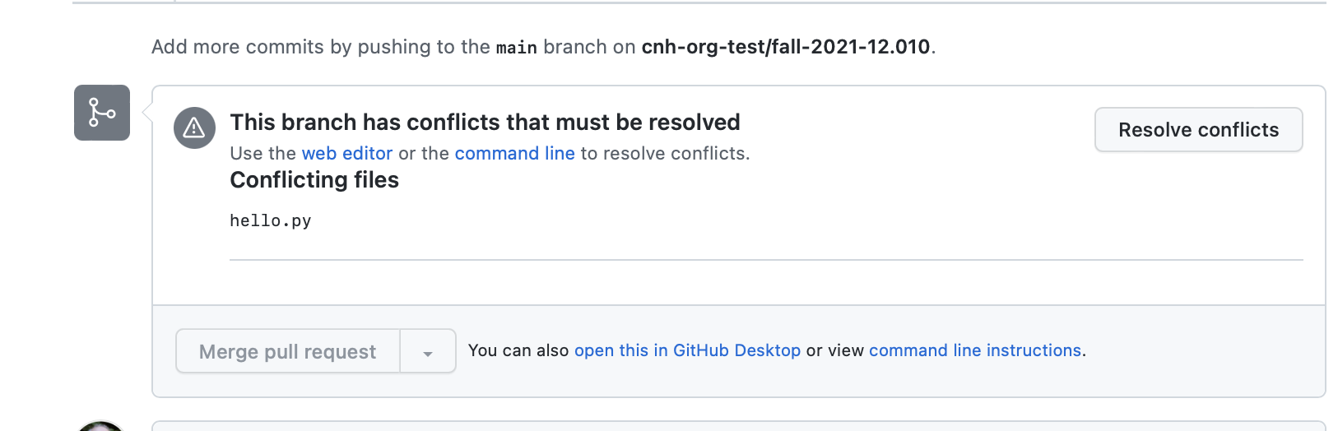
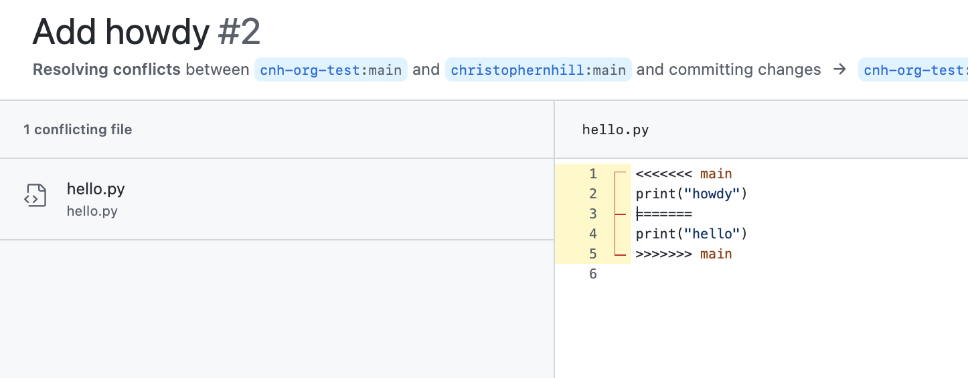
Conflicts
Two commits can potentially contain changes to same file.
Git will try and merge if the changes are from the same “base” _and_ they are in different parts of the file.
Otherwise a conflict will be detected and will need to be resolved manually.

Slide 18
Hands on
Try fork, clone, edit, diff, log, status, commit/add, push, pull request….

Slide 19
Git and Github/Gitlab streamline collaboration and versioning.
BUT - what about checking if a PR will break something.
For this testing is important.
Github/Gitlab have builtin features to help with automated testing.
  CI/CD – continuous integration/continuous deployment is a name somtimes given to this sort of automated testing. The CI/CD name comes from online software, where the deployment of continually evolving software to web is automated (Facebook, twitter etc….)

Slide 20

Automated testing tools
These are not part of Git, but Github/Gitlab do provide
  Github actions is a common tool for automated testing
Automated testing as a concept is an important piece of maintaining software.
This is an area where specific tools are evolving particularly quickly.
We will look at “Github Actions” as an example. It is widely used, but only appeared in 2019.
© 2025 GitHub, Inc. All rights reserved. This content is excluded from our Creative Commons license. For more information, see https://ocw.mit.edu/help/faq-fair-use.

Slide 21
Automated testing
General idea is
  Have some tests that check things still work
    Whenever new code is added, or changed
    Regularly (nightly, weekly etc…) in case something else changes that affects code working
  Automating testing is preferable where possible
  Tests can be a mix of
    Unit tests
    Integration tests
    System tests
  Different sets of tests may run at different frequencies
  Tools like Github, Gitlab have features to help set up these processes

Slide 22
Github actions – automated testing example
Add a special directory “.github/workflows” to a repository.
Adds files in that directory that describe “actions” to take in response to events (such as a commit or a pull request)
The actions are scripts that can perform whatever tests make sense
Github provides virtual machines that run the scripts when they are triggered.

Slide 23
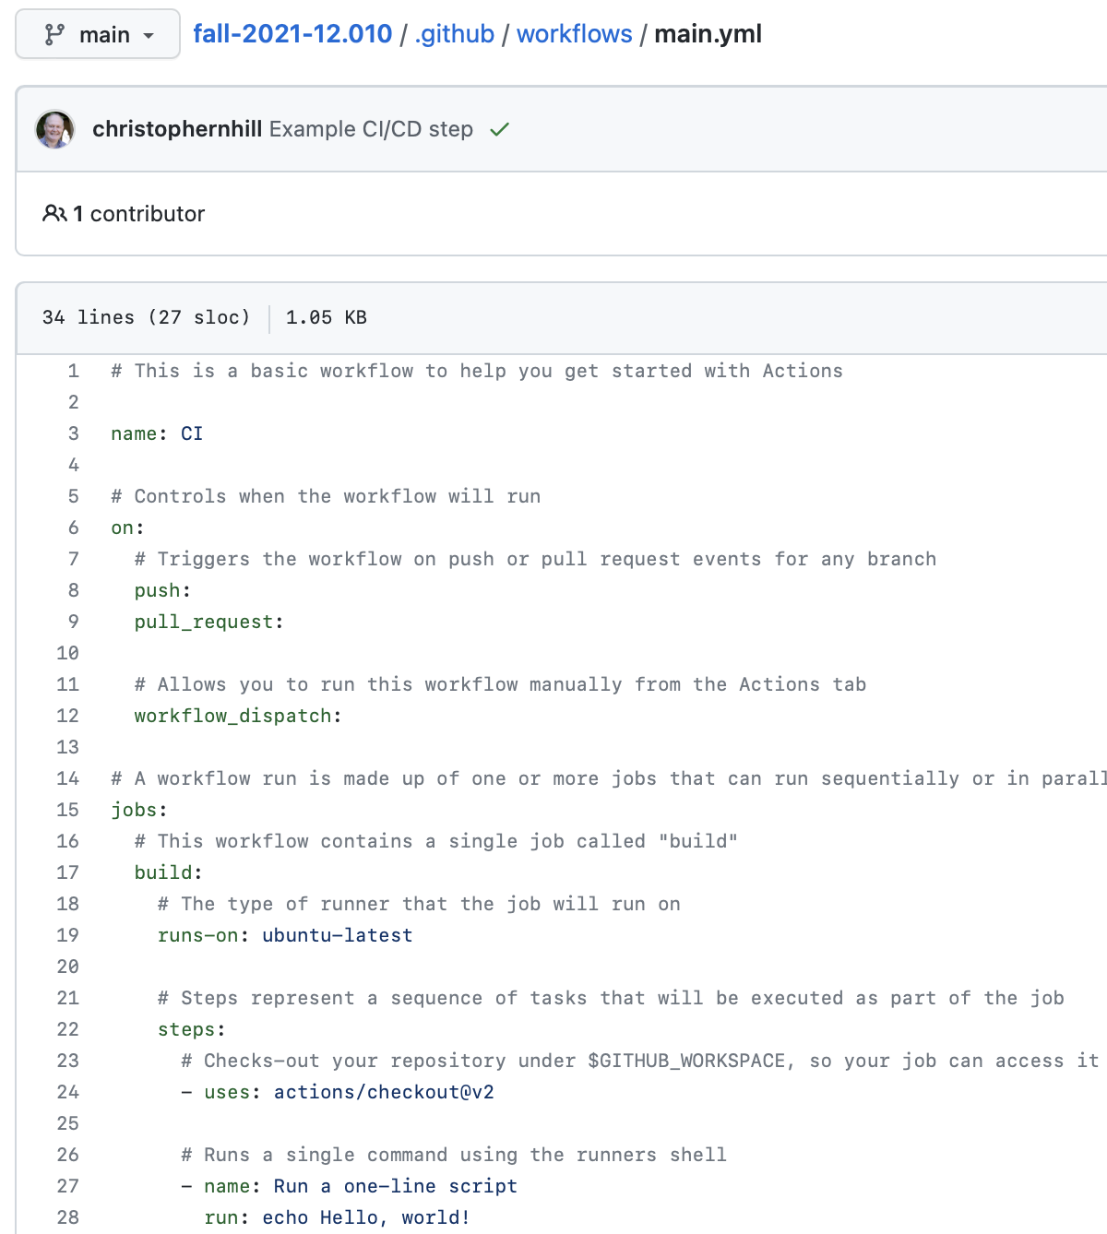
Github actions – automated testing example
A simple example, provided by default.
It uses Github actions specific syntax (based on a file format called yaml ).

Slide 24
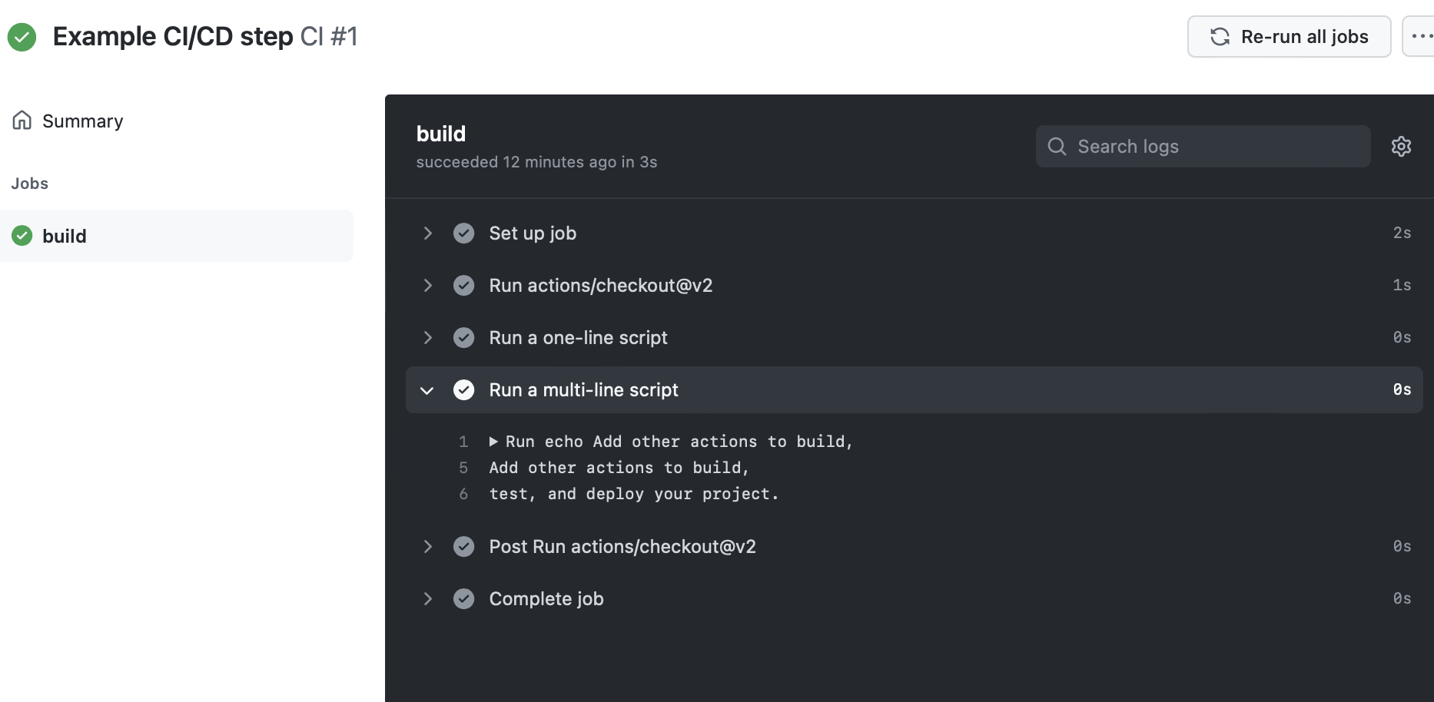
Github actions – results
Results of actions can be used to control whether a pull request can be merged.

Slide 25
Hands on
Try create CI/CD action

Slide 26
There are other CI/CD systems
all have a somewhat similar pattern
  they are controlled by files with specific names/in specific directories
  they have some high level syntax based on YAML/TOML
  they can invoke specific commands that are controlled by the repository needs
Some other examples
  Travis, buildkite, CircleCI, Gitlab

Slide 27
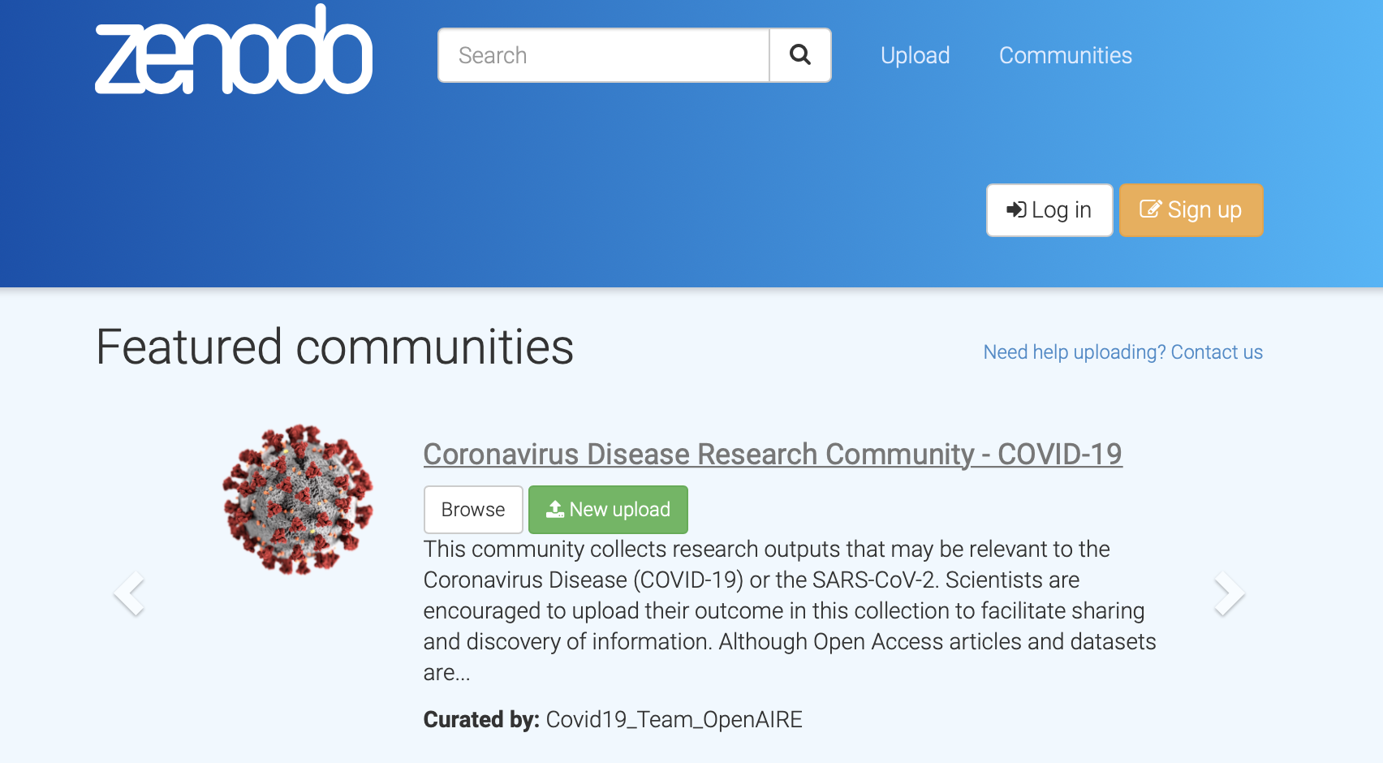

Publishing software
Tools like Github provide a new way to “publish” software
Not quite like a paper sharing science results, but still increasingly useful in research for sharing ideas/techniques.
There are some useful tools for providing citation, that allow projects using published software to reference properly
This is becoming increasingly common in research communities.
© Source unknown. All rights reserved. This content is excluded from our Creative Commons license. For more information, see https://ocw.mit.edu/help/faq-fair-use.
Notes:
To here 21/12/02: Still need to see CI

Slide 28

Containers
In addition to Github there are recent services called “Container registries”
These can be used with Github to record the entire Operating system and sets of packages used by some software
See https://journals.plos.org/ploscompbiol/article?id=10.1371/journal.pcbi.1008316
https://psyarxiv.com/fwxs4/
As software is more and more central to research keeping track of what was used, testing etc… becomes more and more important!
© Source unknown. All rights reserved. This content is excluded from our Creative Commons license. For more information, see https://ocw.mit.edu/help/faq-fair-use.

Slide 29
MIT OpenCourseWare
https://ocw.mit.edu
12.010 Computational Methods of Scientific Programming, Fall 2024
For more information about citing these materials or our Terms of Use, visit https://ocw.mit.edu/terms.

