Slide 1
12.010 Computational Methods of Scientific Programming
Lecture 20: Julia Objects, Multiple Dispatch

Slide 2
Summary
Objects v Multiple Dispatch
  Julia does not use “classes” exactly
    instead functions can have multiple methods
    which method/methods are used depends on the type of arguments
    types are used extensively within Julia to direct which methods get invoked - "multiple dispatch"

Slide 3
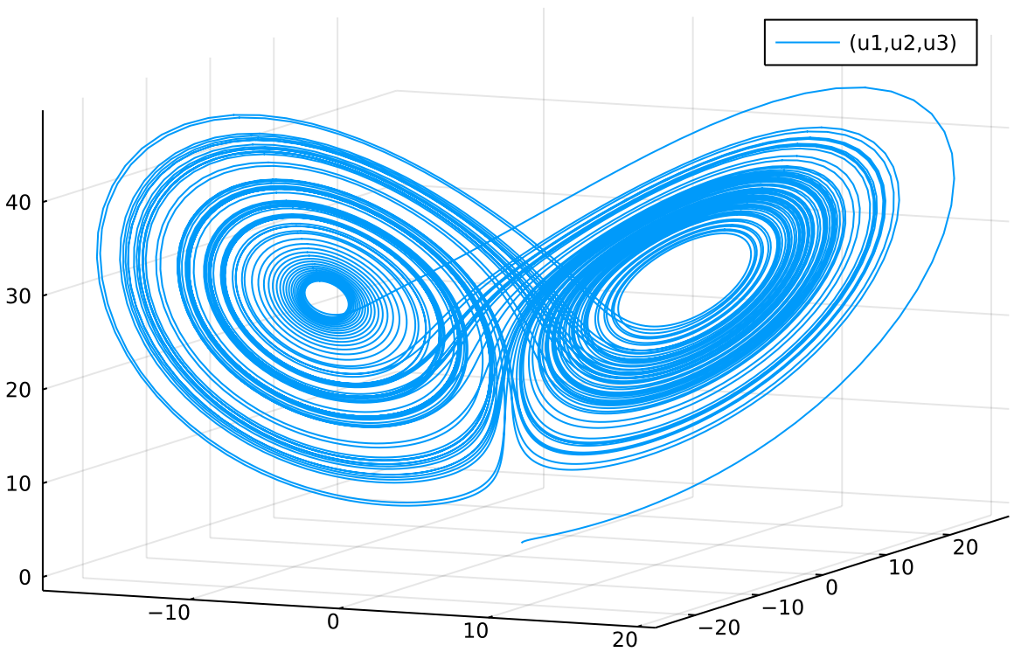
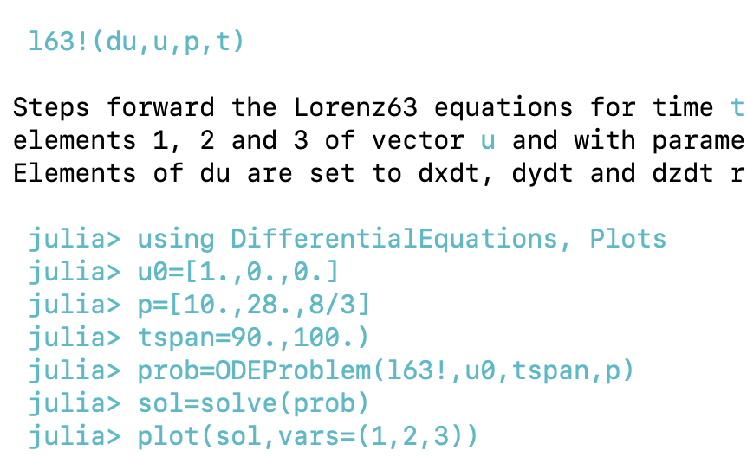
Julia programming language cont…
ODE solve – look at Lorenz 63 again

Slide 4
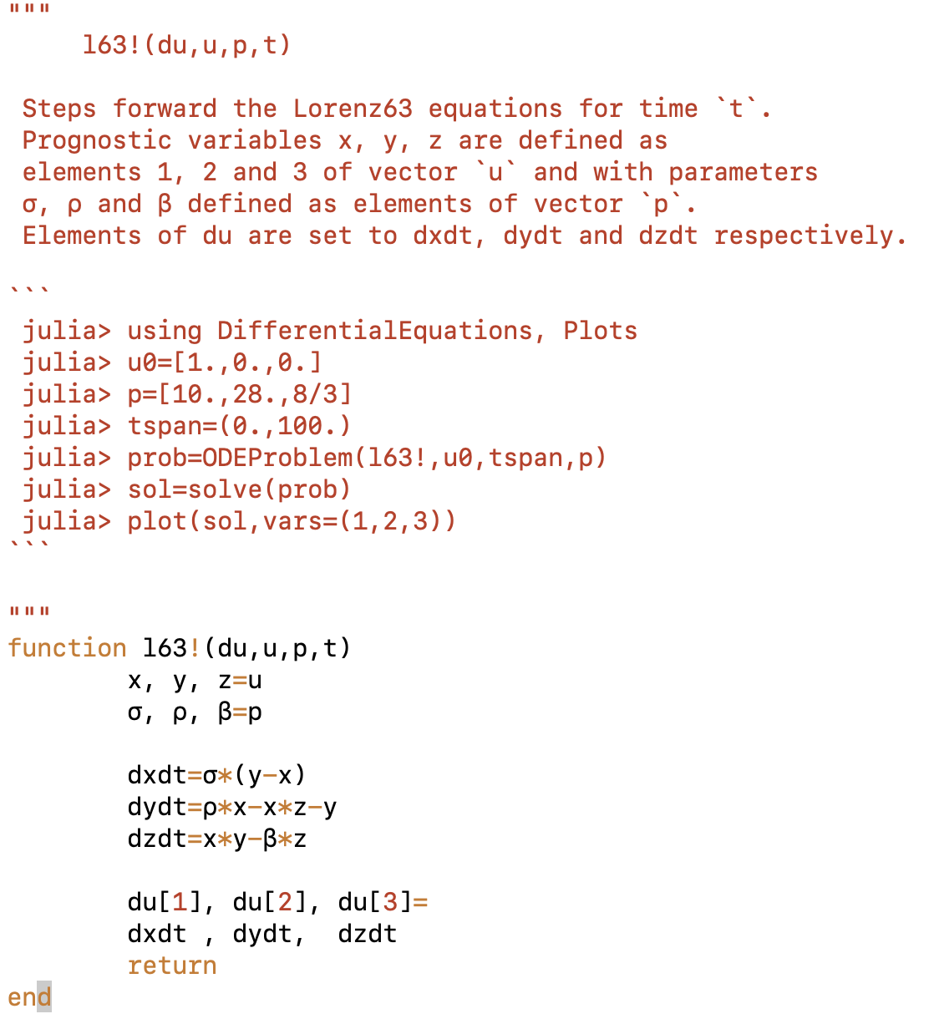
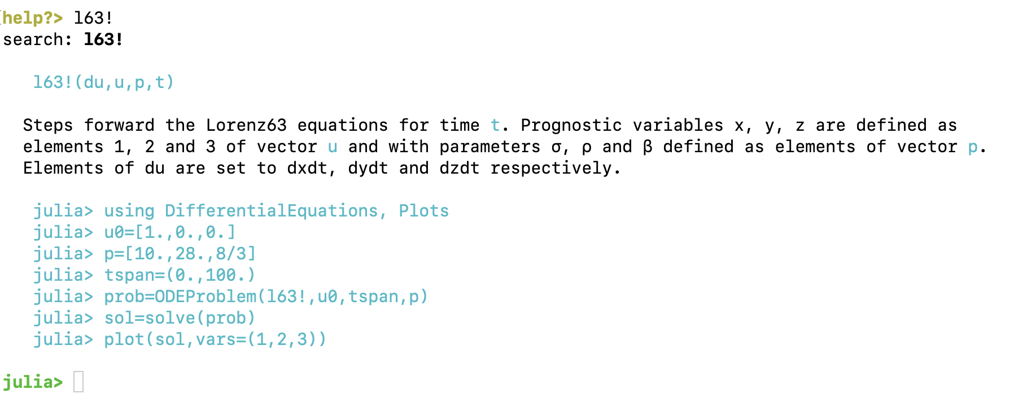
Julia programming language cont…
Defining l63.jl
“”” … “”” is docstring
  within docstring indent name by 4 characters, ``` creates literal block e.g.

Slide 5
Julia programming language cont…
Defining l63.jl
  Function NAME! is a convention for indicating a function that alters/sets its arguments, by default first argument are the altered variables.
  Here we use l63! the altered variable is du.
  The arguments to l63! fit the standard layout for the Julia DifferentialEquations package ODE solver.

Slide 6
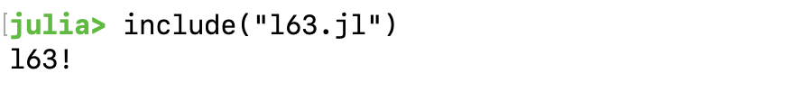
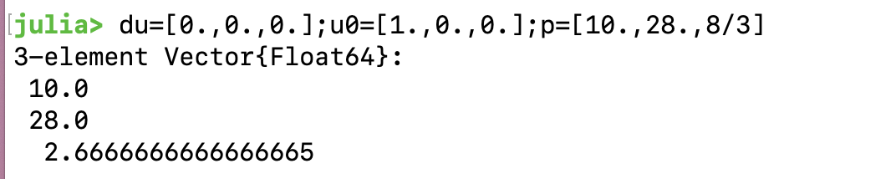
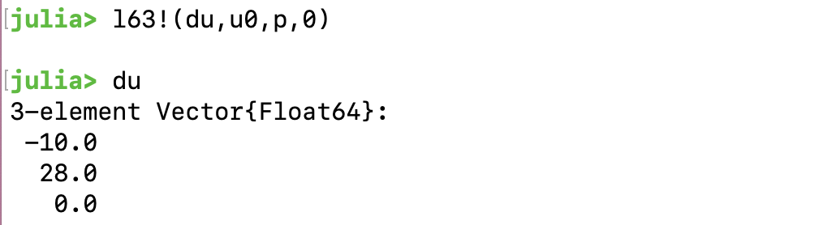
Julia programming language cont…
Using l63.jl
  To use a function directly we can use include in the REPL e.g.

Slide 7
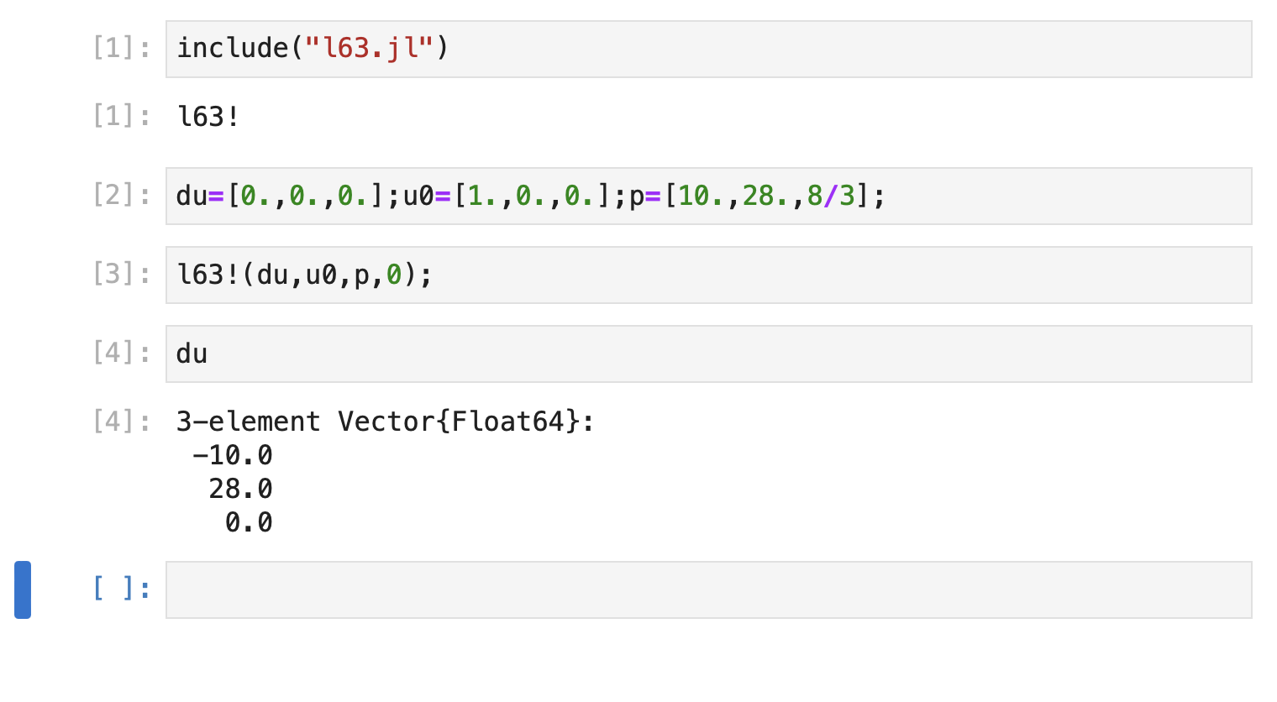
Julia programming language cont…
Using l63.jl
  Can also include in a notebook (see runl63.ipynb).

Slide 8
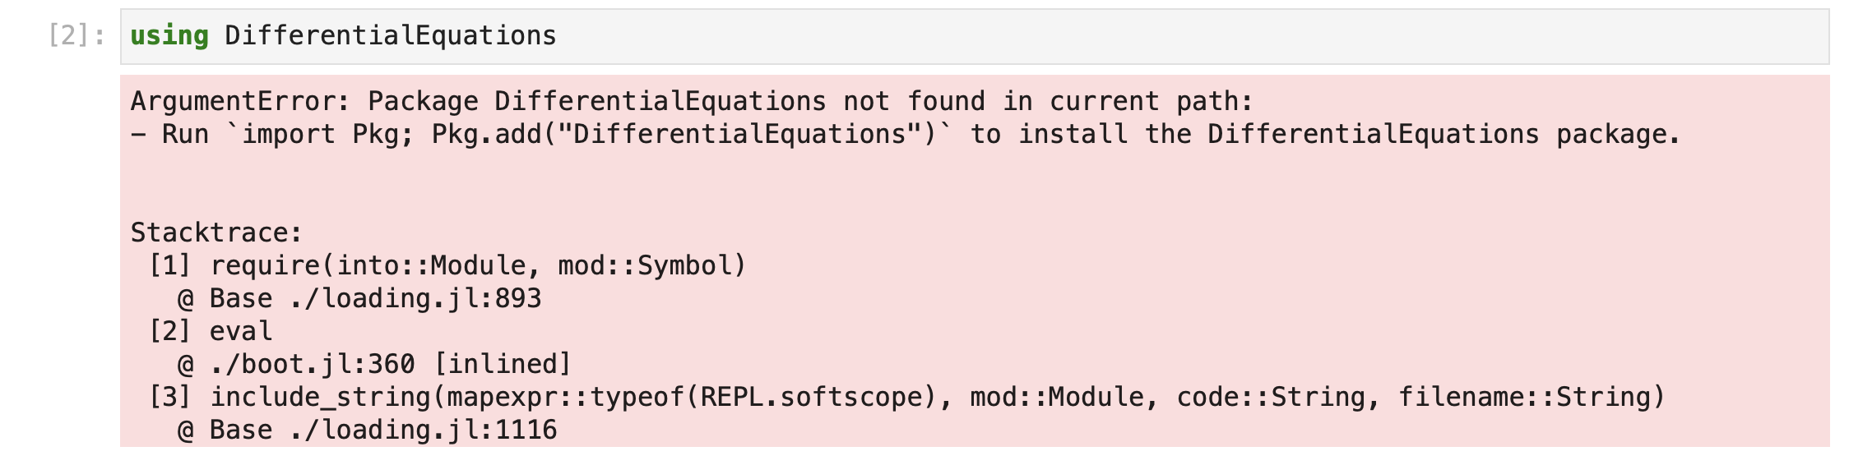
Julia packages
Most Julia code will use other packages
  By convention examples tend to include “using”, but not package install so may need to install packages for code to work.
  Packages are installed once and then will be available for reuse

Slide 9
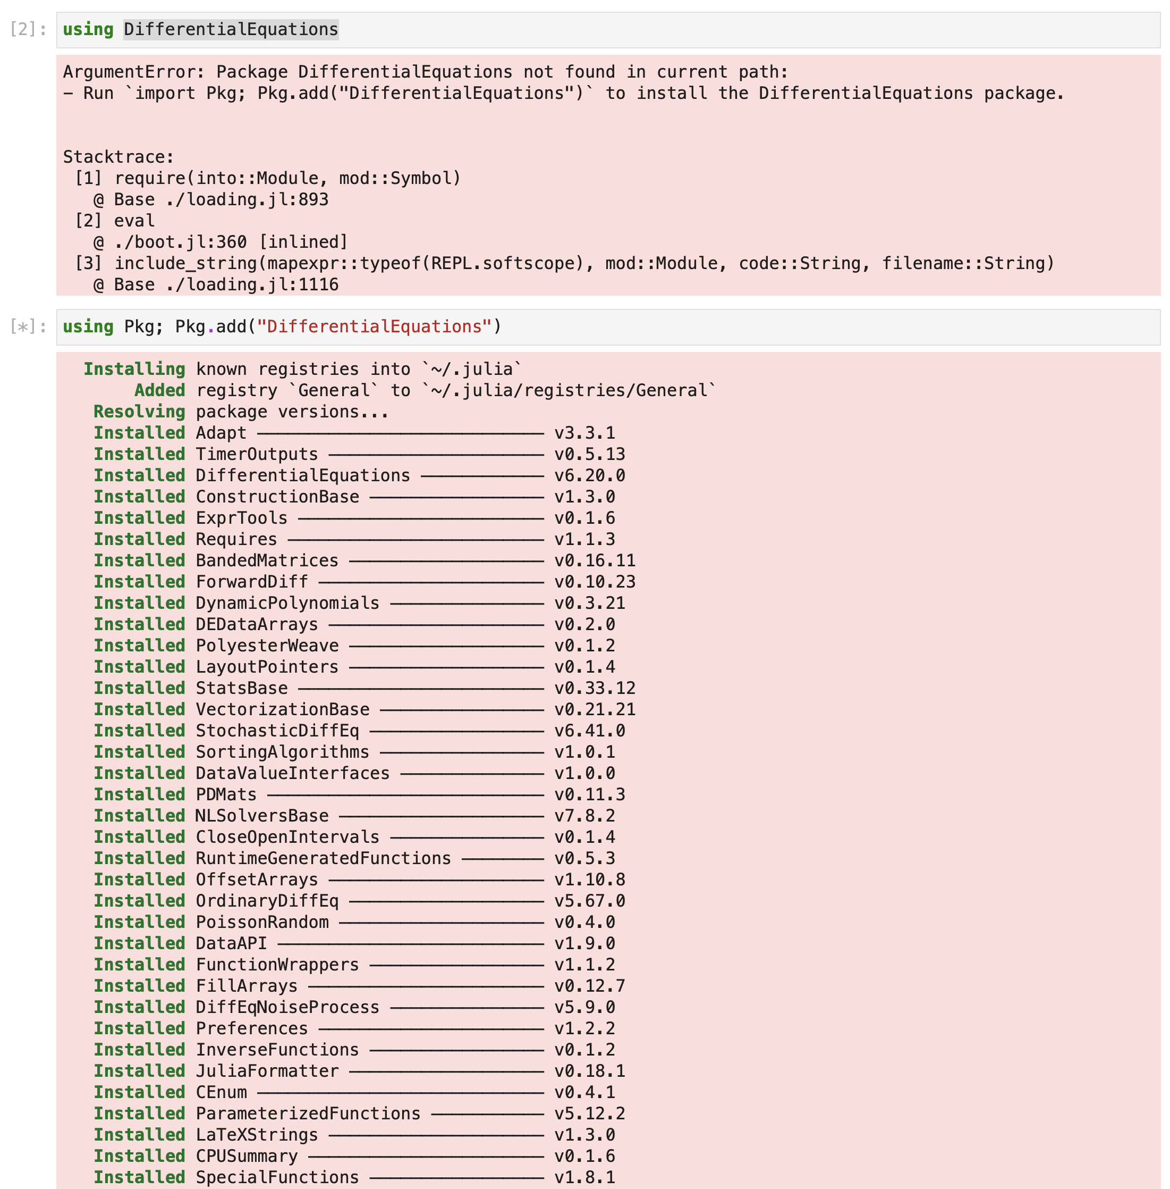
Julia packages
Most Julia code will use other packages
  To install
    using Pkg; Pkg.add(“NAME”)
    a package will often download and install other dependencies
    can also use ] in REPL to enter “Package mode”
    use backspace to exit “Package mode”
    once a package is installed it is added to “.julia” directory (or location of JULIA_DEPOT_PATH) and does not need to be downloaded again.

Slide 10

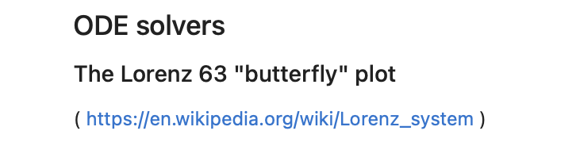
Hands on
Try runl63jl.ipynb ( needs l63.jl )
May need to Pkg.import “DifferentialEquations” and/or “Plots”
Try and create a Julia equivalent of Lec05-ode.ipynb (try without looking at l63_euler_julia_butterfly.ipynb first!)

Slide 11
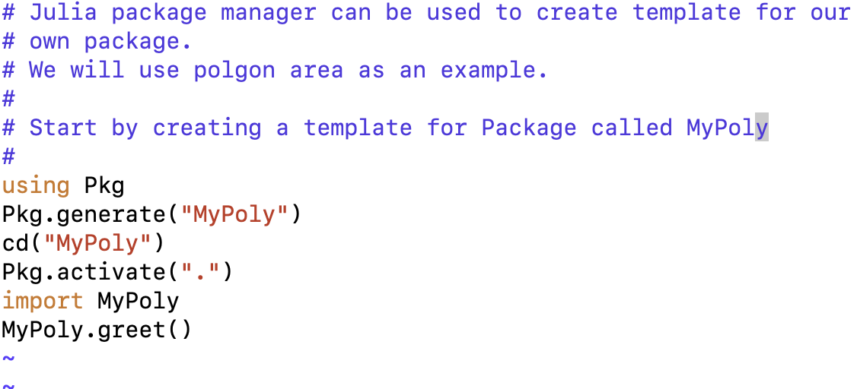
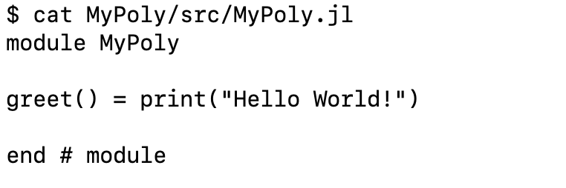
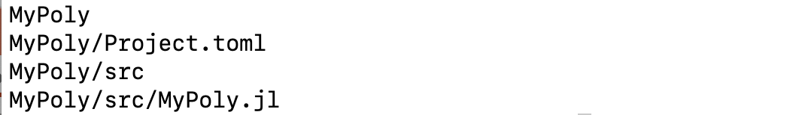
Julia programming language cont…
Polyarea package
  Using polyarea we can show how Julia uses types and multiple-dispatch to create the same sort of capabilities as object-oriented code. Julia does not have classes.
  Julia packages have a standard basic layout

Slide 12
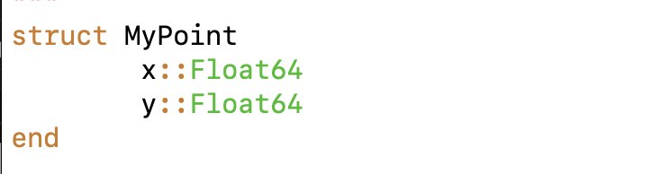
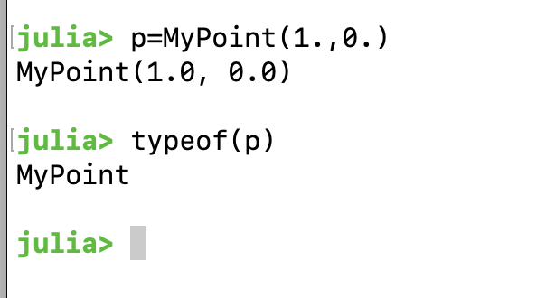
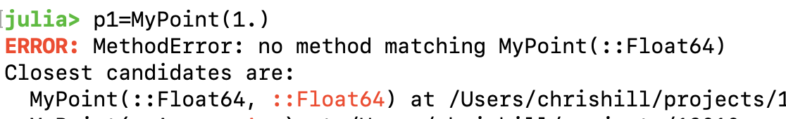
Julia programming language cont…
Polyarea packge
Julia uses struct and type concepts
  struct creates a type with same name as struct.
  Here MyPoint is a type
  The :: syntax can be used with program defined types
  A constructor function with args matching struct members is created by default.

Slide 13
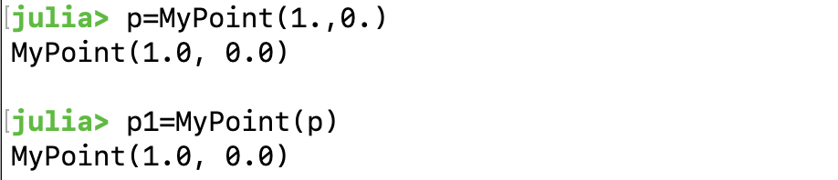
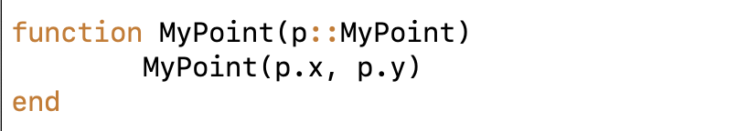
Julia programming language cont…
Polyarea package
Julia uses struct and type concepts
  struct creates a type with same name as struct.
  Here ::MyPoint is a custom type. Multiple-dispatch uses type matching in place of functions within classes.
  Alternate constructor functions must be written

Slide 14
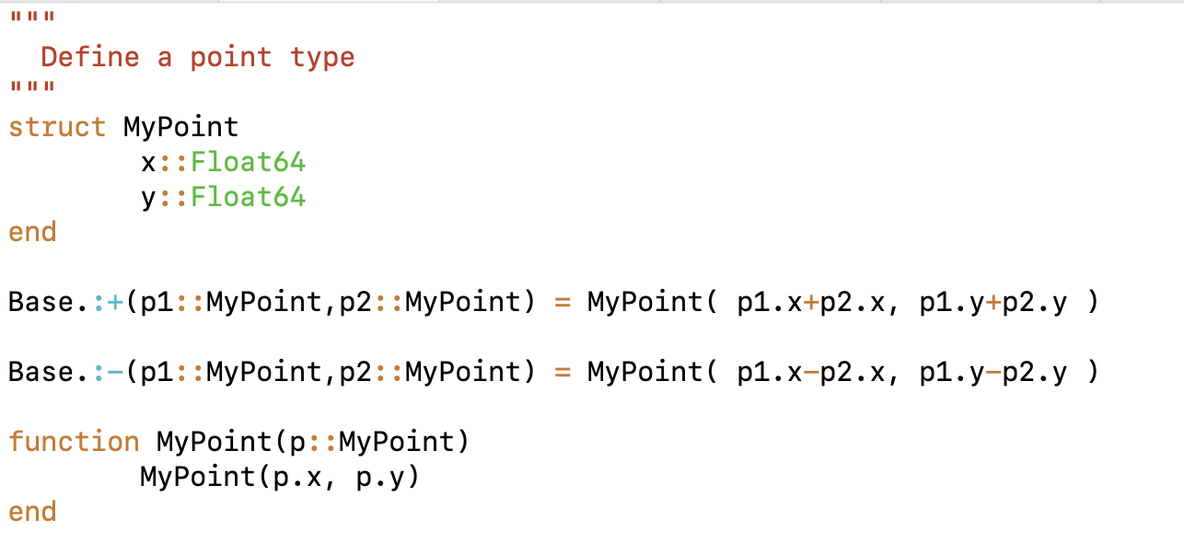
Julia programming language cont…
Polyarea package
  Full “MyPoint” type and methods.
    Overload “+” and “-”
    A custom method
  Can now add this to the MyPoly package

Slide 15
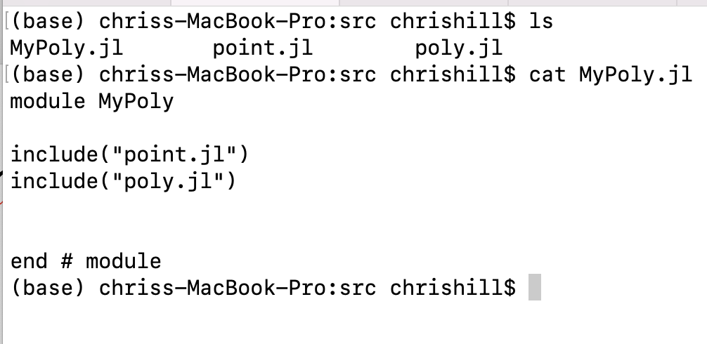
Julia programming language cont…
Polyarea package
  Adding to a package
  include(“xxxxx”)
  include starts search from directory where file with include lives
  typically, package component files are in same directory as the main package file

Slide 16
Julia programming language cont…
Polyarea package
  poly.jl defines polynomial functions
    Add points
    Compute areas
  it is included after point.jl so that is can reference MyPoint types and methods.
    e.g. Julia type hierarchy is “acyclic”.

Slide 17
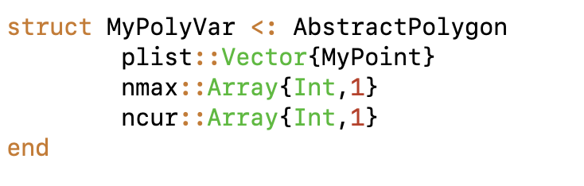
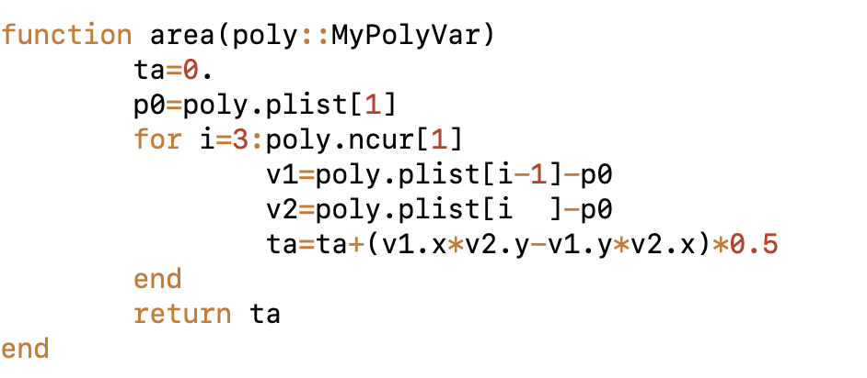
Julia programming language cont…
Polyarea package
poly.jl
  needs
    type
    functions

Slide 18
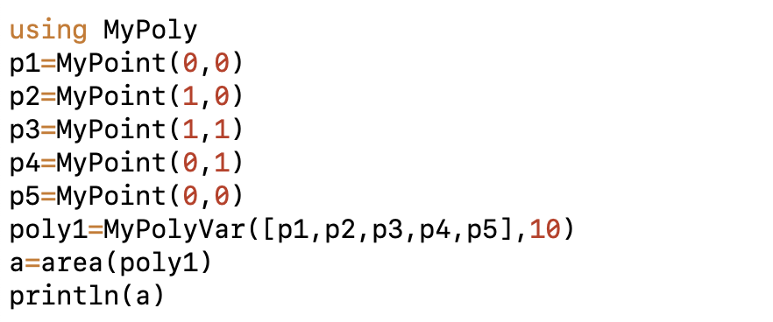
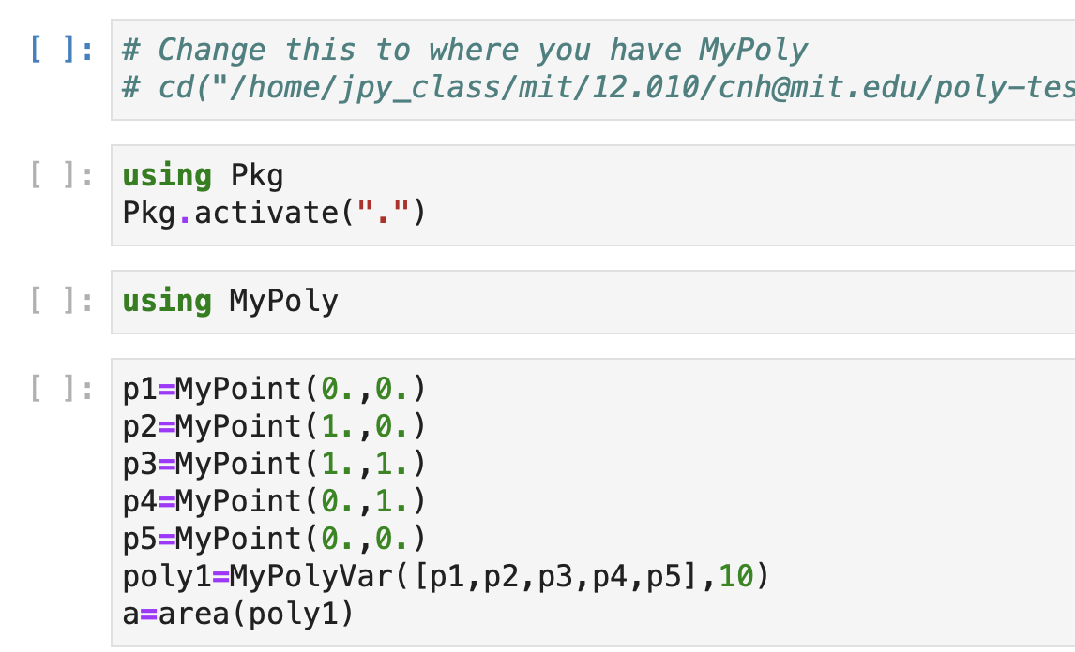
Julia programming language cont…
Using Polyarea package
Need to tell Julia where to find package

Slide 19
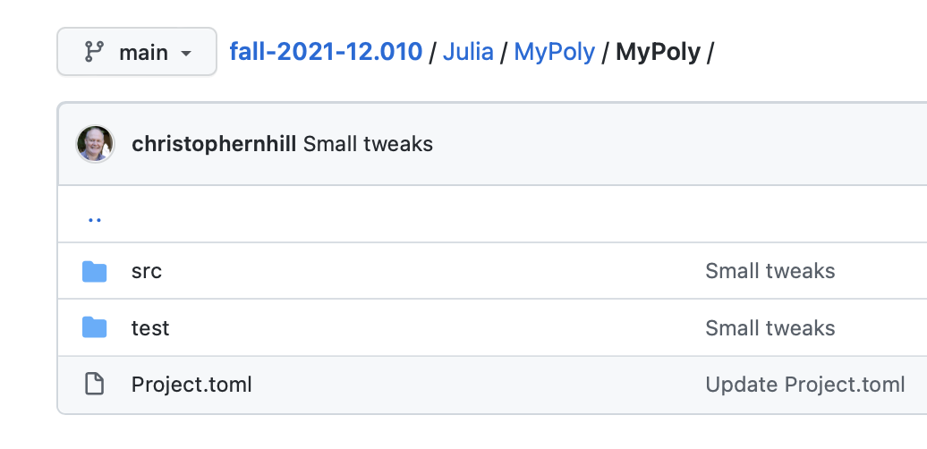
Hands on
Try out mypoly-julia.ipynb
uses

Slide 20
MIT OpenCourseWare
https://ocw.mit.edu
12.010 Computational Methods of Scientific Programming, Fall 2024
For more information about citing these materials or our Terms of Use, visit https://ocw.mit.edu/terms.

