Slide 1
12.010 Computational Methods of Scientific Programming 2021
Lecture 17: C/C++ Continued

Slide 2
Continuing C/C++
Pointers
Structures

Slide 3
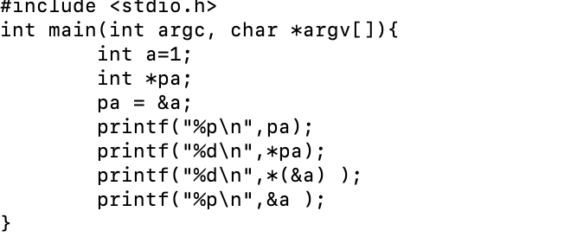
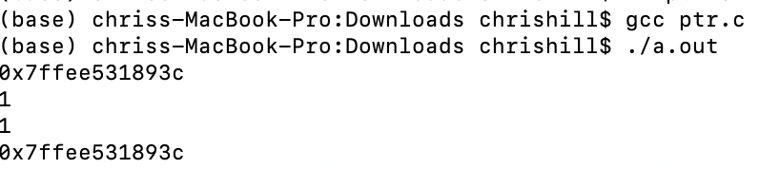
C pointers
Some of Lec17_polyarea.c is a bit clunky e.g. NMAX
in many C codes pointers to blocks of memory are used instead of arrays, and “indexing” is computed in code.
int a=1
&a – address used by variable a
*(&a) – value stored at address used by a
int *pa - pa is a pointer to an integer
Memory
0x1
……
0
1
2
3
4
memory addresses

Slide 4
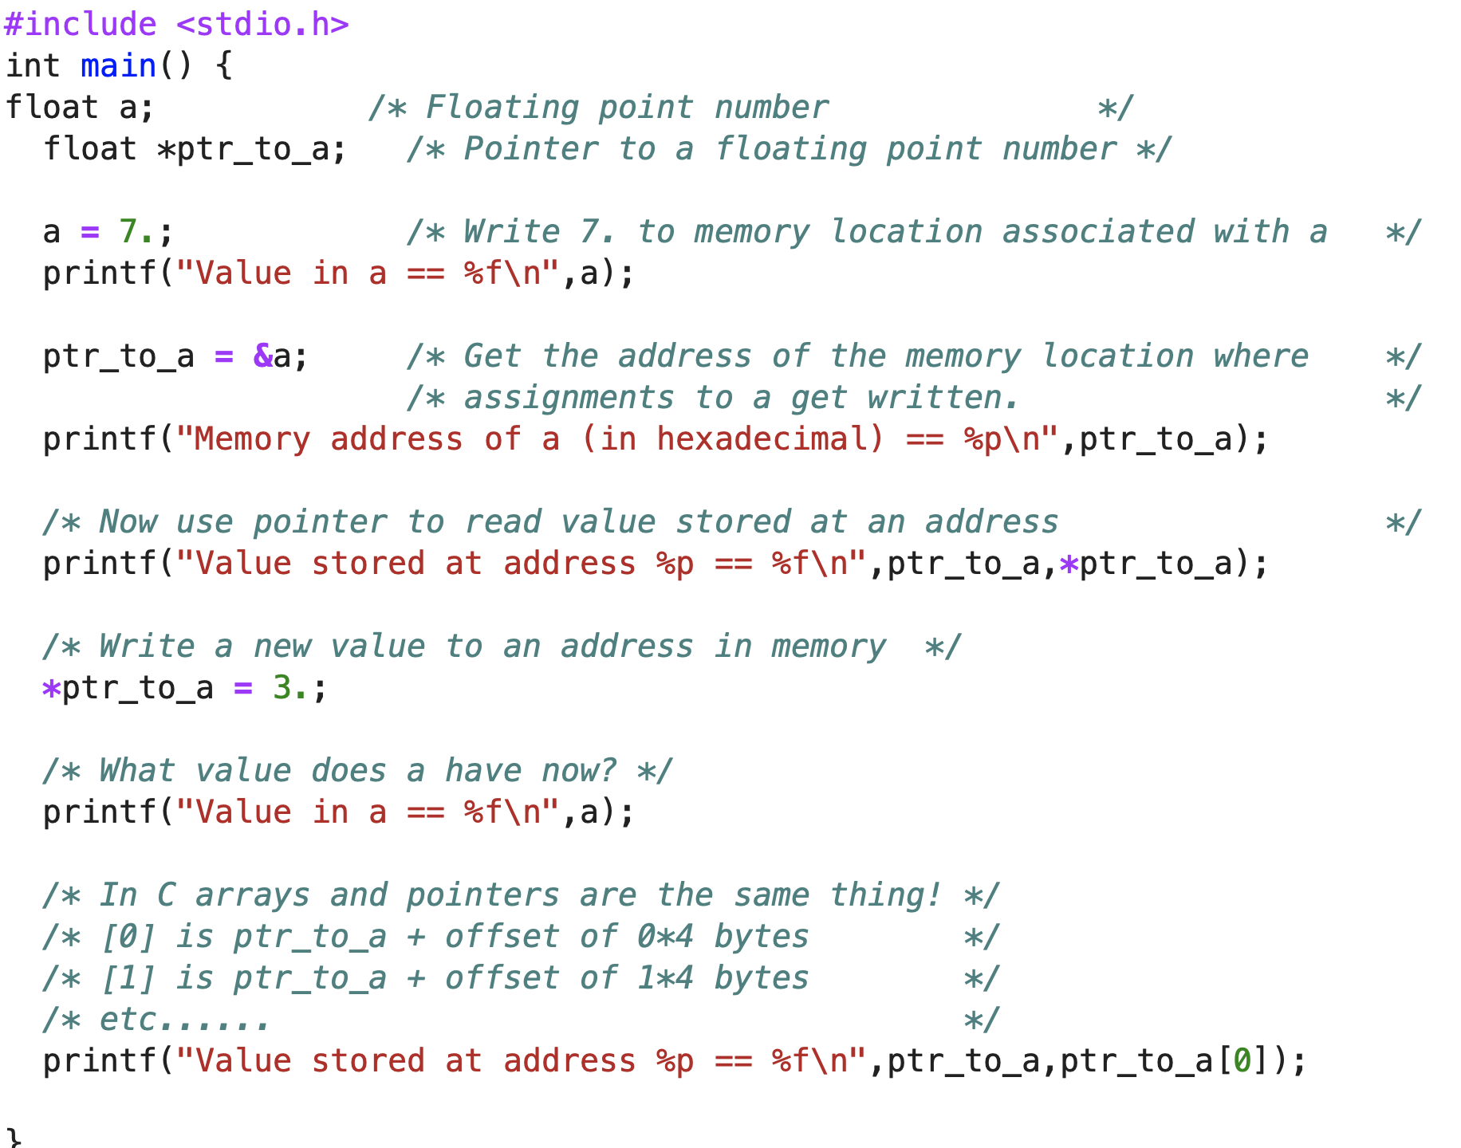
C pointers
TAHMac[1559] cc Lec18_ptr.c
TAHMac[1560] a.out
Value in a == 7.000000
Memory address of a (in hexadecimal) == 0x16cef327c
Value stored at address 0x16cef327c == 7.000000
Value in a == 3.000000
Value stored at address 0x16cef327c == 3.000000
Small test program – Lec18_ptr.c
Shows accessing values versus addresses.

Slide 5
C pointers
Try Lec18_ptr.c

Slide 6
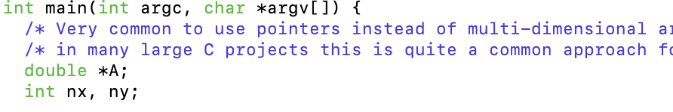
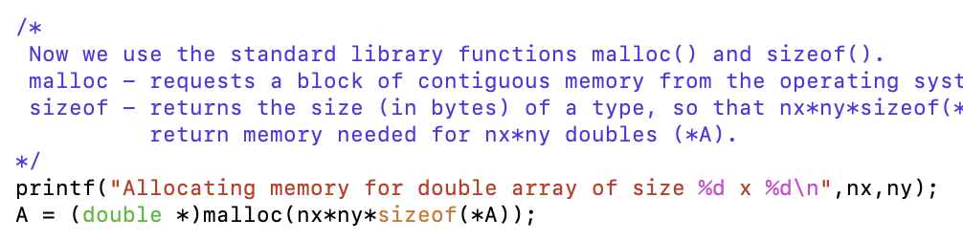
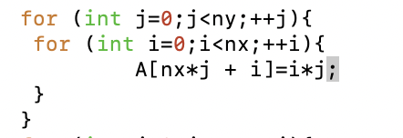

C pointers with arrays
C pointers are often used as an alternate to multi-dimensional arrays in scientific codes.
Key parts are
  array is a “pointer”
  sizes are runtime values
  C library functions malloc() and sizeof() are used
  index arithmetic is part of code
  C library function free() is used to release memory – prevents “memory leak”

Slide 7
C pointers with arrays
Try Lec18_array_ptr.c – try and notice “warnings”
TAHMac[1563] cc Lec18_array_ptr.c
Lec18_array_ptr.c:29:26: warning: format specifies type 'int' but the argument has type 'unsigned long' [-Wformat]
29 | printf("Sizes %d %d\n",sizeof(*A),sizeof(A));
| ~~ ^~~~~~~~~~
| %lu
Lec18_array_ptr.c:29:37: warning: format specifies type 'int' but the argument has type 'unsigned long' [-Wformat]
29 | printf("Sizes %d %d\n",sizeof(*A),sizeof(A));
| ~~ ^~~~~~~~~
| %lu
Lec18_array_ptr.c:32:54: warning: format specifies type 'int' but the argument has type 'unsigned long' [-Wformat]
32 | if( A == NULL ) {printf("Cant allocate %d bytes\n",nx*ny*sizeof(A)); exit(-1);}
| ~~ ^~~~~~~~~~~~~~~
| %lu
3 warnings generated.

Slide 8
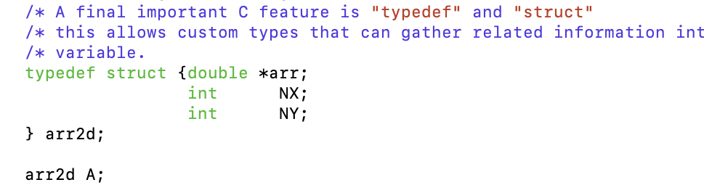
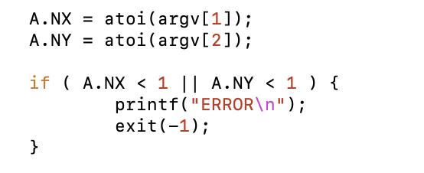
C with structs and typedef
C struct and typedef are a way to make code more modular and very common and useful.
Key parts are
  declare a struct and ”wrap” in typedef
  declare a variable with the type
  access components of the type using “.”
.
.
.

Slide 9
C pointers with structs
Try Lec18_array_struct.c – try and make C poly area use malloc() and struct + typedef
Lec18_poly_area_struct_ptr.c

Slide 10
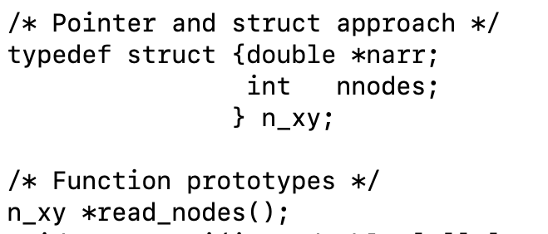
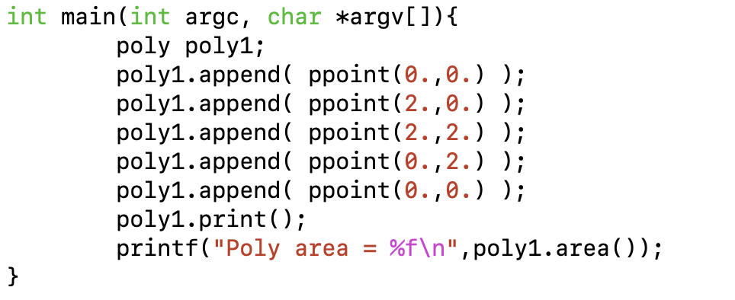
C pointers, structs and typedefs ➔ C++ with classes
C++ builds on C structs, typedefs to create object oriented style.
  A C++ class based polyarea
➔
C structure and typedef.
With C++ can attach methods (aka functions) to new types, to create higher-level interfaces.
poly and ppoint are like C types, but they have their own data and methods (append(), area(), etc…) collected all in one concept (Class).
C++ adds classes to C.

Slide 11
C++
First main-stream “object oriented” language. Compose complex applications from building blocks.
Appeared around 1984 (Bjarne Stroustrup, Bell Labs)
ANSI standard 1997
Syntax is like C. Getting started: a few extra keywords + few new formalized concepts.
Book “C++ The Core Language” – O’Reilly
Successful because you can compose applications from other peoples building blocks. Windows etc….
V. complex in detail, takes many years to learn everything!!

Slide 12
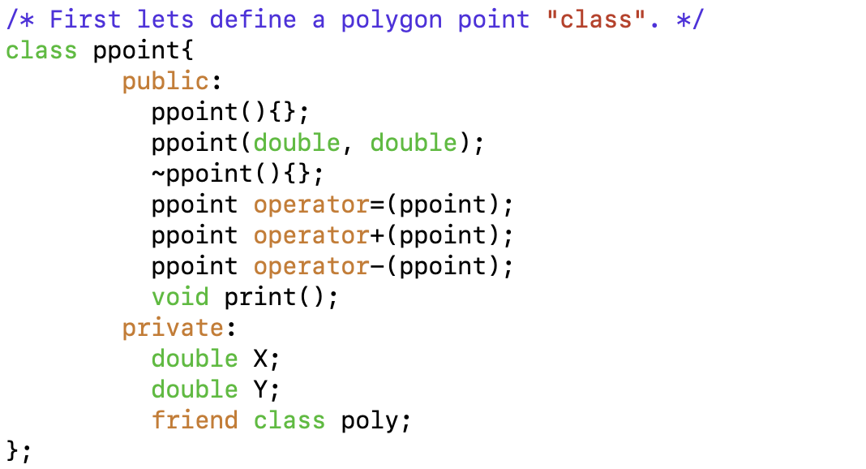
C++ compared to C
C language + classes
Class is a formal way to think about good program design.
  Modularity, encapsulation, hierarchy, abstraction
A class has
  Methods ( program logic)
  Data ( variables )
  can be private or public
We will look at expressing polyarea using C++ object-oriented classes.
Start with “ppoint” class – point in a Polygon
Example of defining a “class” for a polygon point in 2d.

Slide 13
C++ class
C++ introduces
  class NAME{ … }
  instance of a class is called an “object” e.g.
    ppoint ppoint1;
  class defines functions (methods) for operating on objects of type
  class defines variables that hold the state of an object
  in example state is the coordinates X and Y
  methods are constructor and destructor (NAME, ~NAME), print(), =, + and -.

Slide 14
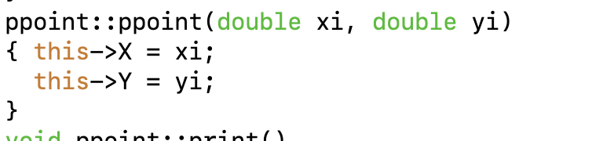
C++ ppoint constructor
C++ constructors
  class NAME{ … }
  all classes have constructor and destructor methods
  these have name that is the same as the class NAME (~ in front for destructor)
  can be defined in class block, or separately prefixed by full name NAME::NAME.
  C++ adds CLASSNAME::FNAME for full names of functions.
  Same function can have several definitions for different argument types (polymorphism).
Keyword “this” is used to indicate the “current” object.

Slide 15
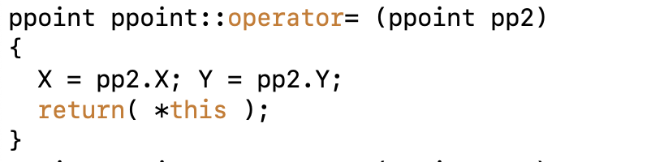
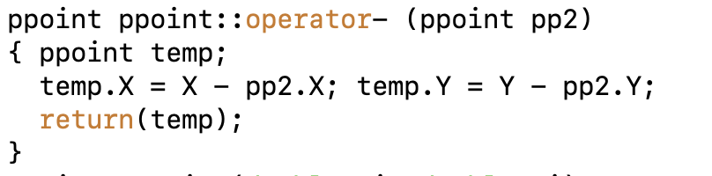

C++ operator overloading
Can redefine +, -, = etc… to have different definition for different type/class arguments.
For polyarea we define an “=“ and a “-” method for a ppoint object.
These can be used when computing the vector between two points.

Slide 16
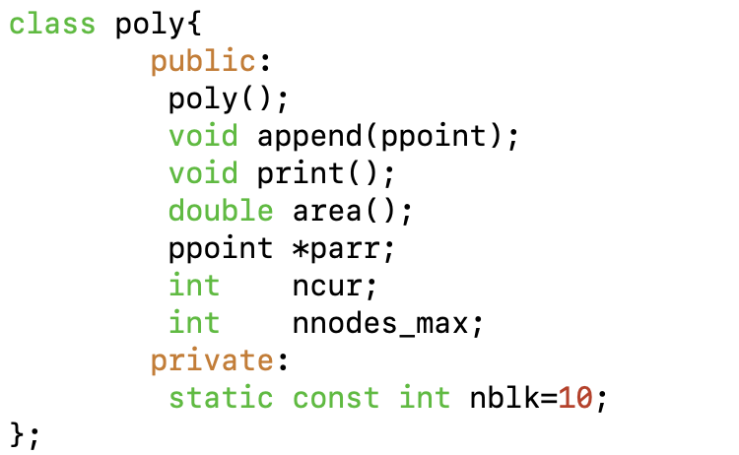
C++ creating a polygon class
We create a second class “poly::”.
  This can hold a collection of points that make up a polygon
  Calculate area
  Print coordinates
  ppoint:: instances can be added using an “append” method
  Each instance of poly:: keeps track of its internal storage and size and allocates extra memory when needed.

Slide 17
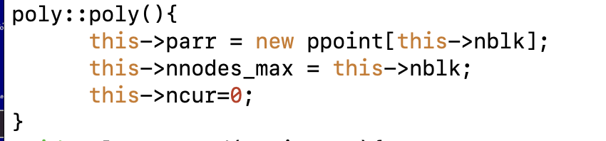
C++ polygon constructor
poly:: class has an array of ppoint:: class instances
  the constructor ( poly::poly ) is invoked when an object of type poly:: is declared.
  the constructor uses the C++ “new” function to allocate an array of ppoint:: instances
  the poly:: instance has its array pointer set to the new memory and the max elements and current element set.
  the keyword “this” is used to refer to the current poly:: instance (e.g. poly1 in main() ).

Slide 18


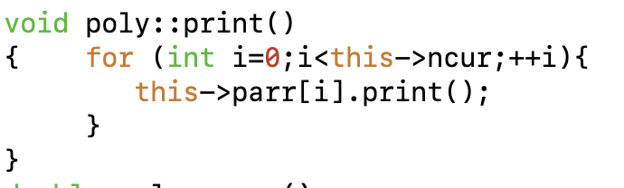
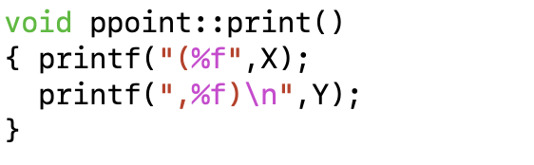

C++ polygon poly::print()
Each poly:: instance has a print() method
The poly::print() method calls the ppoint::print() method for each ppoint:: in the parr array of polygon points.

Slide 19
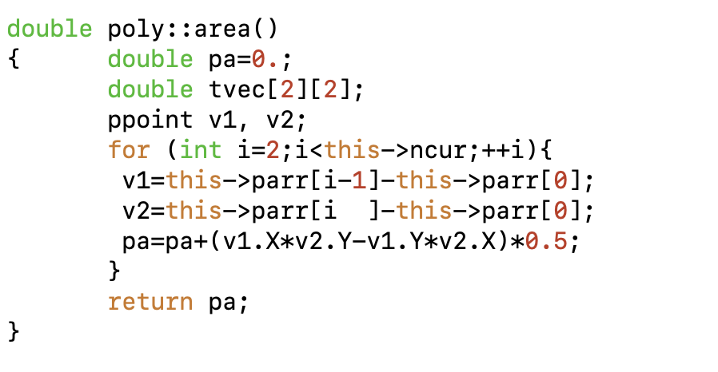
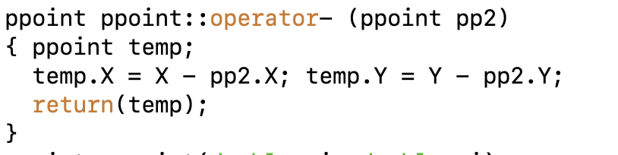
C++ polygon poly::area
Area computation
  uses cross-product formula
  the “-” sign is overloaded for ppoint.

Slide 20
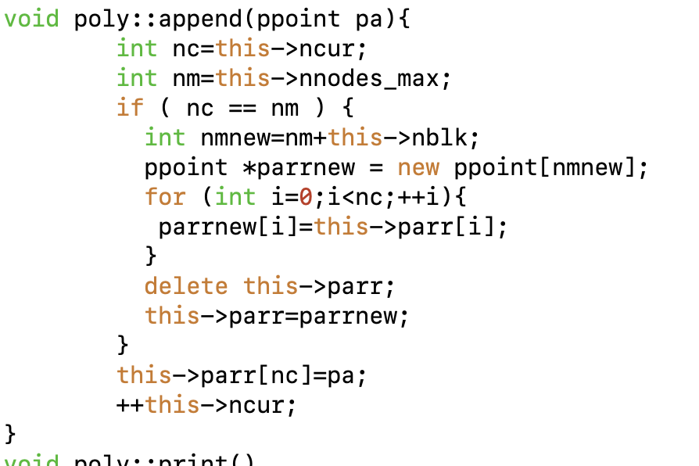
C++ polygon poly::append
poly::append hides a couple of details
  Appending
  Growing the storage process

Slide 21
C++ polyarea example
Look at and try “Lec18_poly_area.cc” (use c++/g++ compiler).
TAHMac[1583] cc Lec18_poly_area.cc
Undefined symbols for architecture arm64:
"std::terminate()", referenced from:
___clang_call_terminate in Lec18_poly_area-32e891.o
"operator delete[](void*)", referenced from:
poly::poly() in Lec18_poly_area-32e891.o
poly::append(ppoint) in Lec18_poly_area-32e891.o
"operator delete(void*)", referenced from:
poly::append(ppoint) in Lec18_poly_area-32e891.o
poly::append(ppoint) in Lec18_poly_area-32e891.o
"operator new[](unsigned long)", referenced from:
poly::poly() in Lec18_poly_area-32e891.o
poly::append(ppoint) in Lec18_poly_area-32e891.o
"___cxa_begin_catch", referenced from:
___clang_call_terminate in Lec18_poly_area-32e891.o
"___gxx_personality_v0", referenced from:
/private/var/folders/t8/r6ksvxyc8xj78r0059bkhsm00000gr/T/Lec18_poly_area-32e891.o
ld: symbol(s) not found for architecture arm64
clang: error: linker command failed with exit code 1 (use -v to see invocation)
Correct compiler.
TAHMac[1581] c++ Lec18_poly_area.cc
TAHMac[1582] a.out
(0.000000,0.000000)
(2.000000,0.000000)
(2.000000,2.000000)
(0.000000,2.000000)
(0.000000,0.000000)
Poly area = 4.000000

Slide 22
Summary
Looked at pointers and structures
Next class; inheritance and classes in Python.

Slide 23
MIT OpenCourseWare
https://ocw.mit.edu
12.010 Computational Methods of Scientific Programming, Fall 2024
For more information about citing these materials or our Terms of Use, visit https://ocw.mit.edu/terms.

