Slide 1
12.010 Computational Methods of Scientific Programming
Lecture 16: C/C++

Slide 2
Summary
Programming concepts and syntax in C/C++
  Some simple examples
  Look at example numerical codes in C
    Polyarea
  Delve into use of
    Pointers
    Structures

Slide 3
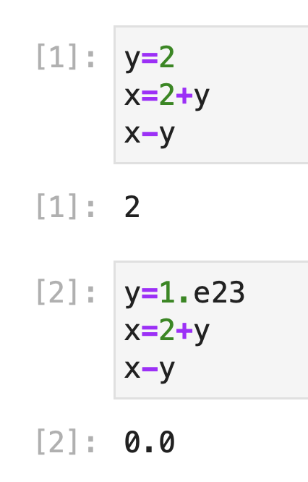
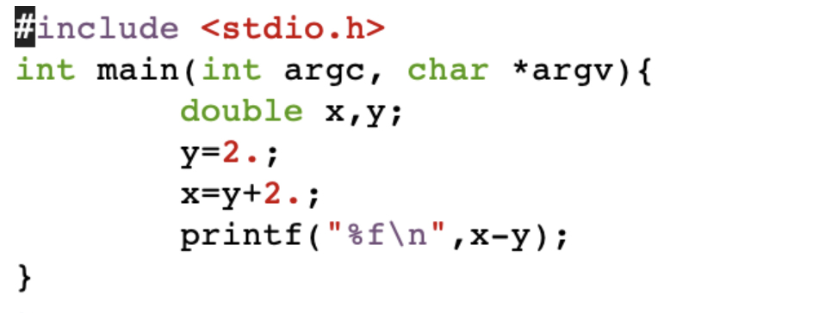
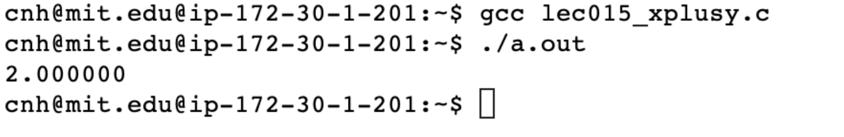
C syntax in action
Simple program exercise that shows functions, loops, pointers and copies etc…
  Remember
How does this look in C
Include standard lib header file (for I/O)
Executable statements in a function
int main(…){…}
Variables all need to be typed explicitly.
Statements have to end with ;
Call a standard lib func to do I/O
Compile and the execute in terminal.

Slide 4
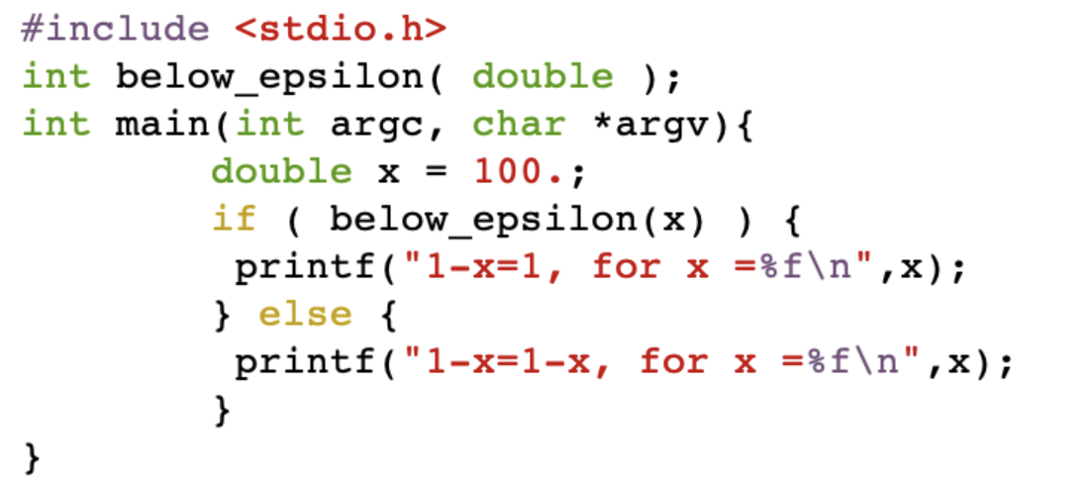
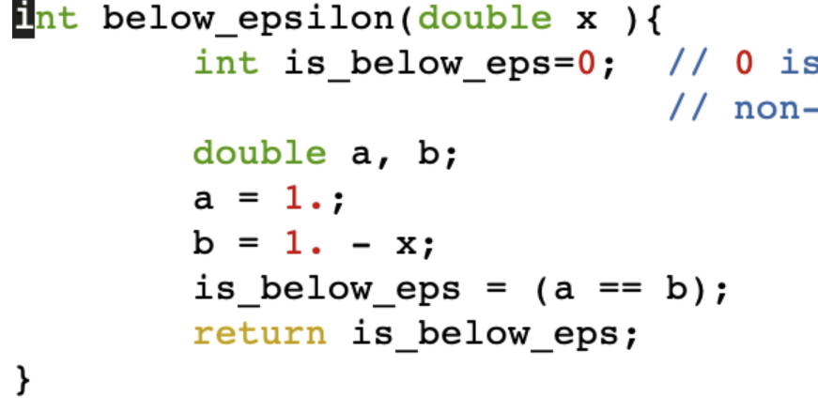
C syntax in action
Lets create a function “below_epsilon” that returns true is a number is too small to change one when subtracted. Historically this is known as “machine epsilon”.
Lec17_below_epsilon_main.c
Lec17_below_epsilon_func.c
- when we split in two files, need a “function prototype” in main, to give function and args types.

Slide 5
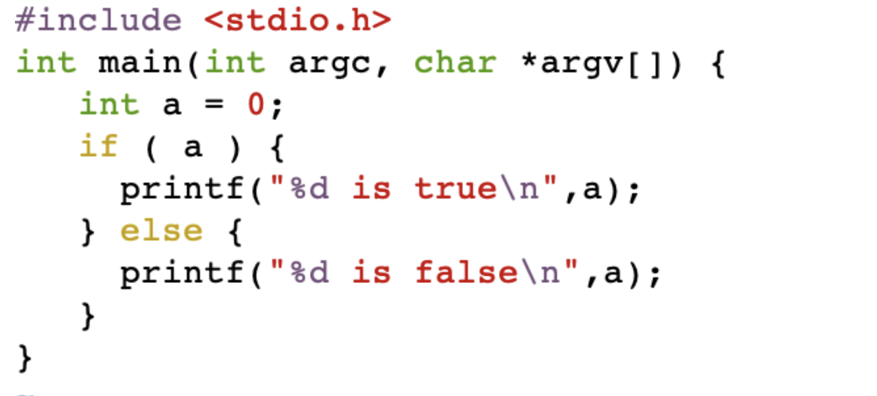
C syntax in action
Are we sure 0 is false? We can write a program to test this.
gcc Lec17_is_0_false_arg.c
./a.out to see

Slide 6
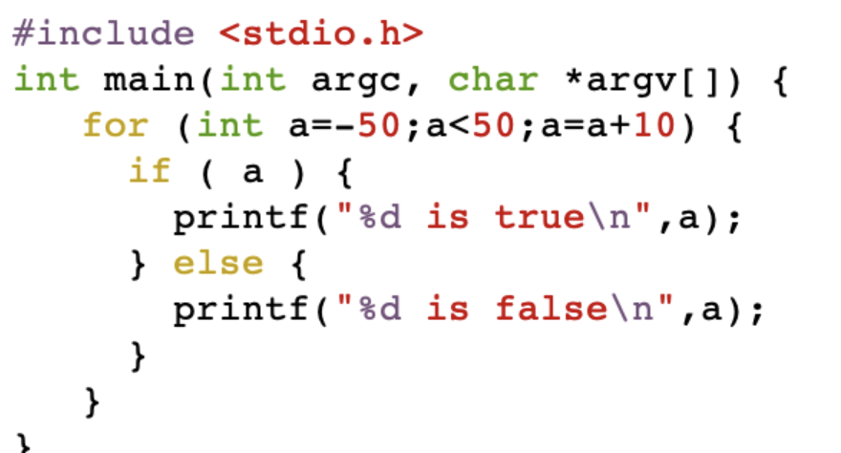
C syntax in action
Are we sure 0 is false? We can loop to check a few values.
% gcc Lec17_is_0_false_loop.c
% ./a.out
-50 is true
-40 is true
-30 is true
-20 is true
-10 is true
0 is false
10 is true
20 is true
30 is true
40 is true
for (initial;test; increment) { body… }
if ( condition ) { expression.. } else { expression.. }

Slide 7
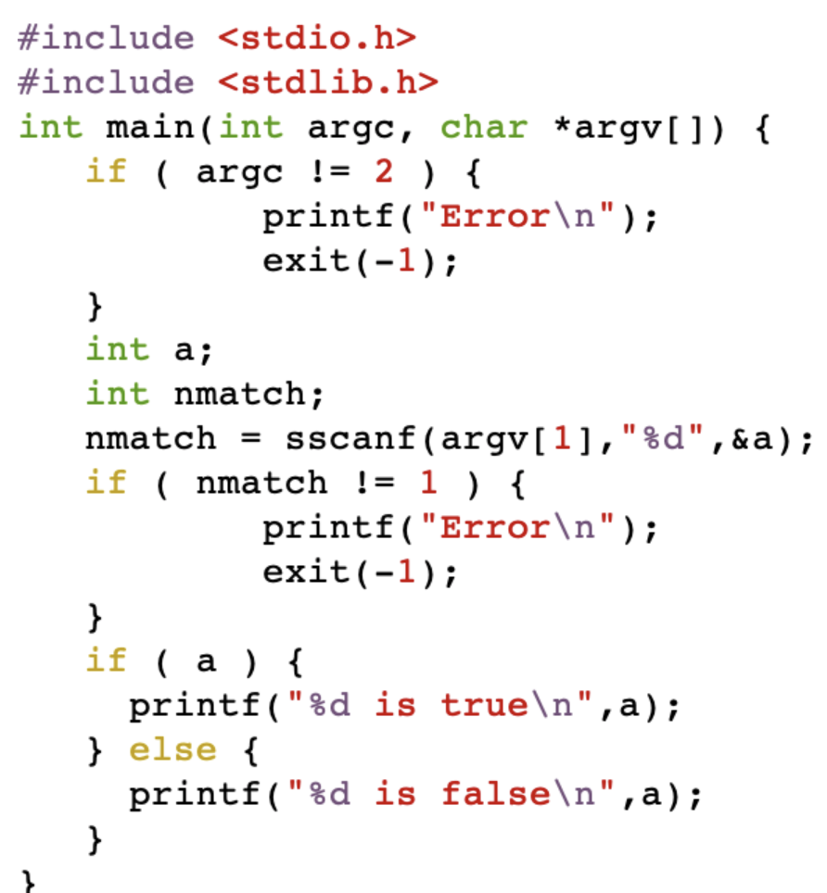
C syntax in action
Are we sure 0 is false? We can check values passed as arguments
TAHMac[1548] cc Lec17_is_0_false_arg.c
TAHMac[1549] a.out 300
300 is true
TAHMac[1550] a.out 0
0 is false

Slide 8
C syntax in action
Try
Lec17_xplusy.c
- Modify to demonstrate “eps”
Lec17_is_0_false.c
- Modify to take an argument
Lec17_below_epsilon_main.c +
Lec17_below_epsilon_func.c
- Modify to take an argument and finds its eps with a loop.

Slide 9
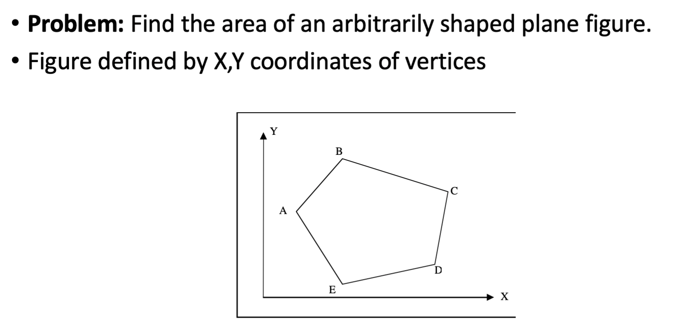
C polyarea
Remember – polyarea.ipynb, Lec 04
How does this look in C.

Slide 10
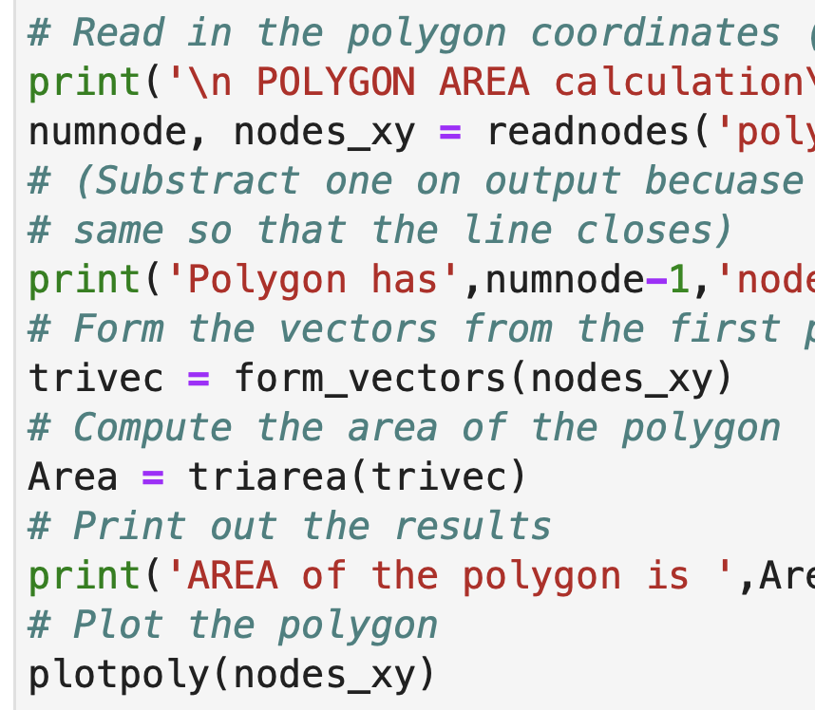
C polyarea
Lets start with high level
Remember – polyarea.ipynb, Lec 04
How does this look in C.
~3 core functions, readnodes(), form_vectors(), triarea().
In C there is not built-in way to plot.

Slide 11
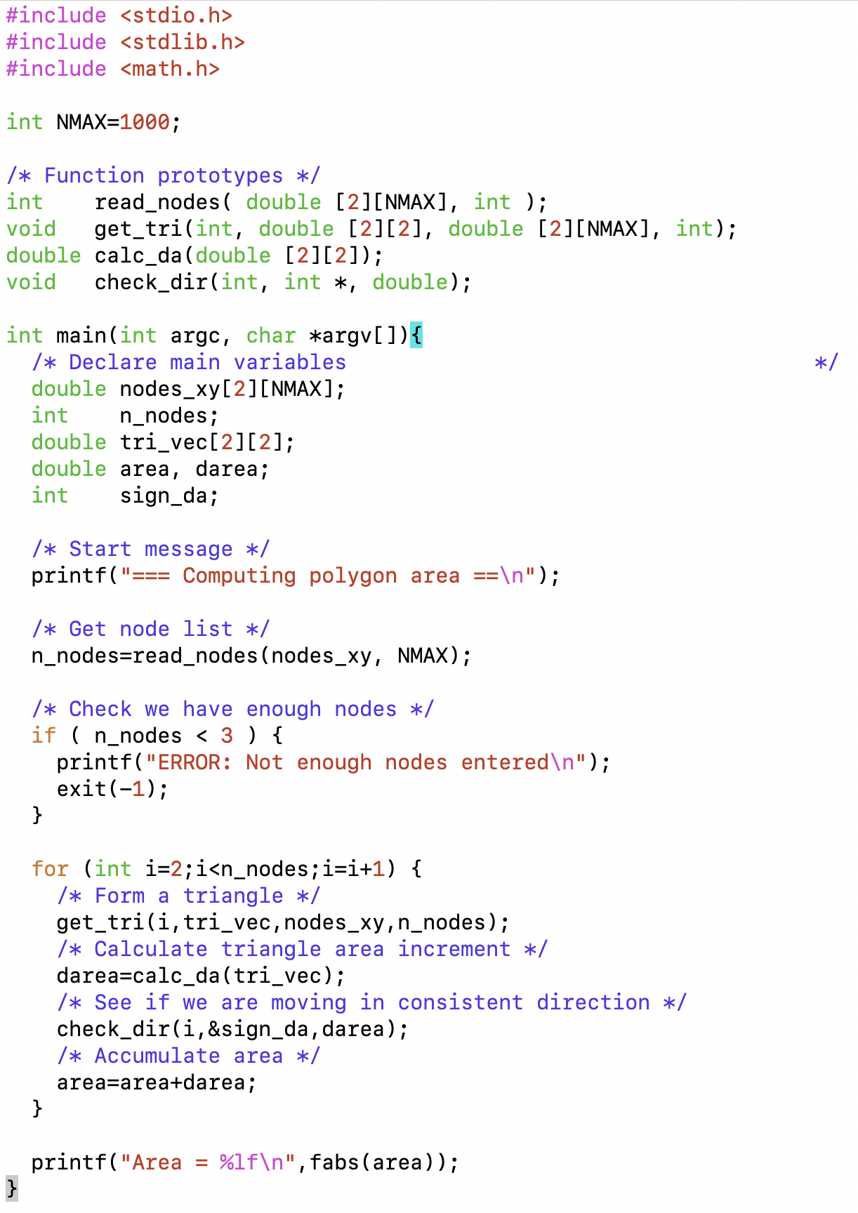
C polyarea
Headers for “printf”, “scanf”, ”exit”, “fabs”.
Global, static max size, later we will use pointer.
Types for our internal functions.
main function – everything starts here.
declare types of main variables
internal function to read
internal function to form triangles
internal triangle area function
A basic poly_area main program in C
internal direction check
sum area
“main”
print total area

Slide 12
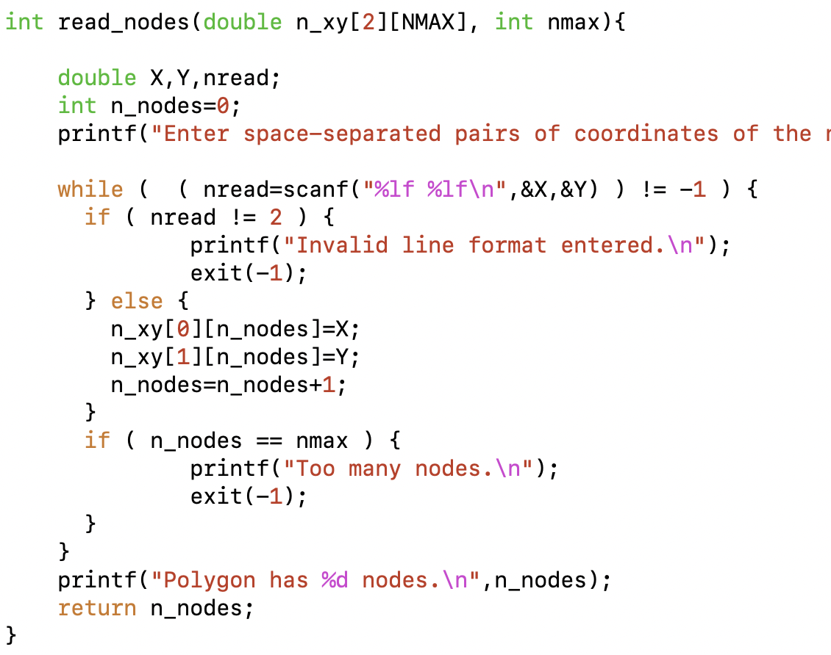
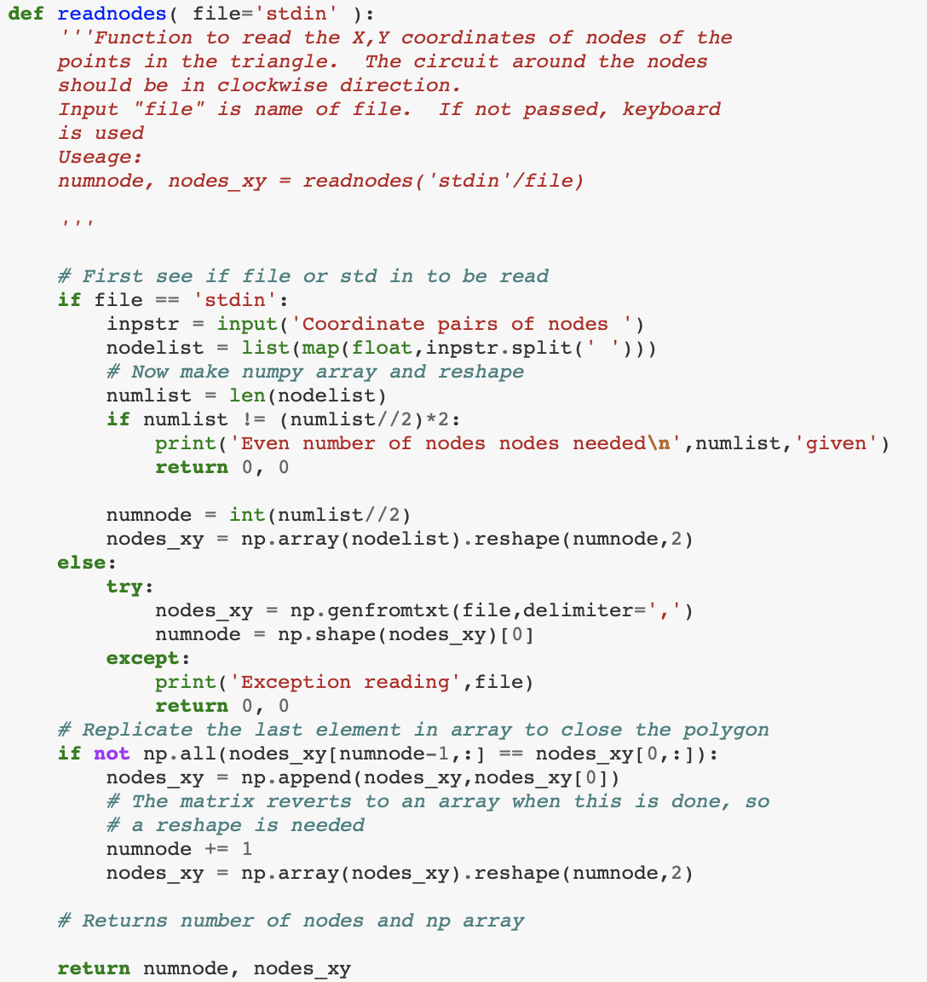
C polyarea vs Python
Pass in array to fill, return number of nodes read, error checking but no error recovery.
while loop testing for “end of file” (-1). if () {} -
I/O

Slide 13
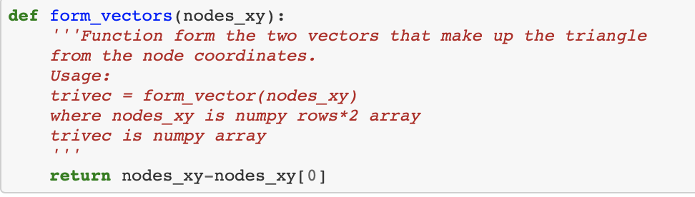
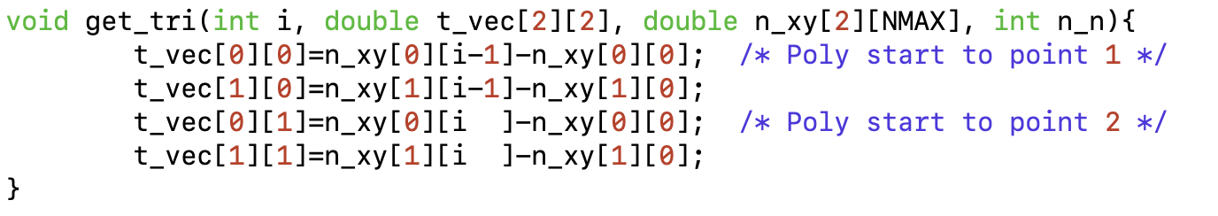
C polyarea vs Python
Python form all triangles in np array
C loop over triangles, form one at a time for node “i”.
Type declarations needed for every variable (NMAX is global).
Result is passed out through array (array is “pointer” to memory).
triangle (wrt to first point)

Slide 14
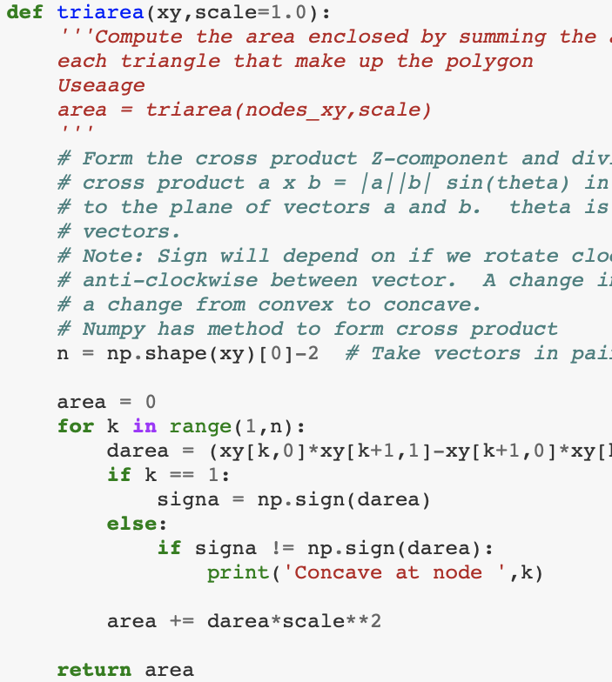
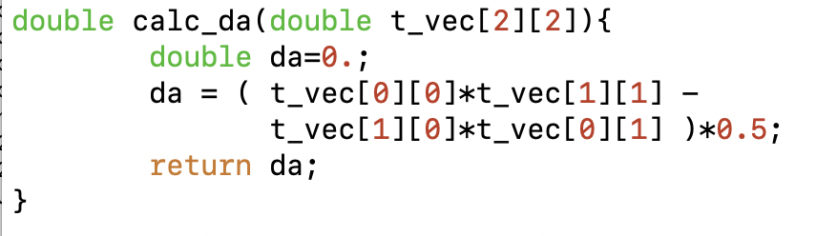
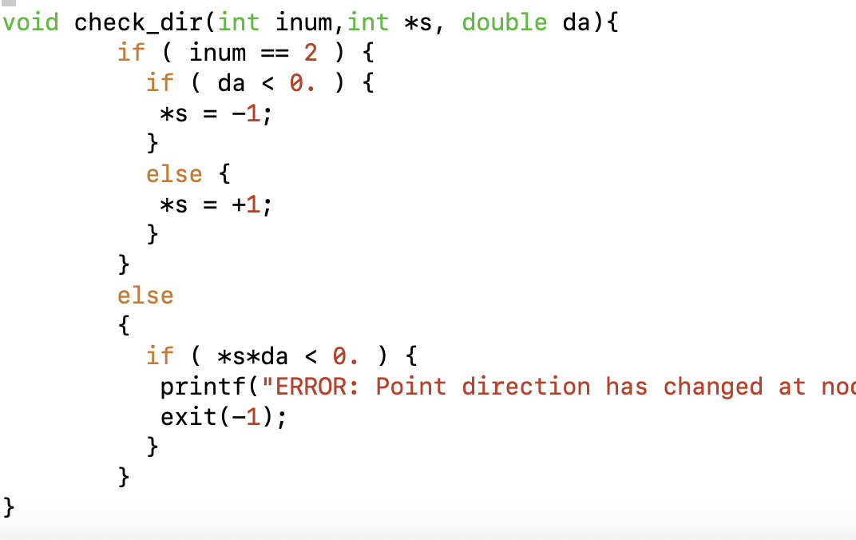
C polyarea vs Python
Python cross product and convex check
cross-product area, (a_{x}b_{y}-a_{y}b_{x})*0.5
Convex check.
Type of function is void, no return value,

Slide 15
C v Python
Try
- Modify to avoid error on concave/to compile from separate files.
Lec17_polyarea.c
TAHMac[1554] cc Lec17_poly_area.c -o Lec17_poly_area
TAHMac[1555] Lec17_poly_area < poly_input.txt
=== Computing polygon area ==
Enter space-separated pairs of coordinates of the nodes, one pair per line.
Polygon has 5 nodes.
Area = 4.000000
TAHMac[1556] cat poly_input.txt
0 0
0 2
2 2
2 0
0 0
TAHMac[1557]

Slide 16
MIT OpenCourseWare
https://ocw.mit.edu
12.010 Computational Methods of Scientific Programming, Fall 2024
For more information about citing these materials or our Terms of Use, visit https://ocw.mit.edu/terms.

