Slide 1
12.010 Computational Methods of Scientific Programming
Lecture 12: Libraries, Geopandas, xarray

Slide 2
Summary
Finding libraries for Python. Examples for some of the topics already covered

Slide 3
Installing geopandas (or use navigator)
conda create -n geo_env # Creating a new environment should protect base installation
conda activate geo_env
conda config --env --add channels conda-forge
# conda config --env --set channel_priority strict # Might be dangerous in terms of why packages come from.
conda init tcsh
tcsh
conda install geopandas
conda install jupyter notebook
conda install xarray
# Note sure is needed:
#python -m ipykernel install --name geo_env
# Run from terminal instead of anaconda.
jupyter notebook
In anaconda: A geo_env environment should now appear and when selected, geoapandas should be available.

Slide 4
Finding libraries – there are lots!
SciPy – catalog (https://www.scipy.org/topical-software.html )
  The SciPy catalog pages have links to many useful tools in different categories
    Environments e.g. Anaconda, Spyder etc…
    Science tools e.. ImageIO, AstroPy, SpacePy, BioPython, ClimPy, SymPy
Example notebooks –
  https://www.earthcube.org/notebooks - some showcases for Earth science
  https://joss.theoj.org - a general online journal for scientific software cataloging (and DOI)
  https://paperswithcode.com ) – ML focused
PyPi.org
  tensorflow, pytorch, JAX, ….

Slide 5
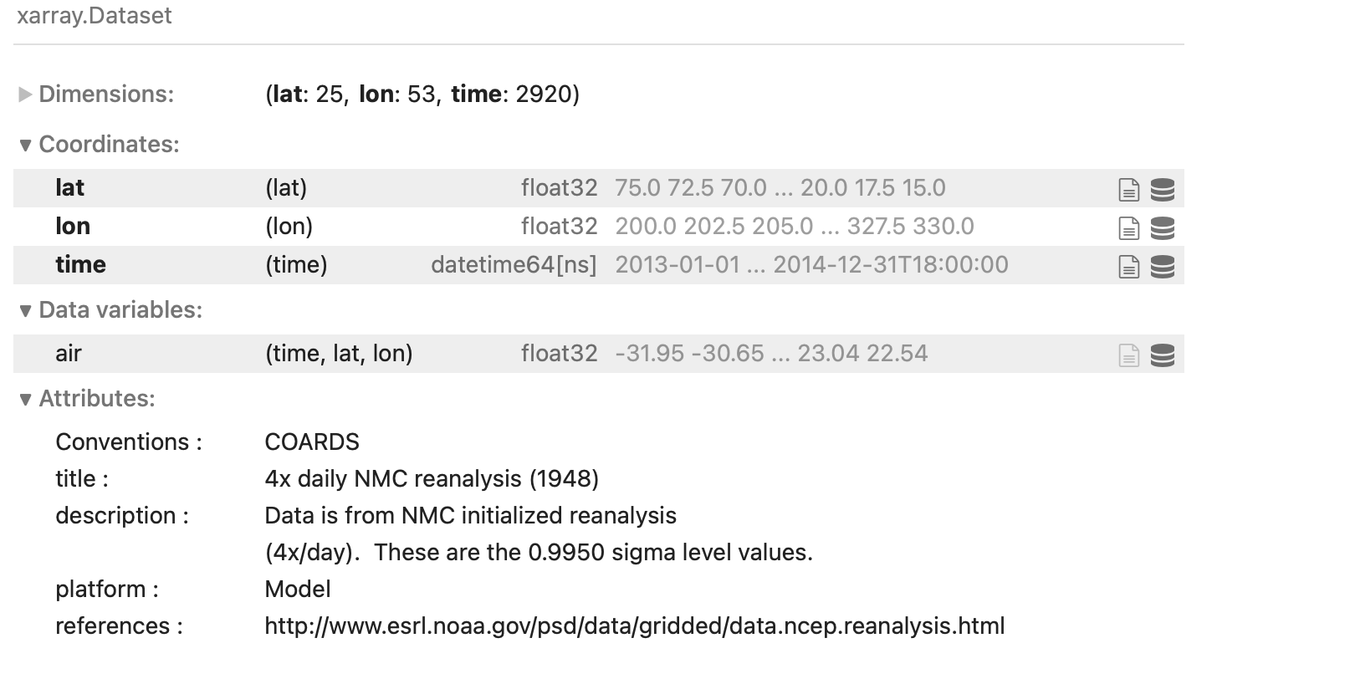
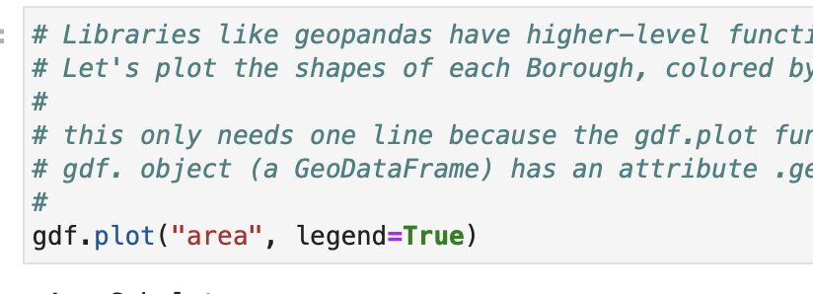
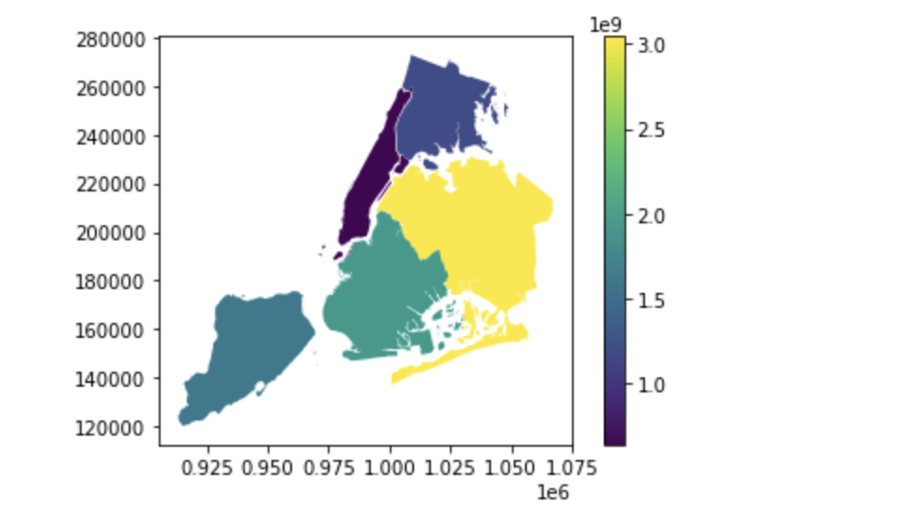
Tabular data beyond Pandas
Pandas provides tabular/column data in “2d”
geopandas
  It builds on top of pandas, and adds some geospatial concepts built-in
xarray
  similar but geared to multi-dimensional data more generally (also builds on pandas)

Slide 6
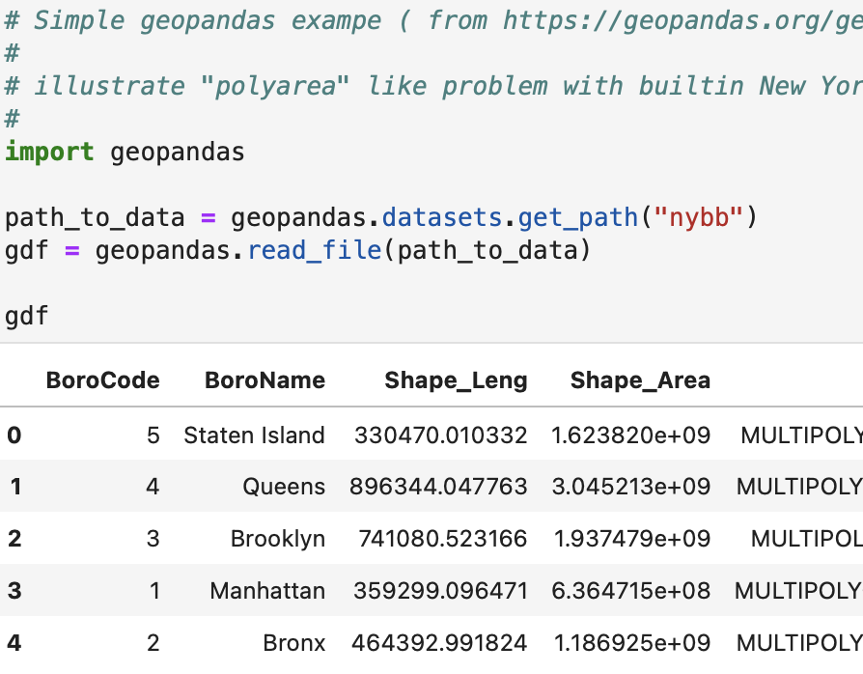
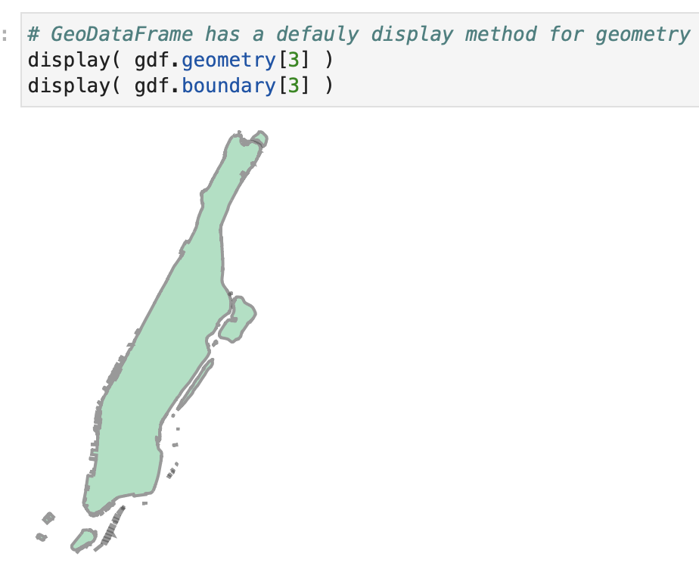
Tabular data beyond Pandas
geopandas - builds on top of pandas, adds some geospatial concepts built-in

Slide 7
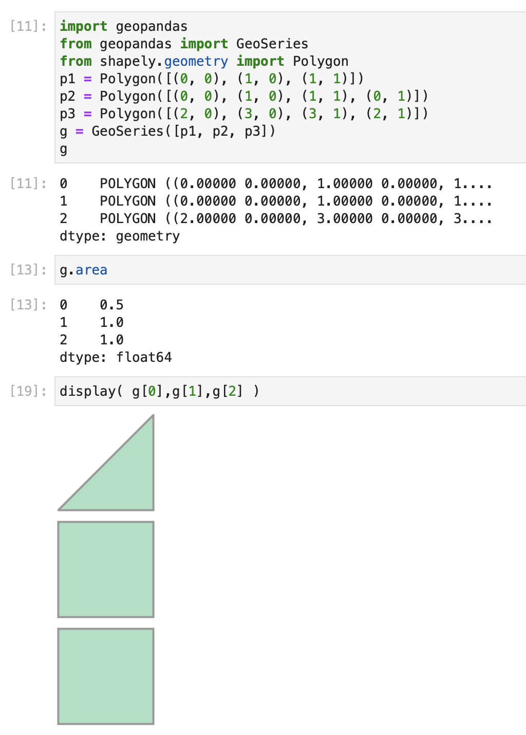
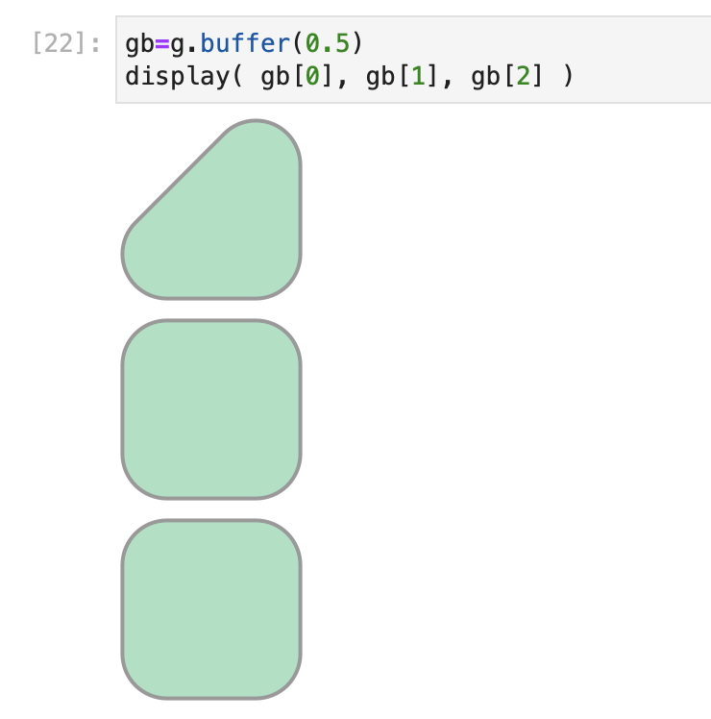
Tabular data beyond Pandas
geopandas – create a polygon example

Slide 8
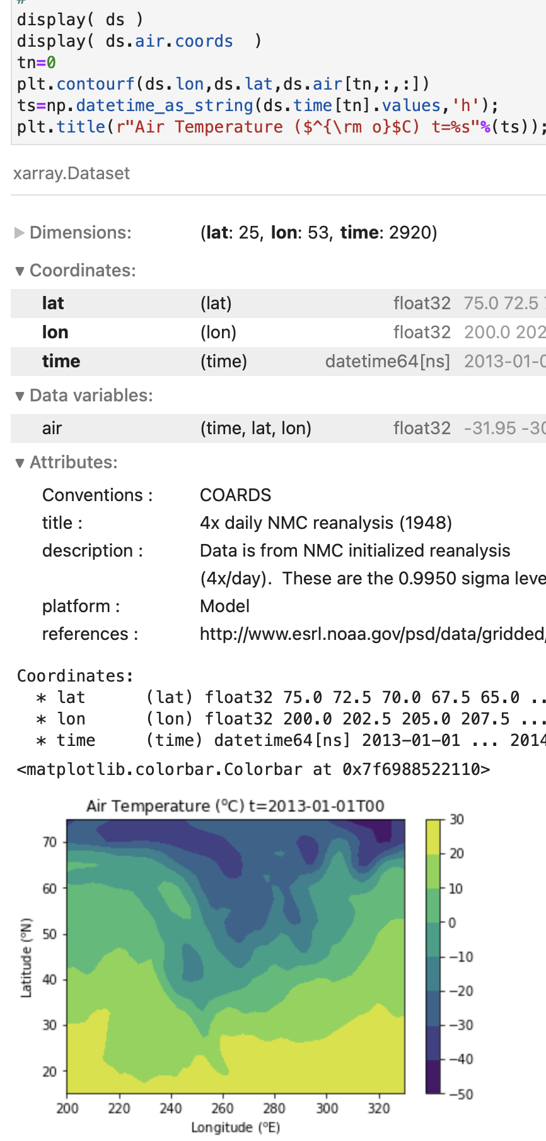
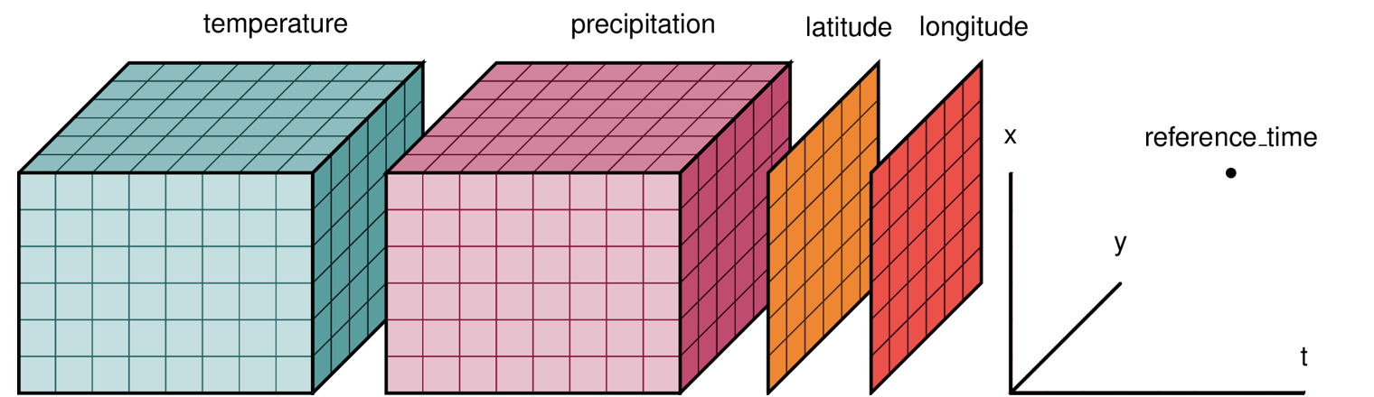
Tabular data beyond Pandas
xarray - geared to multi-dimensional data more generally (also builds on pandas)
  central abstraction is a “Dataset”
  provides I/O, plotting, math, and sampling APIs for “Datasets”.

Slide 9
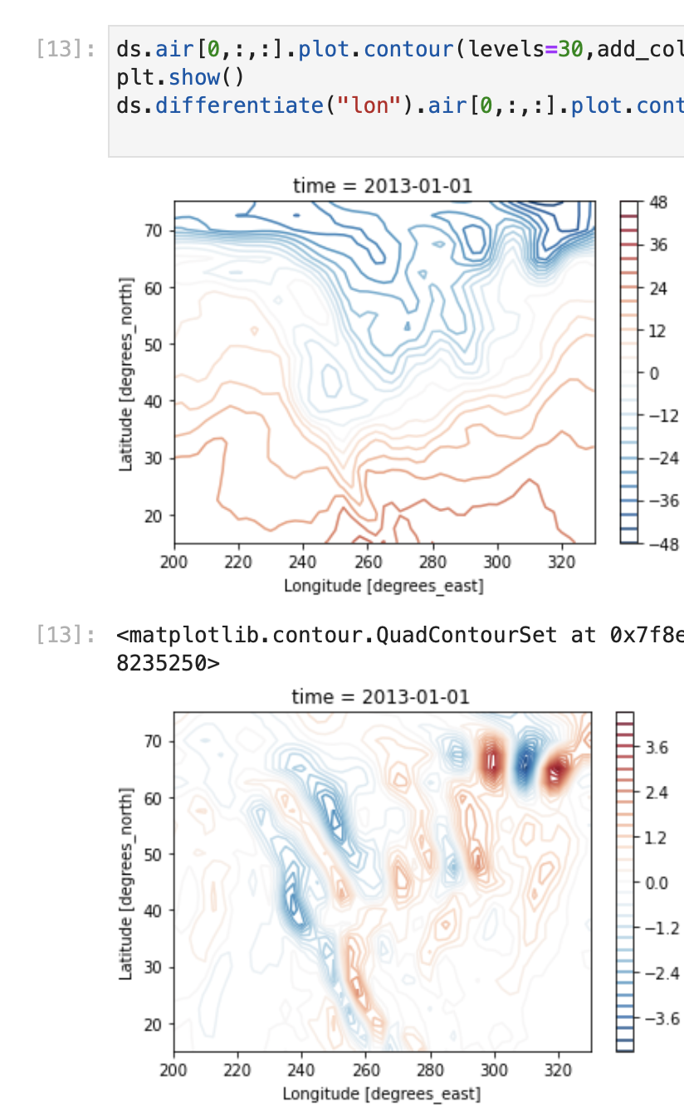
Tabular data beyond Pandas
xarray - calculate derivative example
  xarray abstraction understands a bit about math operations on fields
  for example, we can ask for a derivative wrt a particular “coordinate” dimension
    derivative returns centered derivative where the field is replaced with its derivative (but the name stays the same!).

Slide 10
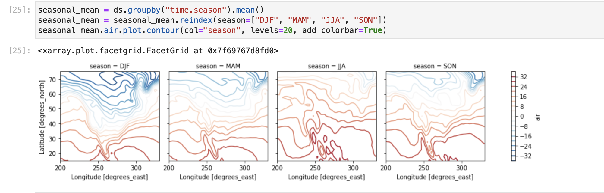
Tabular data beyond Pandas
xarray - quick plot example

Slide 11
Try
Lec13-geopandas-example.ipynb
Lec13-xarray-example.ipynb

Slide 12
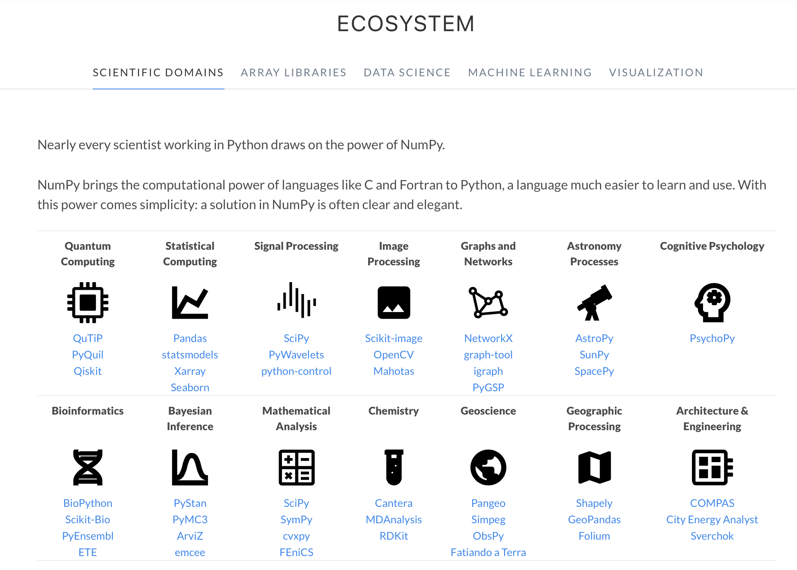
Math beyond SciPy/Numpy
Numpy “taxonomy” (numpy.org)
© 2025 NumPy team. All rights reserved. This content is
excluded from our Creative Commons license. For more
information, see https://ocw.mit.edu/help/faq-fair-use.

Slide 13
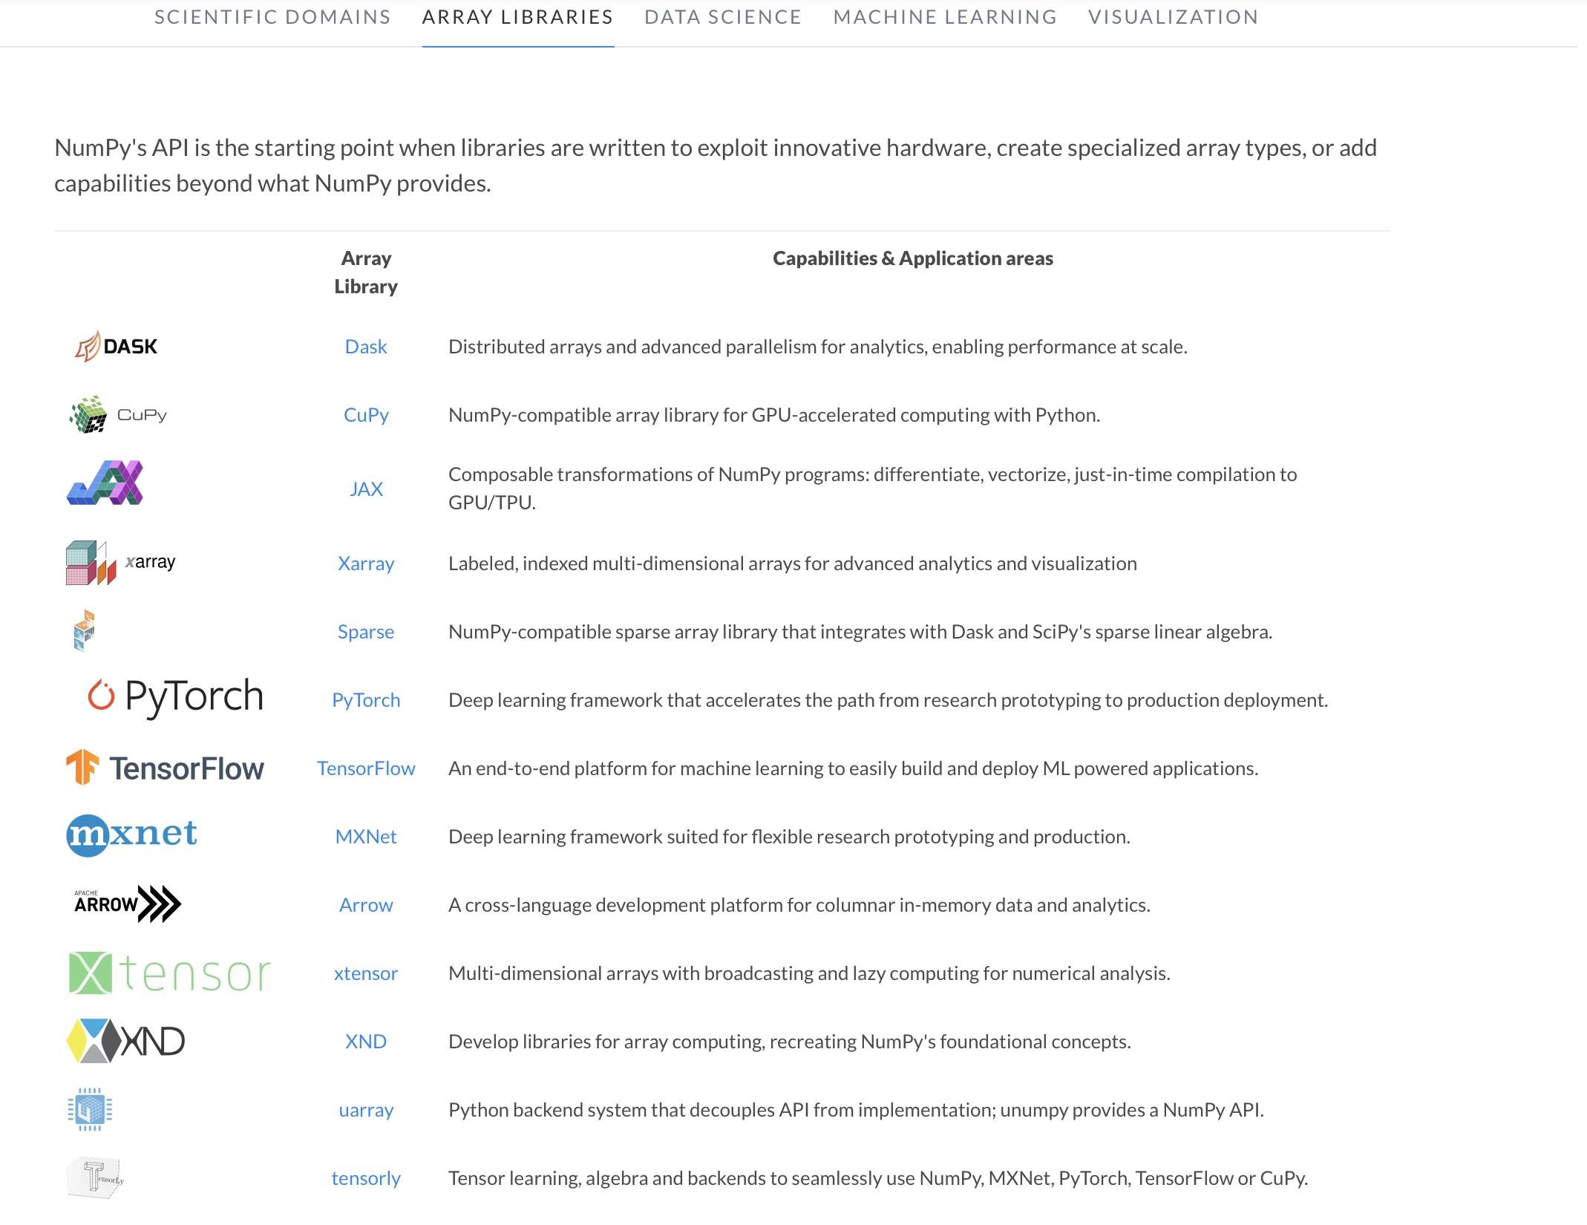
Math beyond SciPy/Numpy
Numpy “taxonomy” (numpy.org)
© 2025 NumPy team. All rights reserved. This content is
excluded from our Creative Commons license. For more
information, see https://ocw.mit.edu/help/faq-fair-use.

Slide 14
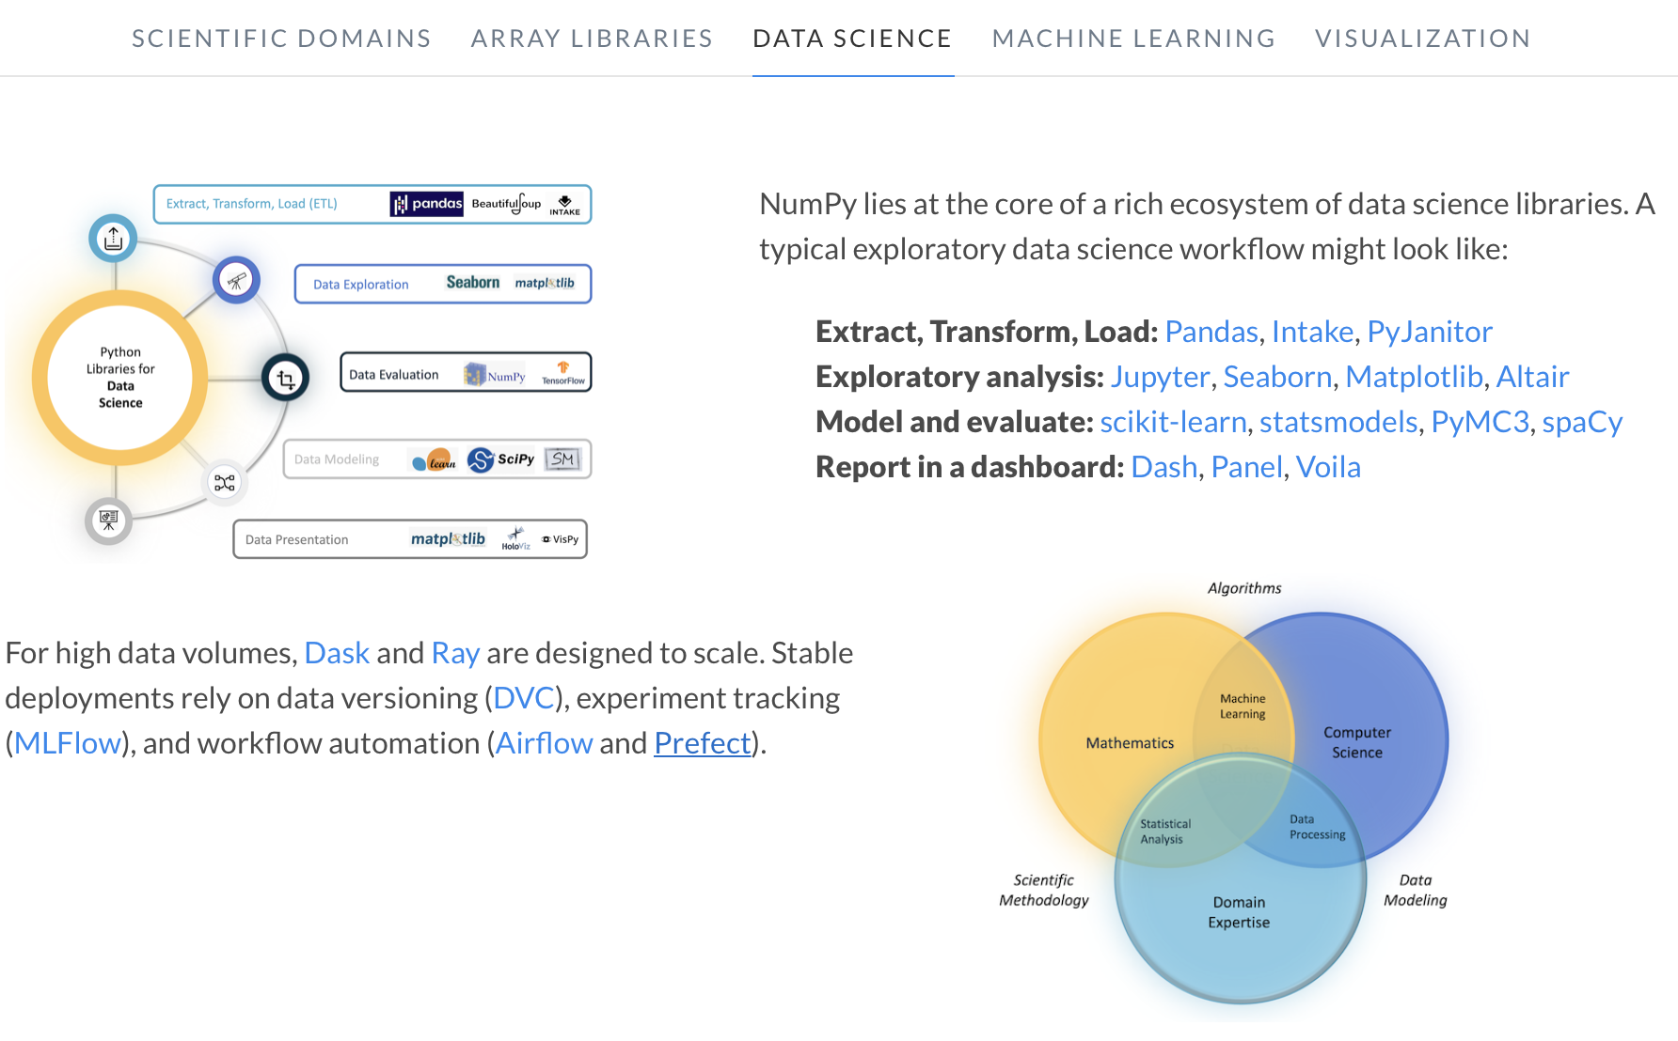
Math beyond SciPy/Numpy
Numpy “taxonomy” (numpy.org)
© 2025 NumPy team. All rights reserved. This content is
excluded from our Creative Commons license. For more
information, see https://ocw.mit.edu/help/faq-fair-use.

Slide 15
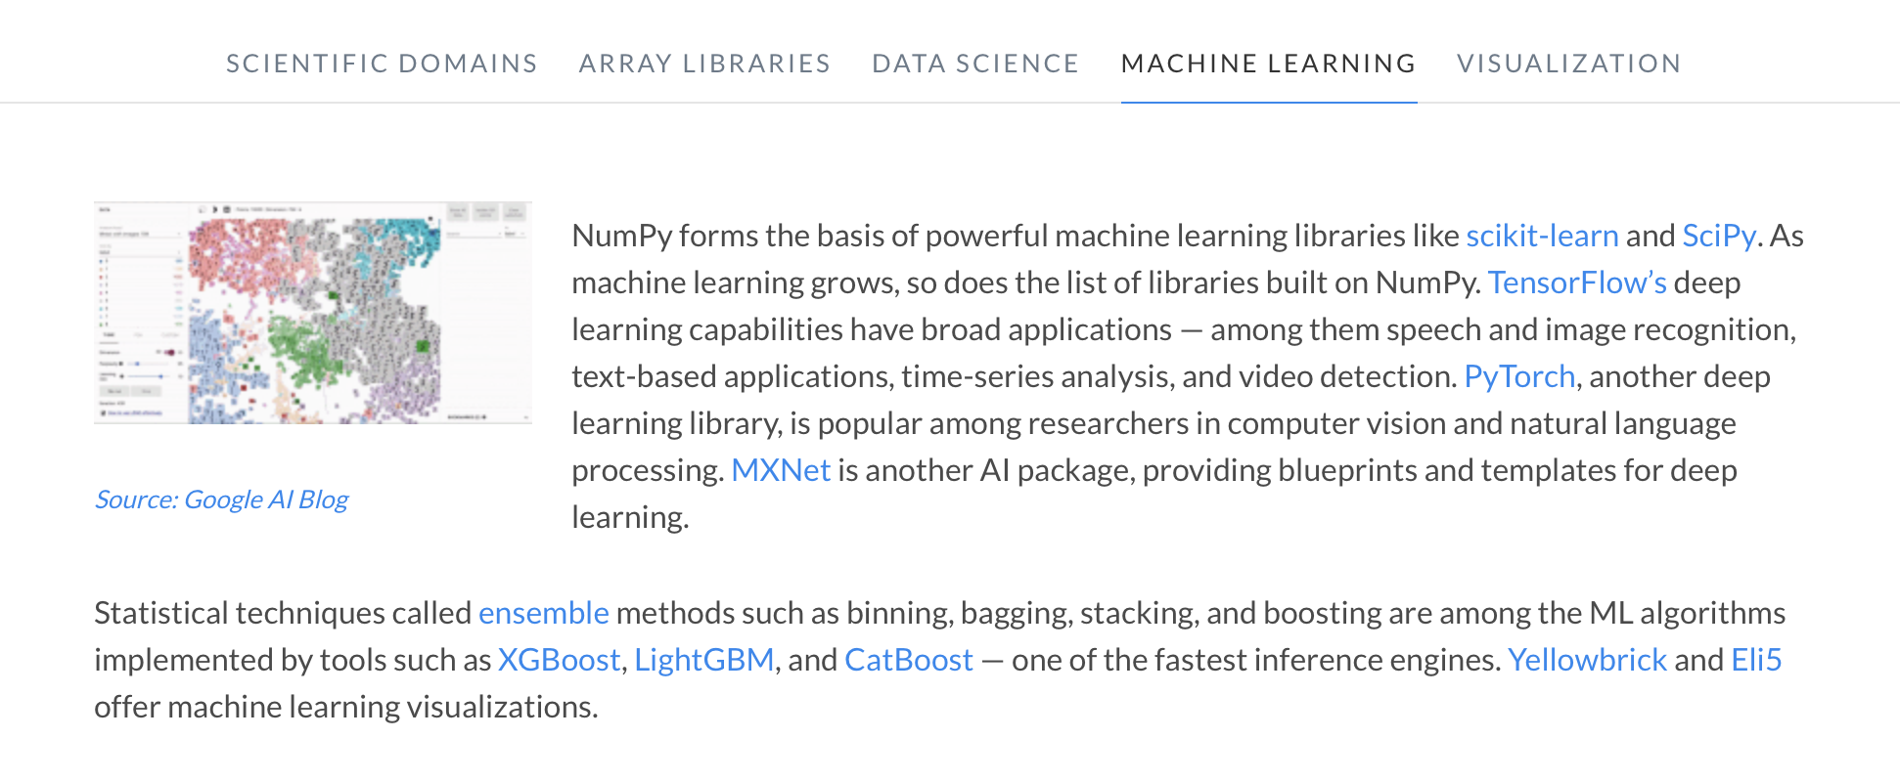
Math beyond SciPy/Numpy
Numpy “taxonomy” (numpy.org)
© Google. All rights reserved. This content is excluded from our Creative Commons
license. For more information, see https://ocw.mit.edu/help/faq-fair-use.

Slide 16
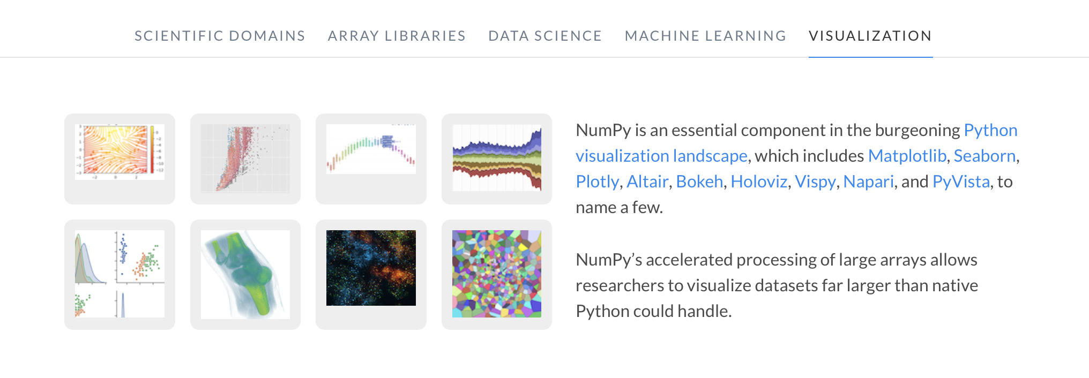
Math beyond SciPy/Numpy
Numpy “taxonomy” (numpy.org)
© 2025 NumPy team. All rights reserved. This content is
excluded from our Creative Commons license. For more
information, see https://ocw.mit.edu/help/faq-fair-use.

Slide 17
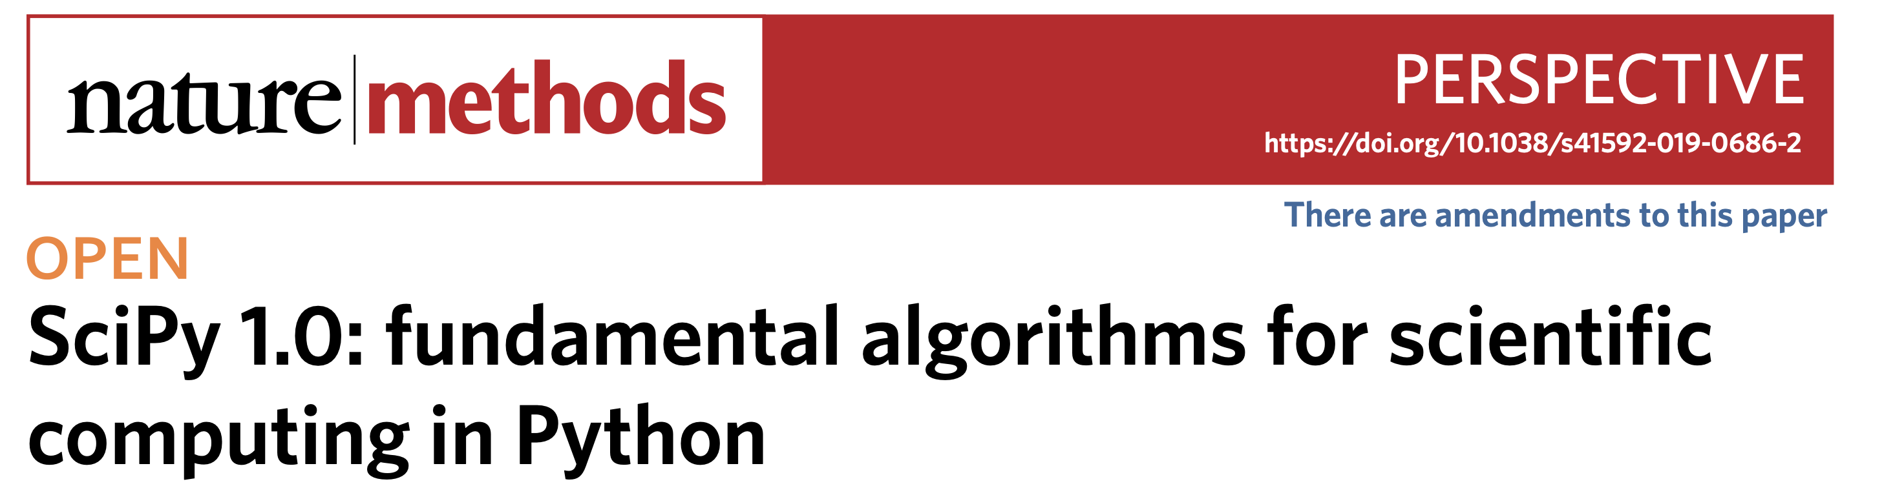
Math beyond SciPy/Numpy
https://www.nature.com/articles/s41592-019-0686-2.pdf
© 2025 Springer Nature Limited. All rights reserved. This content is excluded from our Creative
Commons license. For more information, see https://ocw.mit.edu/help/faq-fair-use.

Slide 18

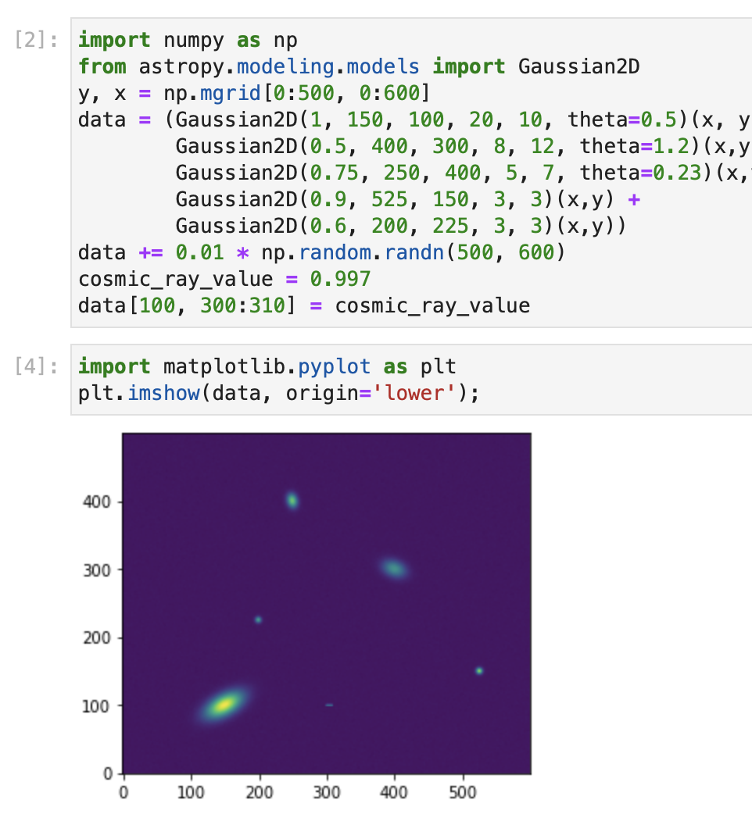
Astropy (https://astropy.org)
Example of an external package that has a lot of useful applications generally.
© 2013, Kyle Barbary. All rights reserved. This content is excluded from our Creative
Commons license. For more information, see https://ocw.mit.edu/help/faq-fair-use.

Slide 19

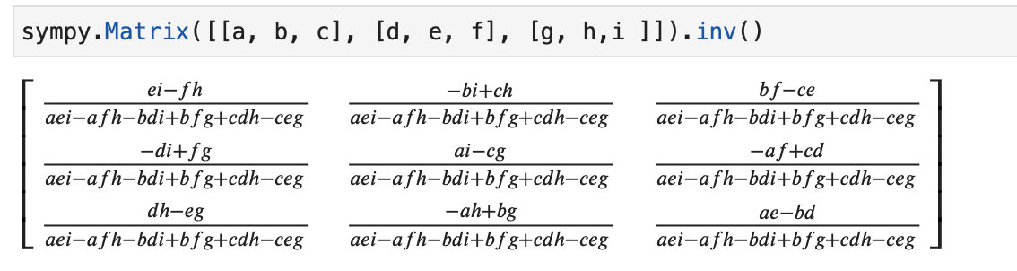
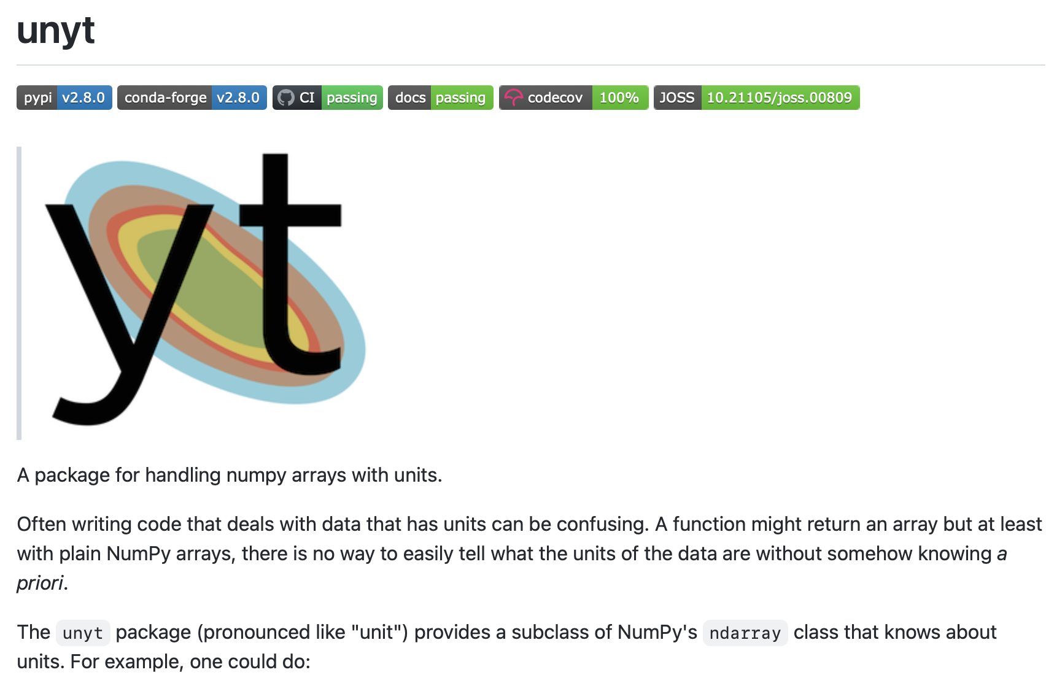
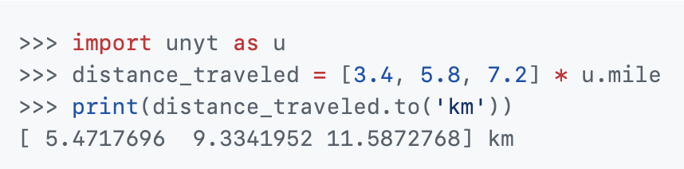
Sympy (https://www.sympy.org)
Symbolic manipulation
© Alexey U. Gudchenko. All rights reserved. This content is excluded from our Creative
Commons license. For more information, see https://ocw.mit.edu/help/faq-fair-use.
unyt (https://unyt.readthedocs.io)
© 2022 The yt Project . All rights reserved. This content is excluded from our Creative
Commons license. For more information, see https://ocw.mit.edu/help/faq-fair-use.

Slide 20
Try
Lec13_astropy-example.ipynb
Lec13_sympy-example.ipynb

Slide 21
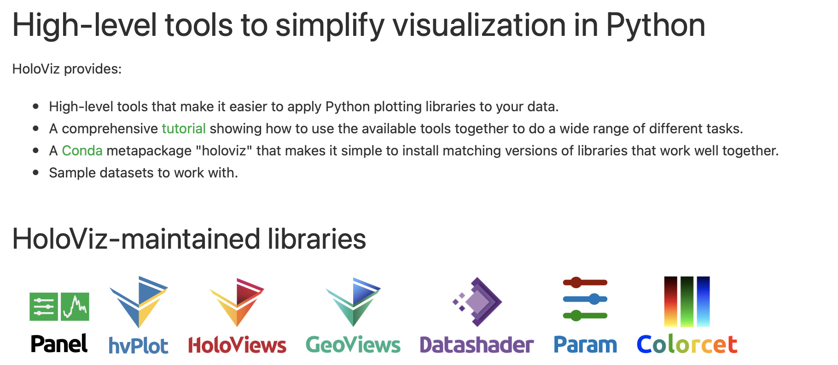
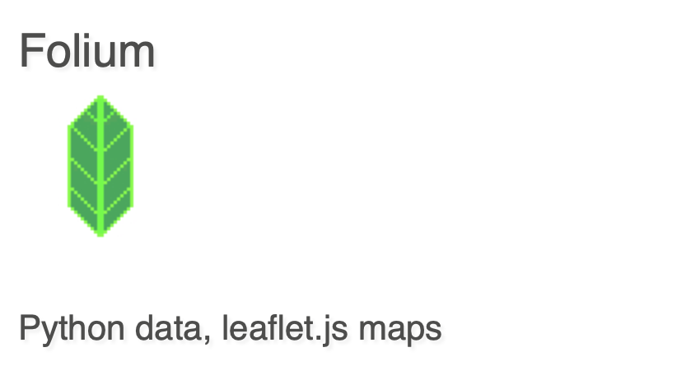
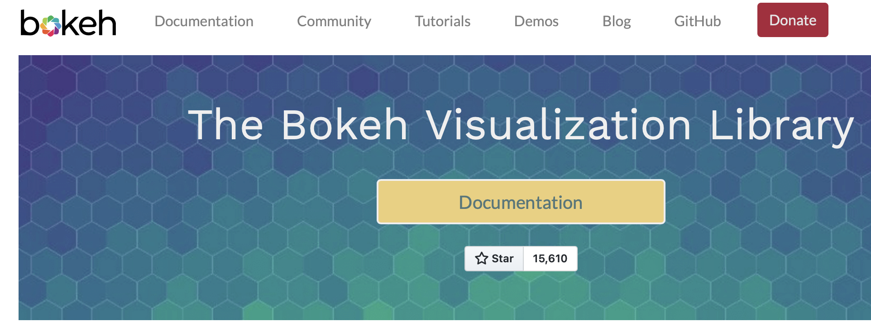
Jupyter Plotting beyond Matplotlib
Holoviz and Geoviews
Folium
Bokeh
© Source unknown. All rights reserved. This content is excluded from our Creative
Commons license. For more information, see https://ocw.mit.edu/help/faq-fair-use.
© Rob Story. All rights reserved. This content
is excluded from our Creative Commons
license. For more information, see
https://ocw.mit.edu/help/faq-fair-use.
© 2025 Bokeh contributors. All rights reserved. This content is excluded from our Creative
Commons license. For more information, see https://ocw.mit.edu/help/faq-fair-use.

Slide 22
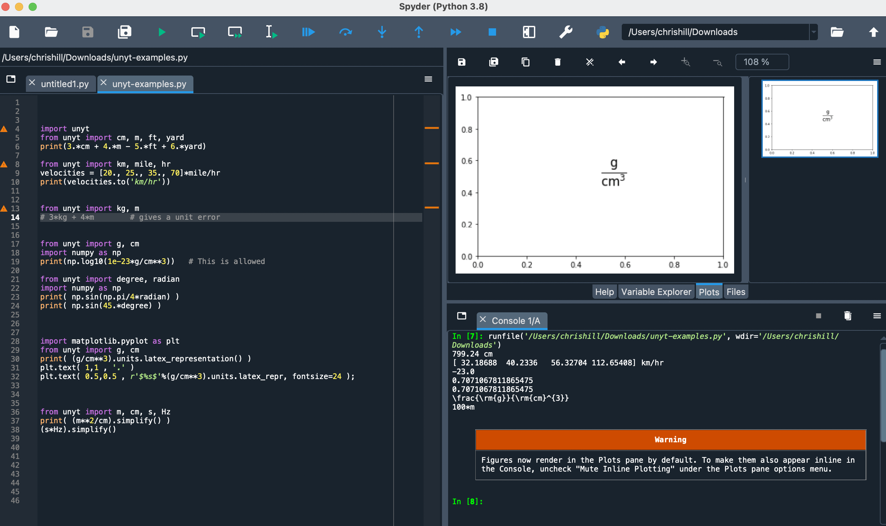
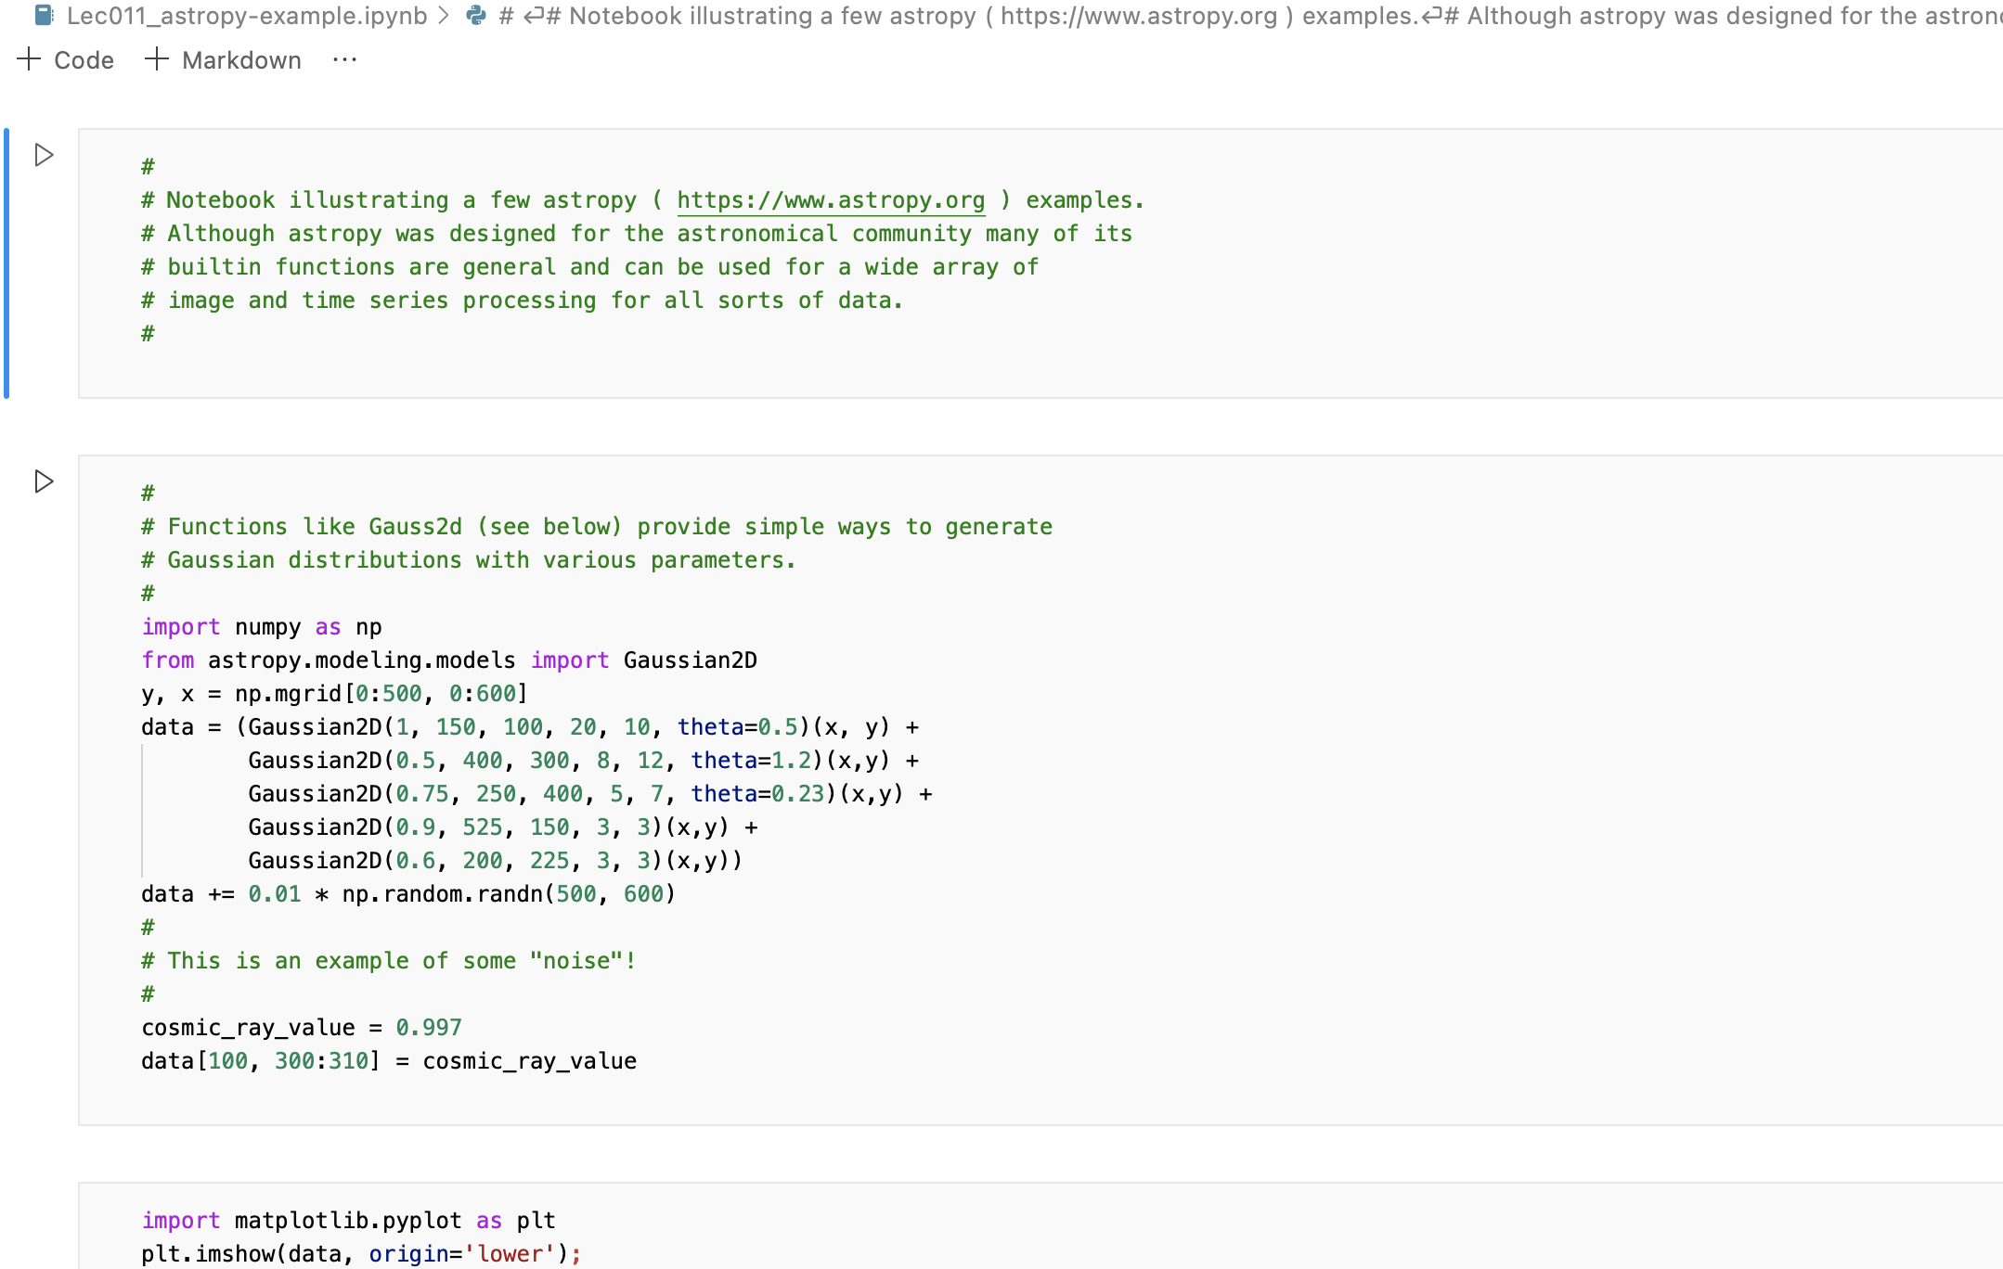
Non - Jupyter
Spyder
VS-code, github.dev/

Slide 23
MIT OpenCourseWare
https://ocw.mit.edu
12.010 Computational Methods of Scientific Programming, Fall 2024
For more information about citing these materials or our Terms of Use, visit https://ocw.mit.edu/terms.

