Slide 1
12.010 Computational Methods of Scientific Programming
Lecture 10: Code re-visits
Notes:
These slides were not used in 2023 (as of 10/23/2023).

Slide 2
Summary
Issues from notebooks that students want to look at?
Re-examine codes; clean-up and add documentation
polyarea
  Check the sign of area (code seemed to depend on int versus float)
  Crossing line issue: Algorithm to test
  Adding image and graphical selection of areas
OS check in my.style creation
Improvements to integrators and ODE solvers

Slide 3
OS check
One notebook used unix ! echo construction to create my.style. This works on unix and macosx but not windows
Check OS:
import sys
sys.platform
Returns darwin for mac, linux2 for my Ubuntu system?

Slide 4
Revisit tick marks
Update to last cell in Lec09_graphics.ipynb to change ticks with ax.tick_params

Slide 5
Revisit polyarea.ipynb
Issue with test of concave/convex with integers and floats
Graphical interface to get values into program: Use image to background of figure.
Axis to np.append in polyarea: Current works but could be improved
Crossing line code?

Slide 6

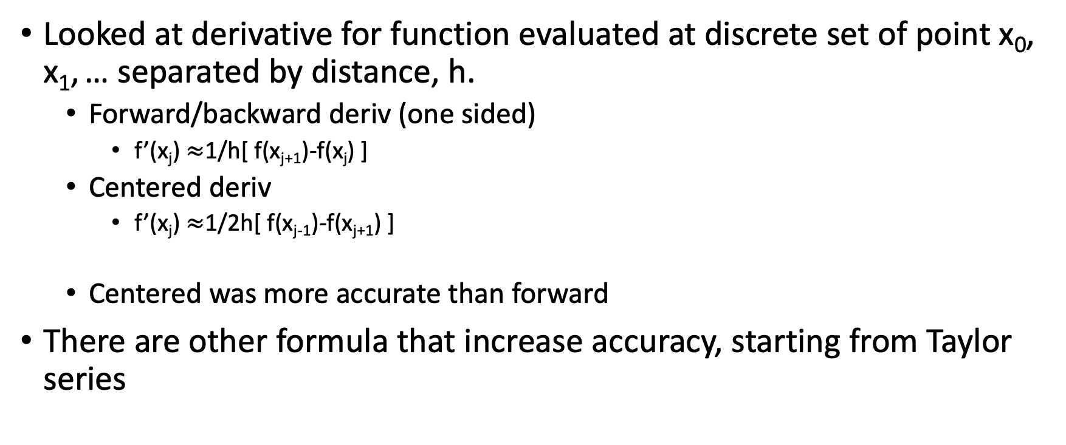
Derivatives revisit
Looked at derivative for function evaluated at discrete set of point x₀, x₁, … separated by distance, h.
  Forward/backward deriv (one sided)
    f’(x_{j}) $≈$1/h[ f(x_{j+1})-f(x_{j}) ]
  Centered deriv
    f’(x_{j}) $≈$1/2h[ f(x_{j-1})-f(x_{j+1}) ]
  Centered was more accurate than forward
There are other formula that increase accuracy, starting from Taylor series

Slide 7
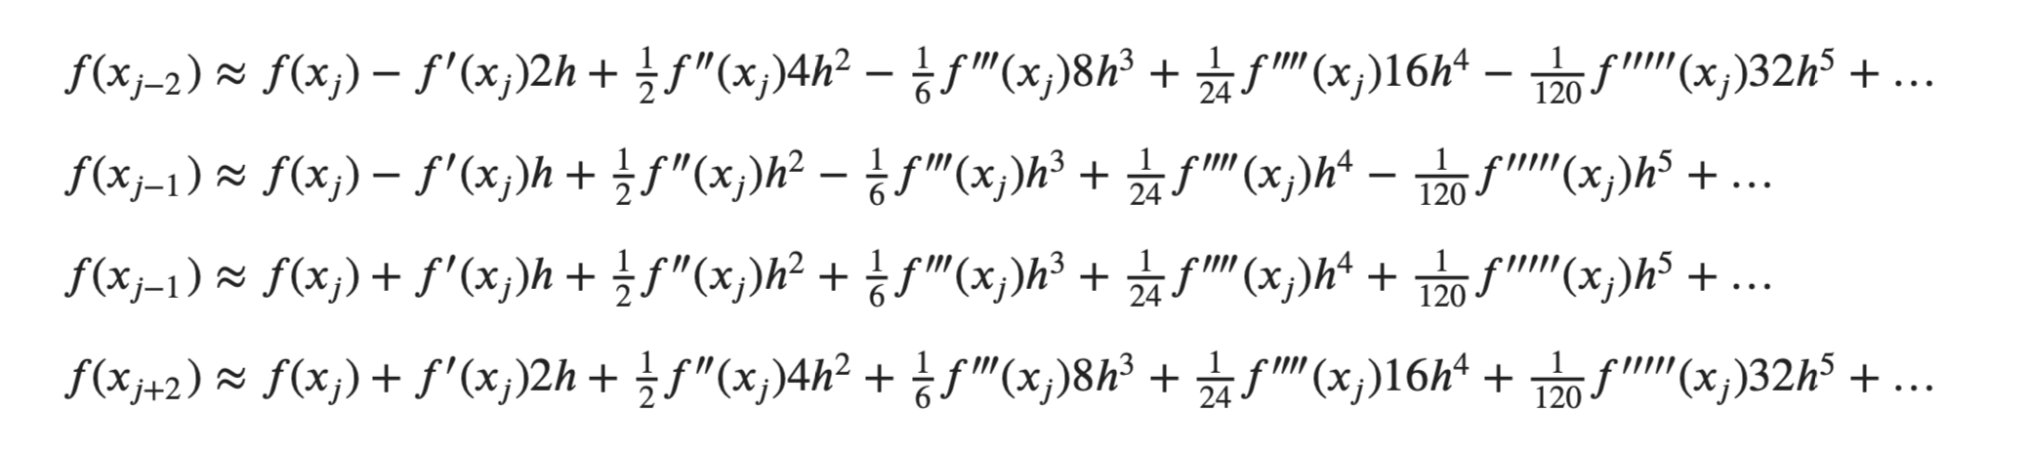
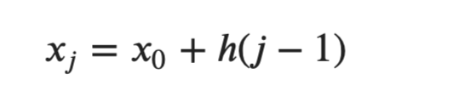
Derivatives revisit
➔
(1)
(2)
(3)
(4)

Slide 8
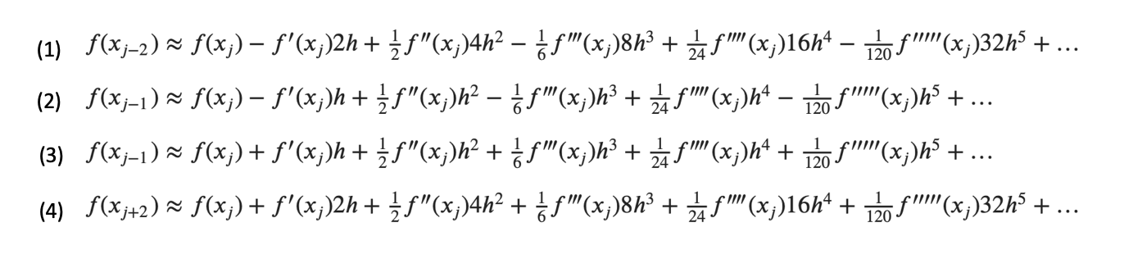
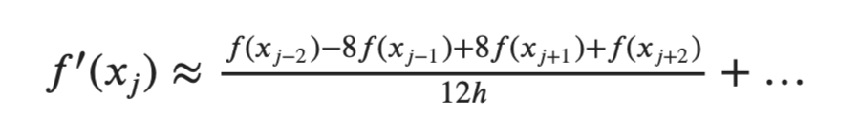
Derivatives revisit
1/(12h) { 8 x [ (2) – (3) ] – [ (4) – (1) ] }
➔

Slide 9
Derivatives revisit
Work through – Lec11-accurate-deriv.ipynb
  Add comments together to explain!

Slide 10
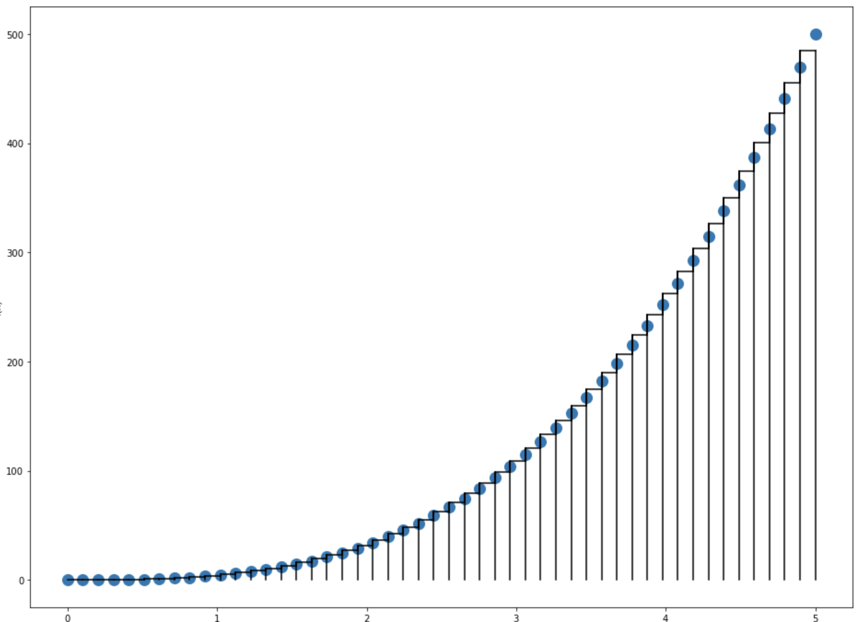
Integration revisit
We looked at trapezoidal method for integration in Lec05-integration.ipynb
More accurate approach
  Simpsons – fits quadratic

Slide 11
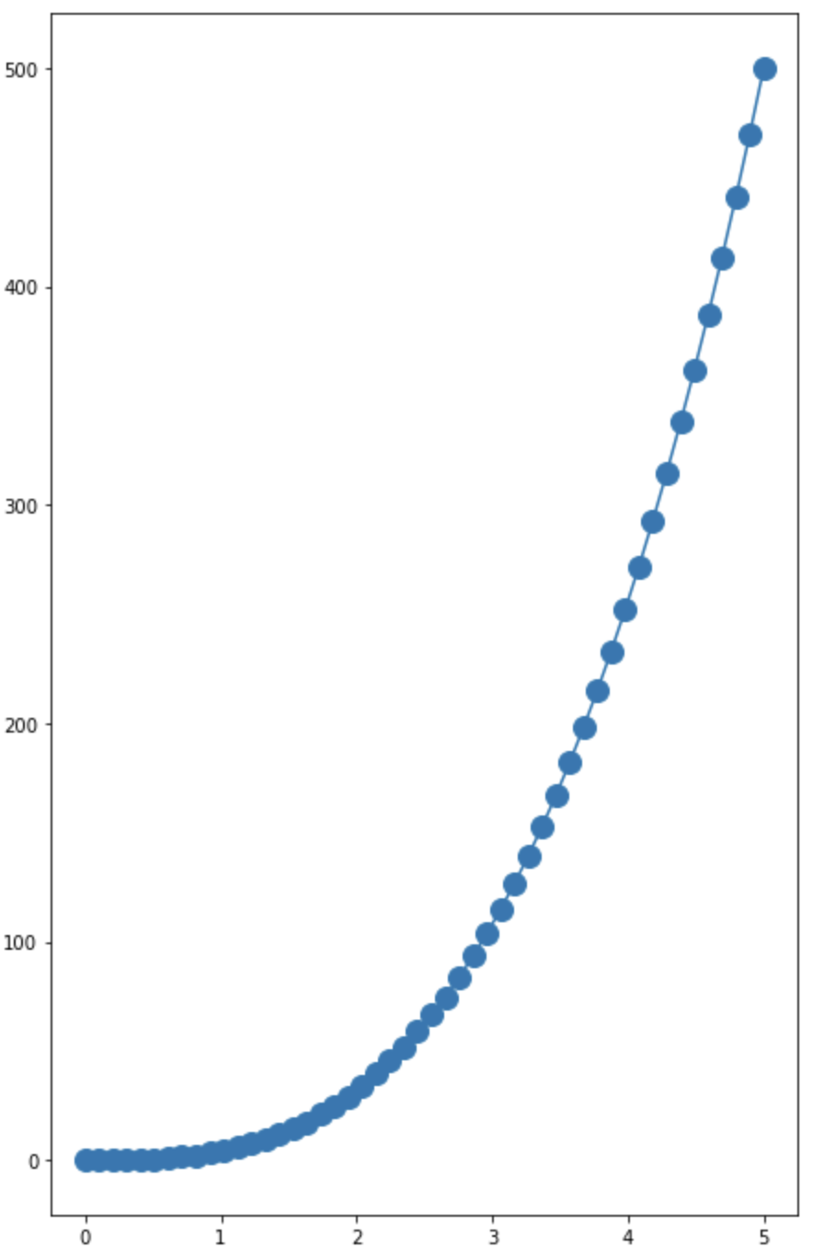
Integration revisit
Simpsons rule
  Fit quadratic curves to successive subintervals, each spanning 3-points.
  Requires an even number of sub-intervals.
    e.g. figure shows 3 successive sets of 3-points
    Covers 6 sub-intervals
    Simpson
      Fit separate quadratic (ax²+bx+c) to each set of 3-points
      Derive a simple formula for the area under each quadratic

Slide 12
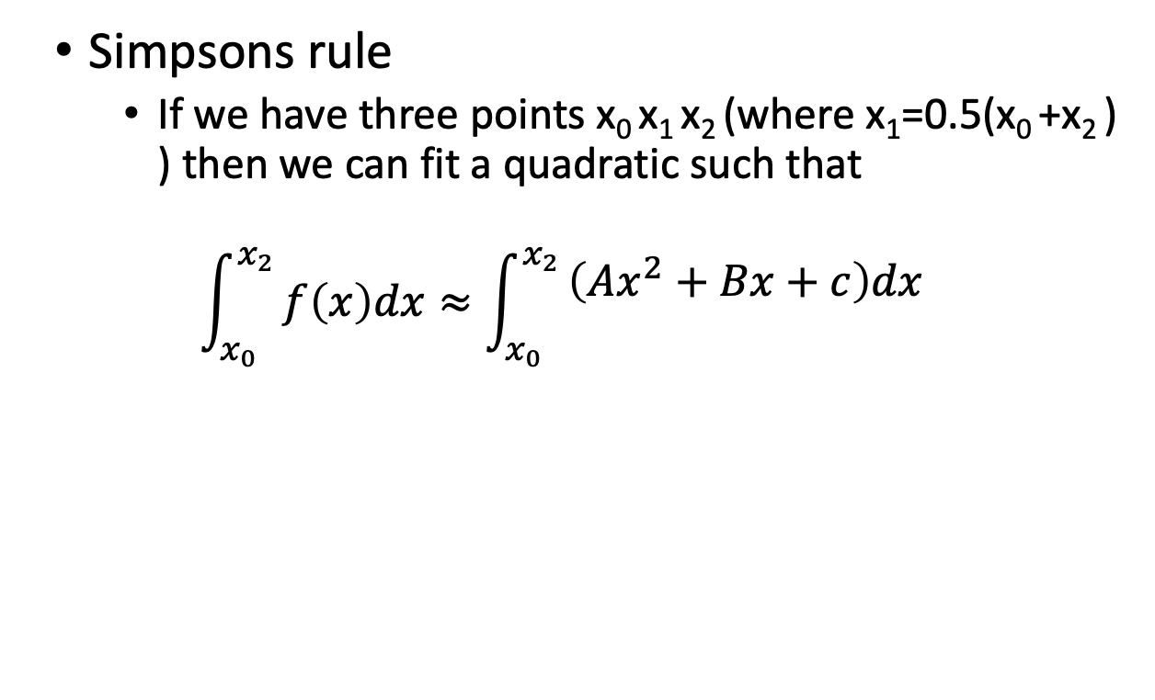
Integration revisit
Simpsons rule
  If we have three points x₀ x₁ x₂ (where x₁=0.5(x₀ +x₂ ) ) then we can fit a quadratic such that
  $$\int_{x_{0}}^{x_{2}}{f\left(x\right)dx≈\int_{x_{0}}^{x_{2}}{\begin{aligned}\left(Ax^{2}+Bx+c\right)dx \\ \end{aligned}}}$$

Slide 13
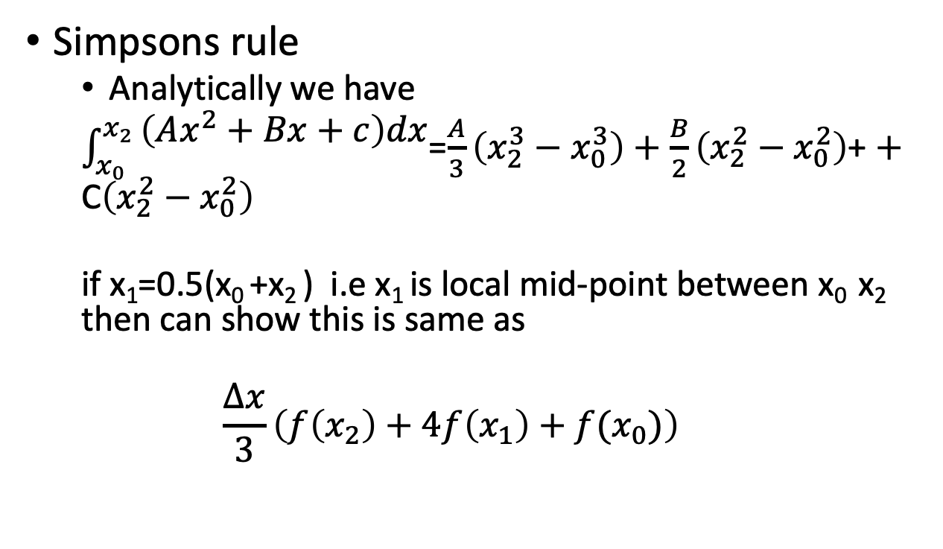
Integration revisit
Simpsons rule
  Analytically we have
  $\int_{x_{0}}^{x_{2}}{\begin{aligned}\left(Ax^{2}+Bx+c\right)dx \\ \end{aligned}}$=$\frac{A}{3}\left(x_{2}^{3}−x_{0}^{3}\right)+$ $\frac{B}{2}\left(x_{2}^{2}−x_{0}^{2}\right)$+ $+$ C$\left(x_{2}^{2}−x_{0}^{2}\right)$
  if x₁=0.5(x₀ +x₂ ) i.e x₁ is local mid-point between x₀ x₂ then can show this is same as
  $$\frac{∆x}{3}\left(f\left(x_{2}\right)+4f\left(x_{1}\right)+f(x_{0})\right)$$
f(x)
x

Slide 14
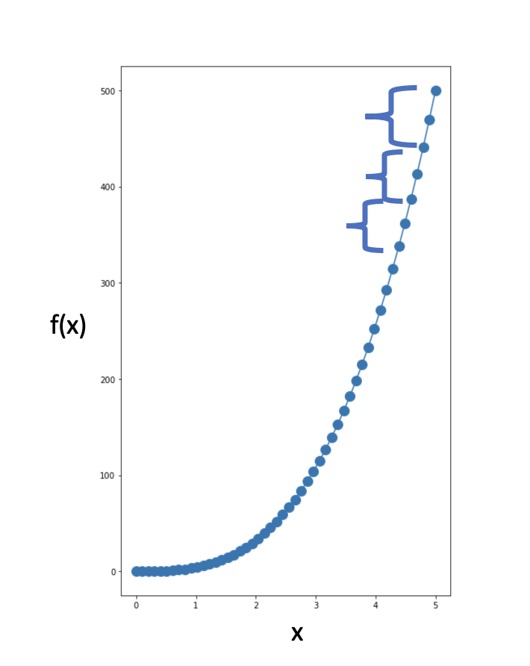
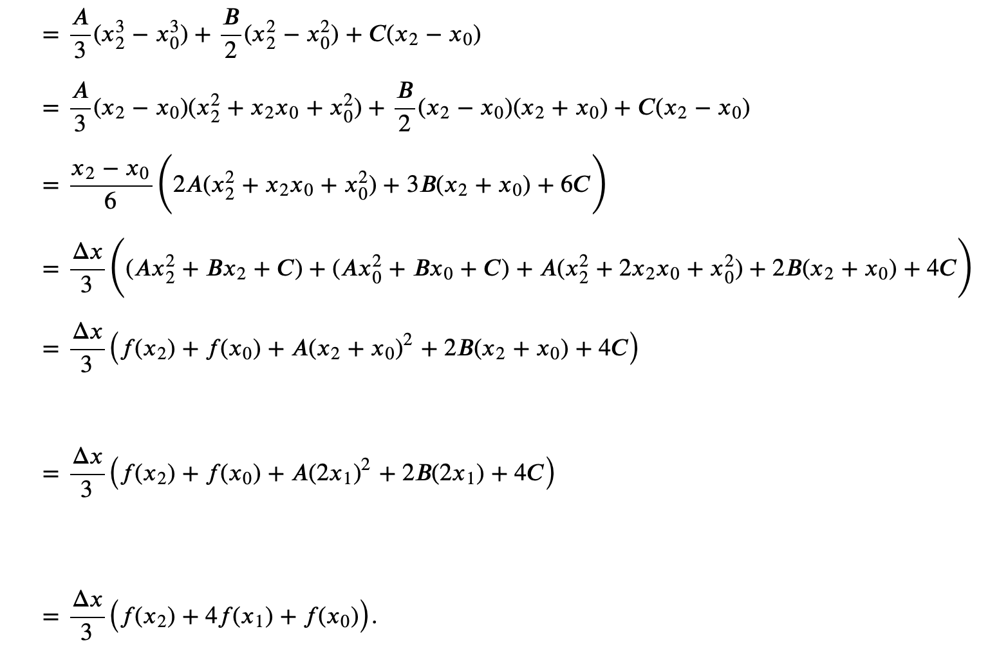
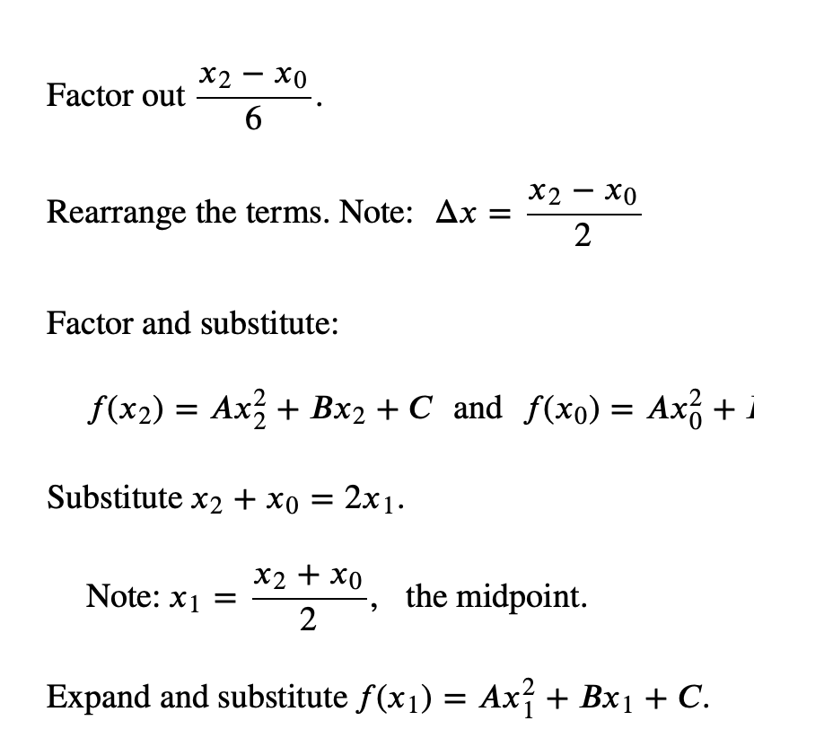
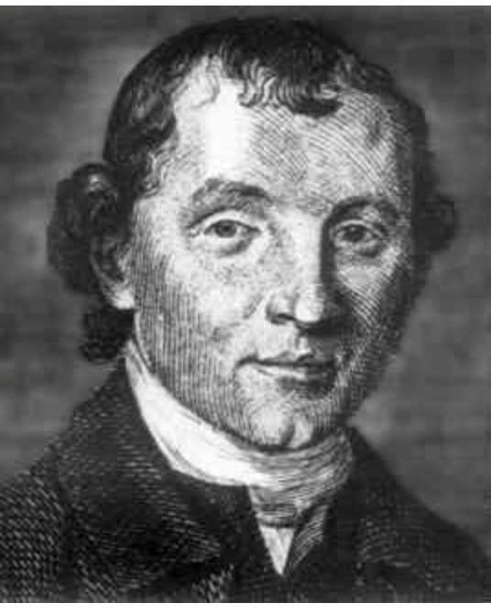
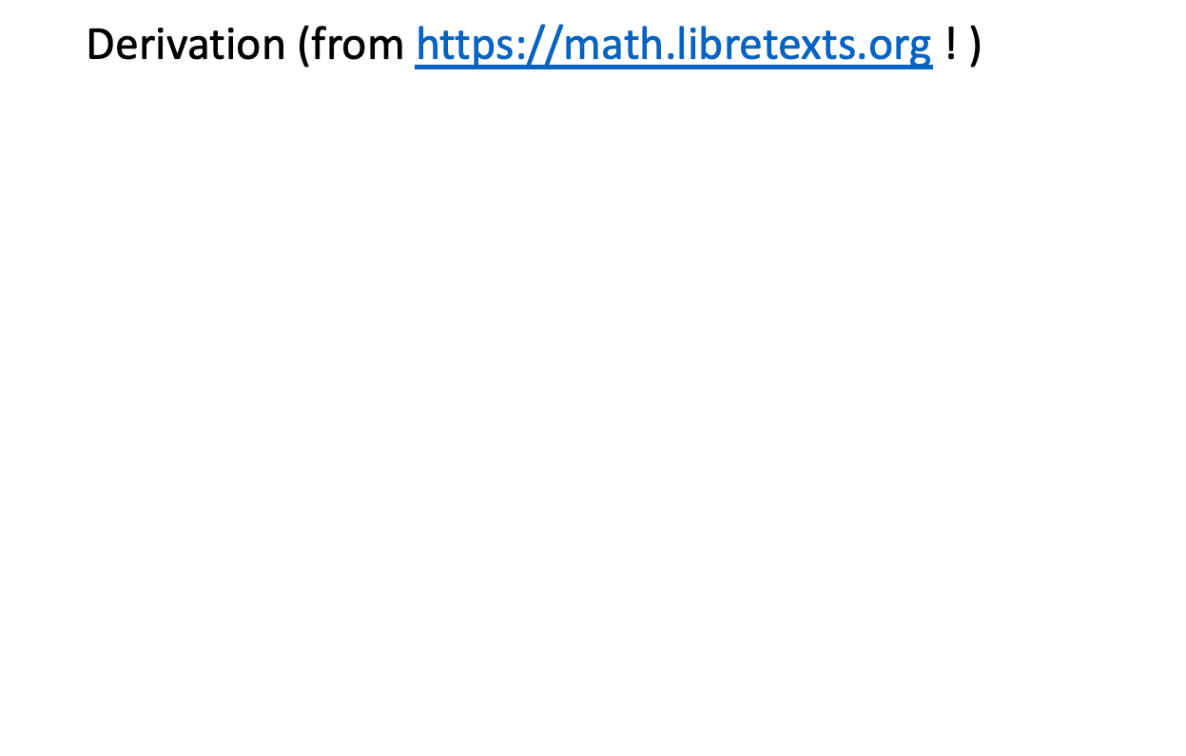
Integration revisit
© Edu Care Theme by drupalthemes.io. All
rights reserved. This content is excluded from our
Creative Commons license. For more information,
see https://ocw.mit.edu/help/faq-fair-use.
  Derivation (from https://math.libretexts.org ! )
1710-1761
(also Keplersche Fassregel, 100 years before!)

Slide 15
Integration revisit
  Try Lec11-accurate-integral.ipynb

Slide 16
MIT OpenCourseWare
https://ocw.mit.edu
12.010 Computational Methods of Scientific Programming, Fall 2024
For more information about citing these materials or our Terms of Use, visit https://ocw.mit.edu/terms.

