Slide 1
12.010 Computational Methods of Scientific Programming 2021
Lecture 8: Graphics

Slide 2
Summary
Graphics: Types
  Raster/image graphics
  Vector graphics (postscript, PDF)
Python Graphics modules
  Examine different plot types and use of methods and objects
The notebook for this class is Lec09_graphics.ipynb on Canvas site.

Slide 3
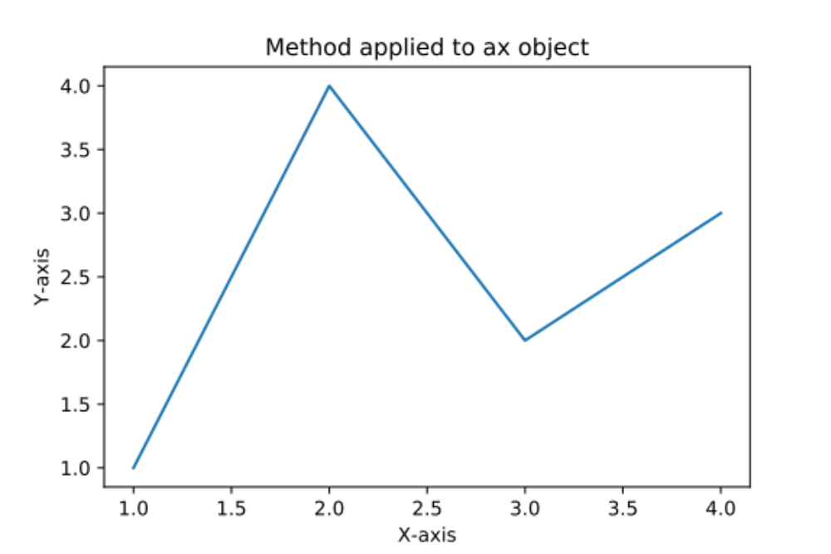
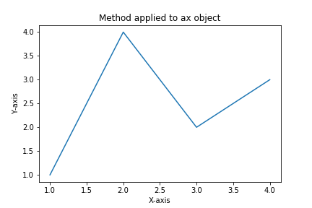
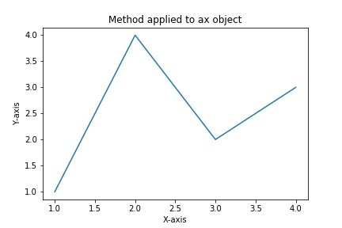
Types of graphics files
Graphics files fall into two basic types:
  Vector (ps, pdf, svg)
  Raster or pixel files (png, jpeg, gif)
PDF is the preferred method for publishing papers and reports because the resolution is maintained with scaling (and zooming of the figure). Examples below (PDF, PNG, JPEG 50% scaling). However, PC Word does not allow insert of PDF files, Mac does).

Slide 4
Now zoom and crop the same figures
PDF, PNG, JPEG

Slide 5
File sizes
For the simple figure here, file sizes are similar (file size in bytes)
19156 Lec09_fig.jpg
10640 Lec09_fig.pdf
16232 Lec09_fig.png
For graphics objects with lots of overlapping points and lines. PDF can be much larger than PNG because all points are retained in PDF (and postscript). PDF figures can be edited in Adobe Illustrator.
PNG can work well if created at the size that it is needed.
Could look at these figures in Preview to see differences as well. (The Lec09_graphics.ipynb generates the figures shown here).

Slide 6
Python methods for creating graphics*
The Lec09_graphics.ipynb shows three different approaches, with the latter two being the preferred:
Use %matplotlib magic to create interactive figures (we will come back to this later)
Basic: Modules loading into the current namespace
from matplotlib.pyplot import * (or list of functions).

Slide 7
Use of object methods
import matplotlib.pyplot as plt
Different methods are applied with plt to current figure and axes.
With this approach ‘plot’ could be different functions from different modules. pyplot is loaded into its own namespace.

Slide 8
Use of object oriented (OO) method
Similar to the previous approach but figure and axis objects are created, and methods applied to the object.
Very similar to the previous slide, but some methods have different names

Slide 9
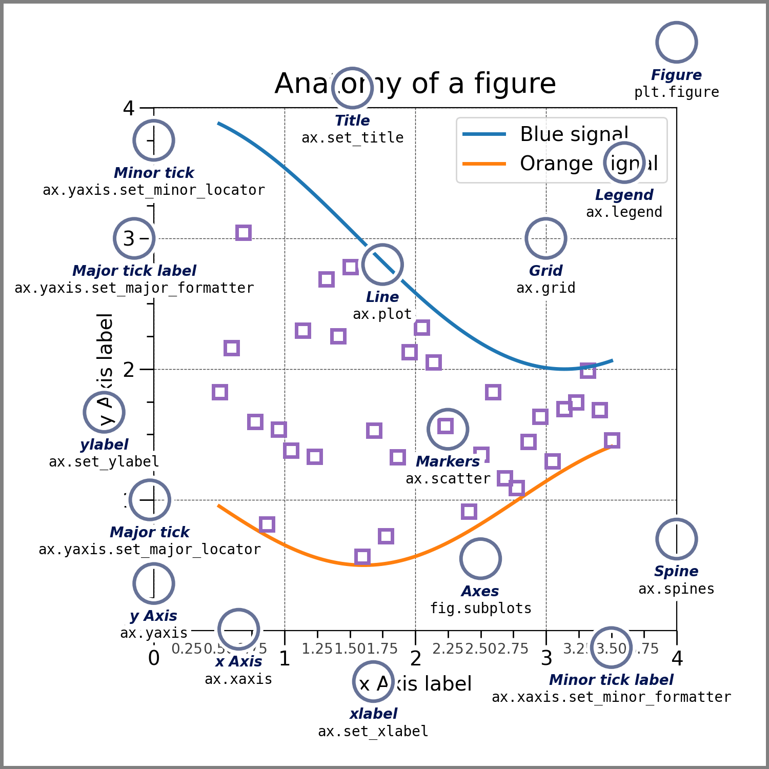
Figure components
Parts of figures
© 2002–2012 John Hunter, Darren Dale, Eric Firing,
Michael Droettboom and the Matplotlib development
team; 2012–2025 The Matplotlib development team.
All rights reserved. This content is excluded from our
Creative Commons license. For more information,
see https://ocw.mit.edu/help/faq-fair-use.
From: https://matplotlib.org/stable/tutorials/introductory/usage.html

Slide 10
Controlling and setting matplotlib style*
There are multiple ways to control the style of matplotlib plots
Options can be included in the plot/axis, etc calls
For the overall style applied to all plots, use rcParams. These can be set with a configuration file or in code (better for exporting code)
Full documentation at:
https://matplotlib.org/stable/api/matplotlib_configuration_api.html#matplotlib.rcParams
Create a style file and plt.style.use('my.style’)
Set with matplotlib.rcParams['lines.linewidth'] = 2
Restore defaults: matplotlib.rc_file_defaults and matplotlib.style.use(‘default’)
matplotlib.rcParams.keys() to see all keys,

Slide 11
Documentation and examples
URL
https://matplotlib.org/stable/gallery/index.html
Look down Examples to see the type of plot you want. Py and ipynb codes are available, which can be modified for your specific problem.
We show some examples
© 2002–2012 John Hunter, Darren Dale, Eric Firing,
Michael Droettboom and the Matplotlib development
team; 2012–2025 The Matplotlib development team.
All rights reserved. This content is excluded from our
Creative Commons license. For more information,
see https://ocw.mit.edu/help/faq-fair-use.

Slide 12
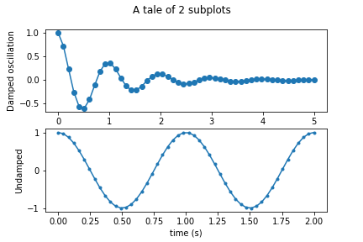
Tutorial from Matplotlib*
Subplots: 2 approaches in Lec09_graphics.ipynb

Slide 13
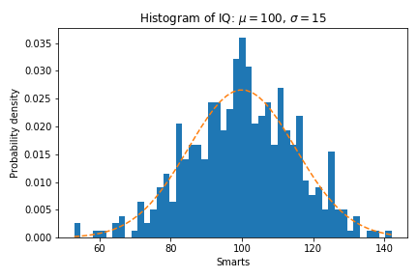
Histogram
Random + expectation

Slide 14
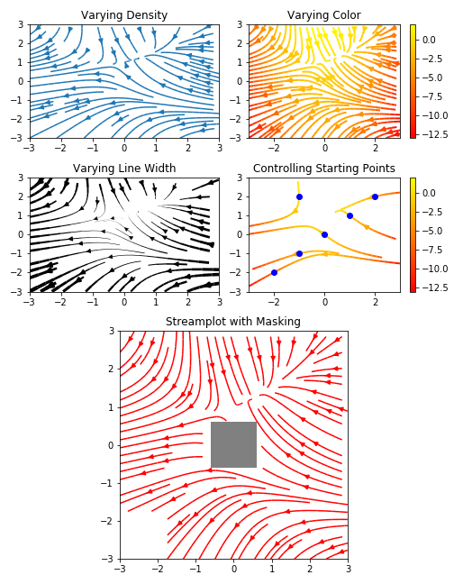
Stream plots
Combination of plots
© 2002–2012 John Hunter, Darren Dale, Eric Firing,
Michael Droettboom and the Matplotlib development
team; 2012–2025 The Matplotlib development team.
All rights reserved. This content is excluded from our
Creative Commons license. For more information,
see https://ocw.mit.edu/help/faq-fair-use.

Slide 15
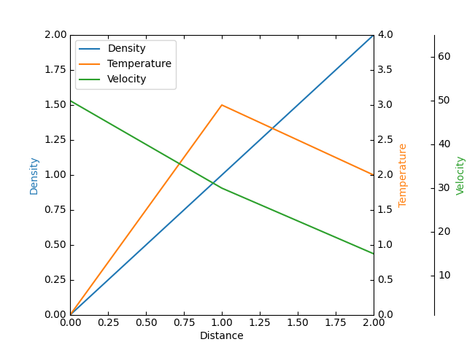
Multiple and offset axes
Original case
https://matplotlib.org/stable/gallery/axisartist/demo_parasite_axes.html#sphx-glr-gallery-axisartist-demo-parasite-axes-py
© 2002–2012 John Hunter, Darren Dale, Eric Firing,
Michael Droettboom and the Matplotlib development
team; 2012–2025 The Matplotlib development team.
All rights reserved. This content is excluded from our
Creative Commons license. For more information,
see https://ocw.mit.edu/help/faq-fair-use.
Notes:
To here 9/30/2021

Slide 16
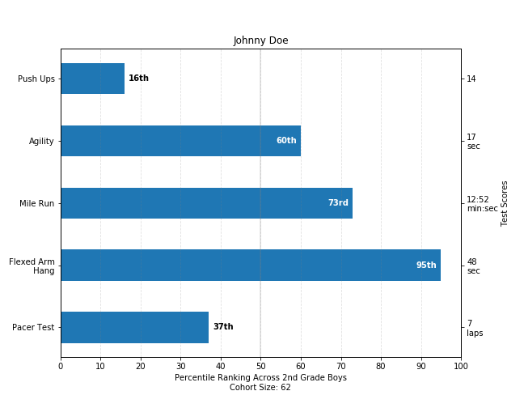
Bar graphs
Many additional features

Slide 17
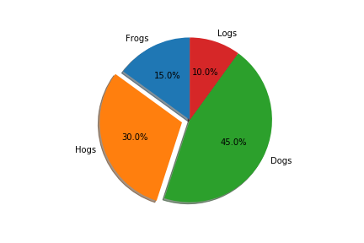
Pie Charts
With exploded segment

Slide 18
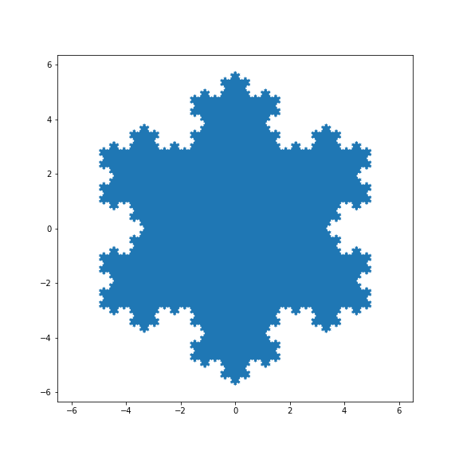
Filled polygon
More options in notebook
© 2002–2012 John Hunter, Darren Dale, Eric Firing,
Michael Droettboom and the Matplotlib development
team; 2012–2025 The Matplotlib development team.
All rights reserved. This content is excluded from our
Creative Commons license. For more information,
see https://ocw.mit.edu/help/faq-fair-use.

Slide 19
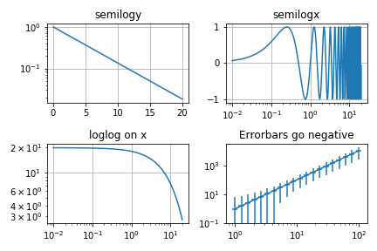
Log plots
Some issues with tutorial code

Slide 20
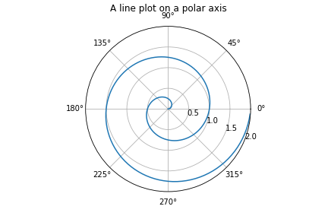
Polar plot
Spiral

Slide 21
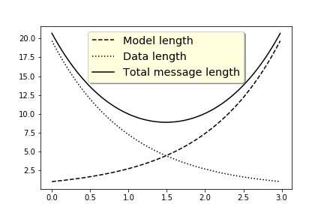
Legends
Set colors

Slide 22
Summary
Lots of good examples but be careful of the version of matplotlib – not all work with anaconda installation.
  In some cases this is due to differences between versions
  One case bug in current code or change between versions that no longer works.
The next discussion is on Graphical User Interfaces (GUI) and interaction with plots. It is not straightforward and version and installation-dependent.
Notes:
Additional slides next that are in Lec08 as well. Reached here 2021 class.

Slide 23
Math rendering
Examples: Renders in the notebook, but figure save is blank. Examine why this is the case in the notebook.
Issue related to show() usage.

Slide 24
MIT OpenCourseWare
https://ocw.mit.edu
12.010 Computational Methods of Scientific Programming, Fall 2024
For more information about citing these materials or our Terms of Use, visit https://ocw.mit.edu/terms.

