Slide 1
12.010 Computational Methods of Scientific Programming
Tom Herring, tah@mit.edu
Chris Hill, cnh@mit.edu
Lecture 6: Solving problems numerically

Slide 2
Topics
Numerical methods:
  Differentiation
  Integration
Numpy Scipy modules
ODE solution (using modules from internet)
Questions on Homework #1?

Slide 3
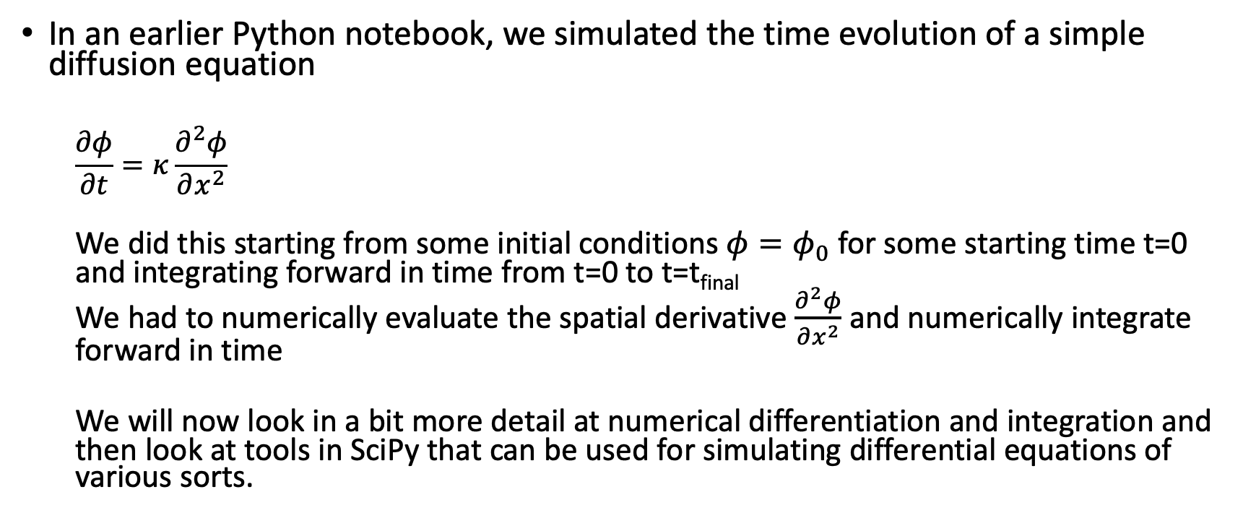
Numerical methods: Differentiation
In an earlier Python notebook, we simulated the time evolution of a simple diffusion equation
  $$\frac{∂φ}{∂t}=κ\frac{∂^{2}φ}{∂x^{2}}$$
  We did this starting from some initial conditions $φ=φ_{0}$for some starting time t=0 and integrating forward in time from t=0 to t=t_{final}
  We had to numerically evaluate the spatial derivative $\frac{∂^{2}φ}{∂x^{2}}$ and numerically integrate forward in time
  We will now look in a bit more detail at numerical differentiation and integration and then look at tools in SciPy that can be used for simulating differential equations of various sorts.

Slide 4
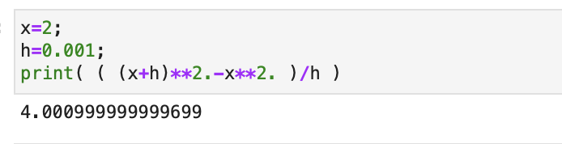
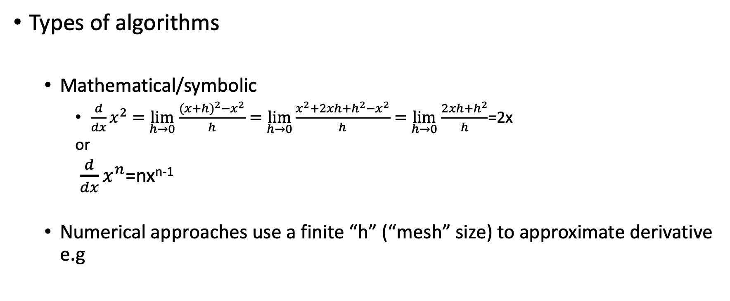
Numerical methods: Differentiation
Types of algorithms
  Mathematical/symbolic
    $\frac{d}{dx}x^{2}=$ $\lim_{h→0}$ $\frac{{(x+h)}^{2}−x^{2}}{h}=$ $\lim_{h→0}\frac{x^{2}+2xh+h^{2}−x^{2}}{h}=$ $\lim_{h→0}$ $\frac{2xh{+h}^{2}}{h}$=2x
    or
  $\frac{d}{dx}x^{n}$=nx^{n-1}
  Numerical approaches use a finite “h” (“mesh” size) to approximate derivative e.g

Slide 5
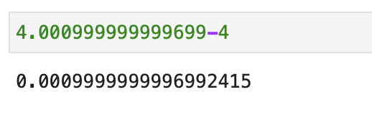
Numerical methods: Differentiation
Error estimating
  With step size of h=0.001
  The error is
  Can we just keep reducing step size to get more accuracy?
Notes:
What happens if we used (x+h/2)**2-(x-h/2)**2?

Slide 6
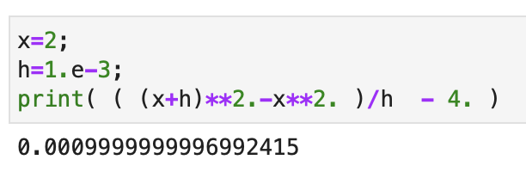
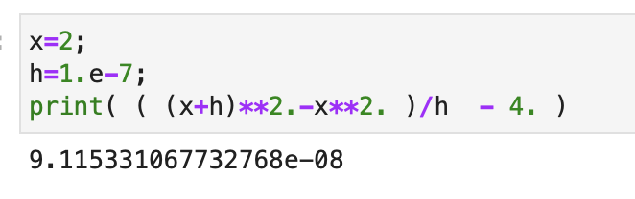
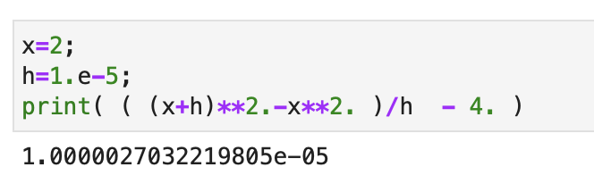
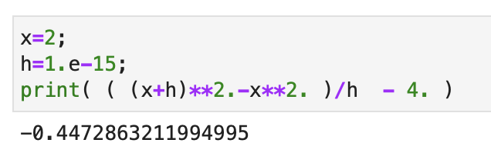
Numerical methods: Differentiation
Lets try reducing step size
works up to a point, but then finite precision numbers start to limit

Slide 7
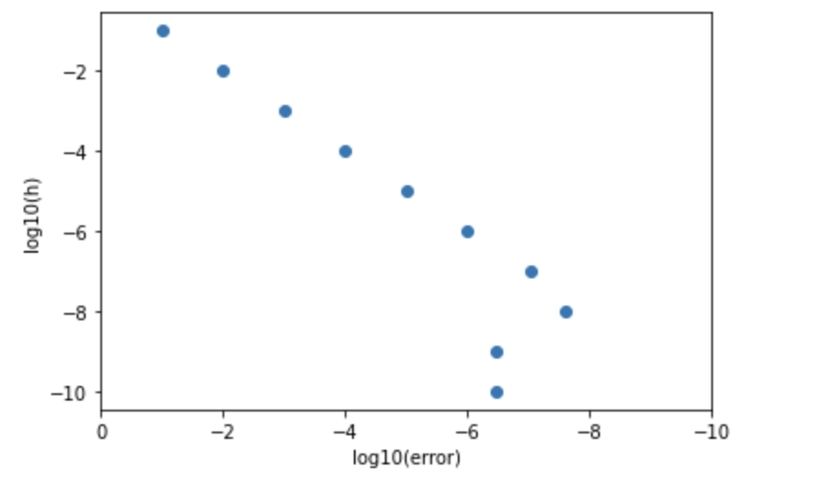
Numerical methods: Differentiation*
We can test reducing step size in a notebook
Error gets smaller with step size, to a point. Then numerical truncation impacts.
Later we will look in libraries to help with this.
Smaller step size
Smaller step error

Slide 8
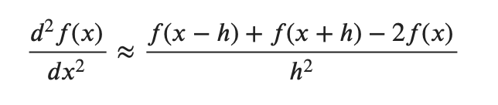
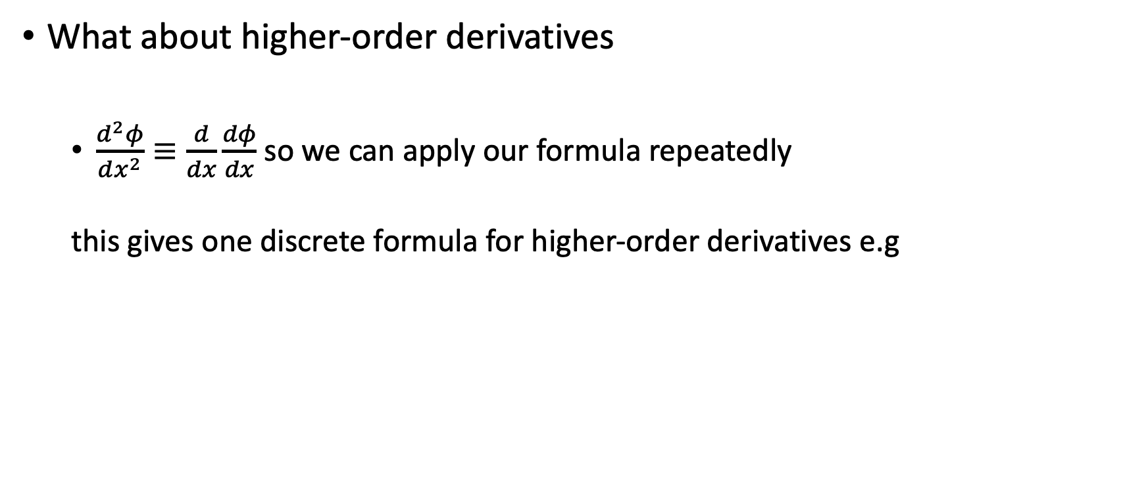
Numerical methods: Differentiation
What about higher-order derivatives
  $\frac{d^{2}φ}{dx^{2}}≡\frac{d}{dx}\frac{dφ}{dx}$ so we can apply our formula repeatedly
  this gives one discrete formula for higher-order derivatives e.g

Slide 9
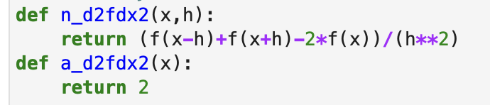
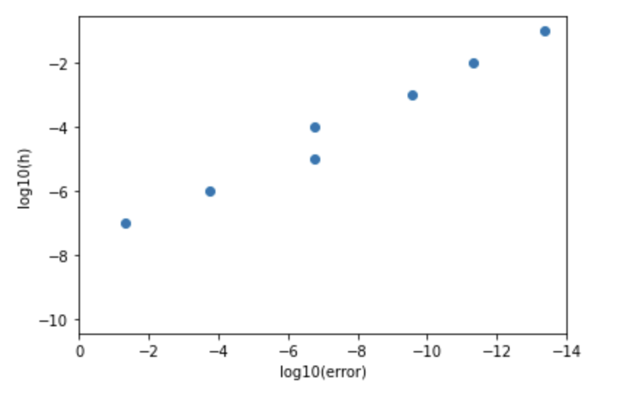
Numerical methods: Differentiation
Testing a second order derivative for f(x)=x² with x=2
Smaller step size
in this case we find smallest error (10⁻¹³) is for largest step size (h=0.1)!
Smaller numerical error

Slide 10
Numerical methods: Differentiation
Try with notebook Lec06-deriv.ipynb

Slide 11
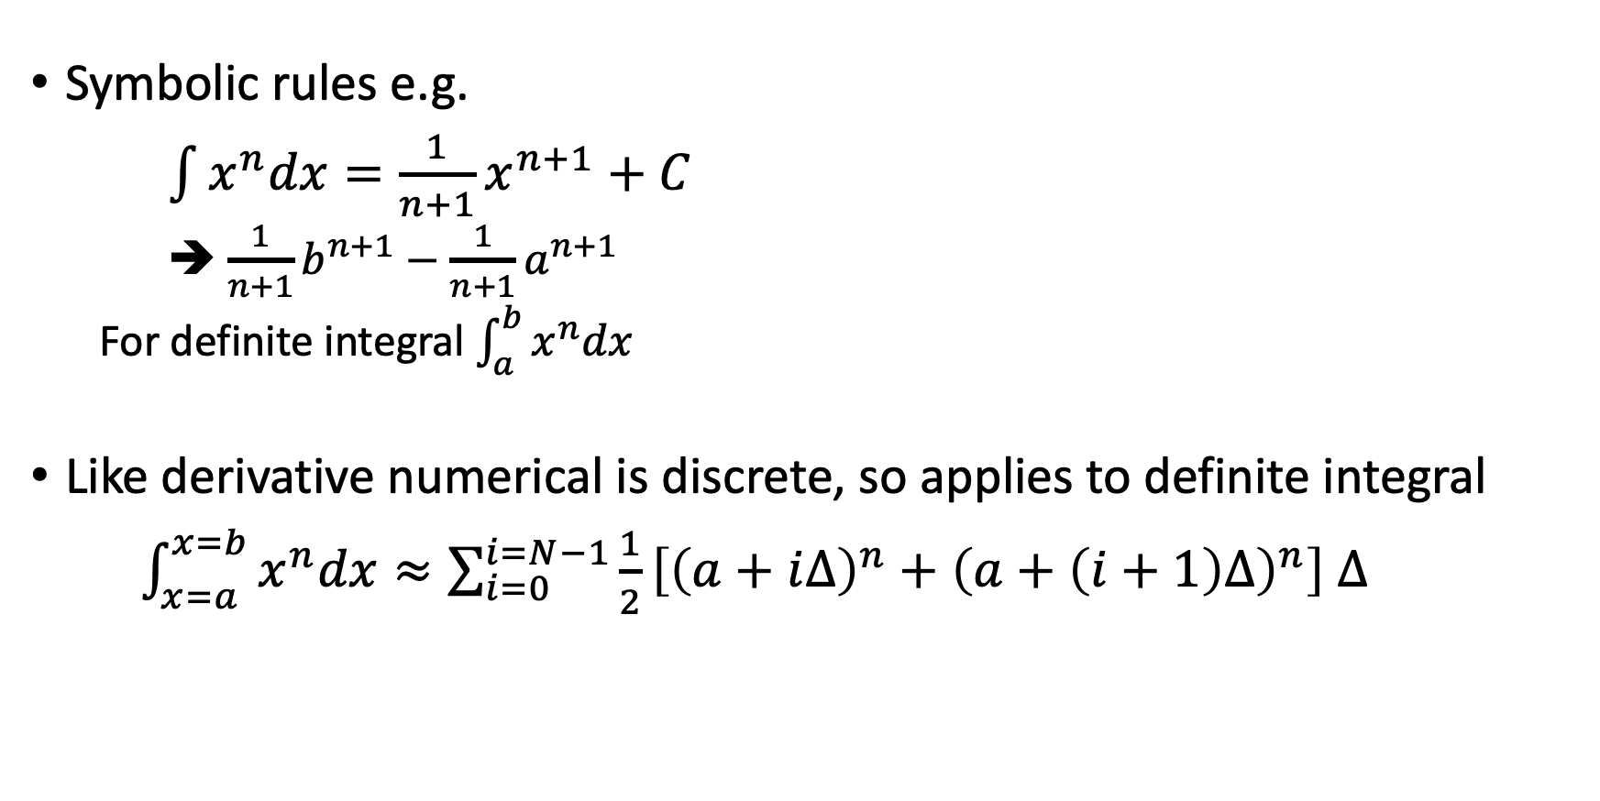
Numerical methods: Integration
Symbolic rules e.g.
$\int{x^{n}dx=\frac{1}{n+1}x^{n+1}+C}$
  ➔ $\frac{1}{n+1}b^{n+1}−$ $\frac{1}{n+1}a^{n+1}$
  For definite integral $\int_{a}^{b}{x^{n}dx}$
Like derivative numerical is discrete, so applies to definite integral
$\int_{x=a}^{x=b}{x^{n}dx}≈\sum_{i=0}^{i=N−1}{\frac{1}{2}\left[{\left(a+i∆\right)}^{n}+{\left(a+\left(i+1\right)∆\right)}^{n}\right]}$ $∆$

Slide 12
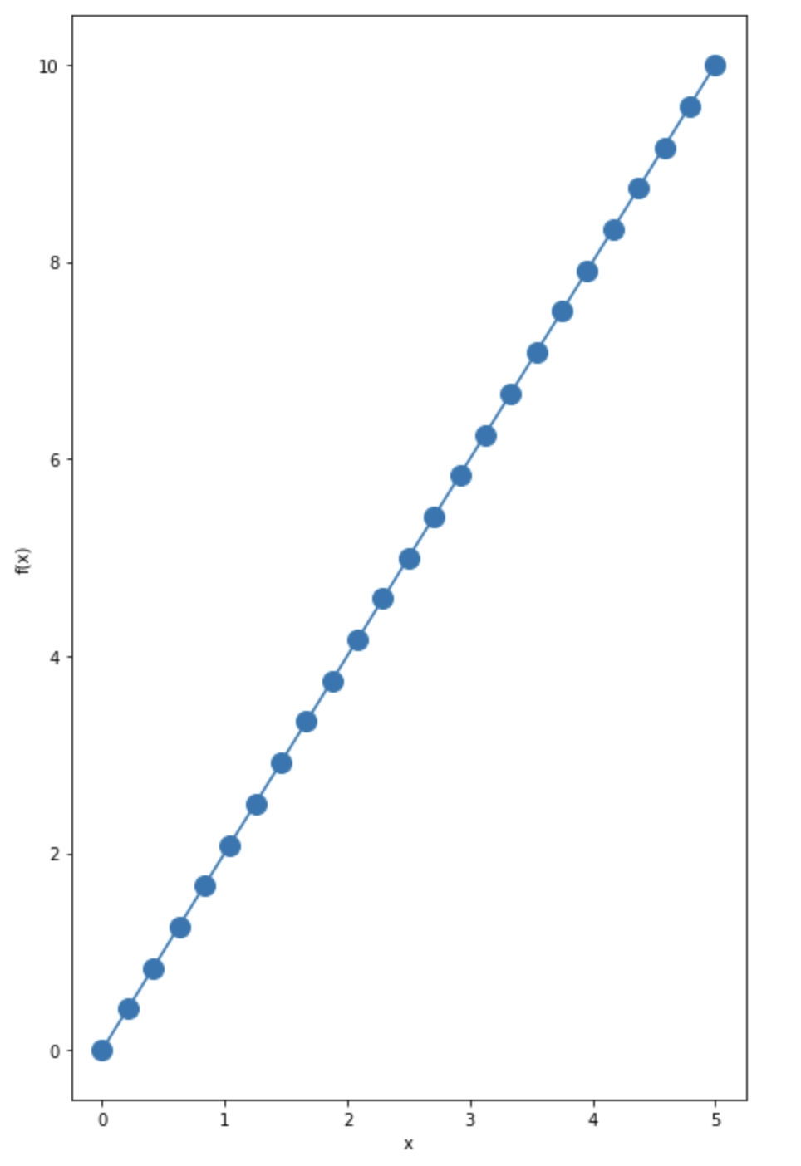
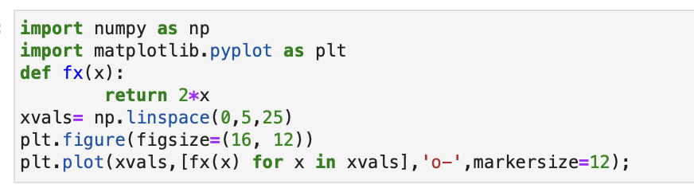
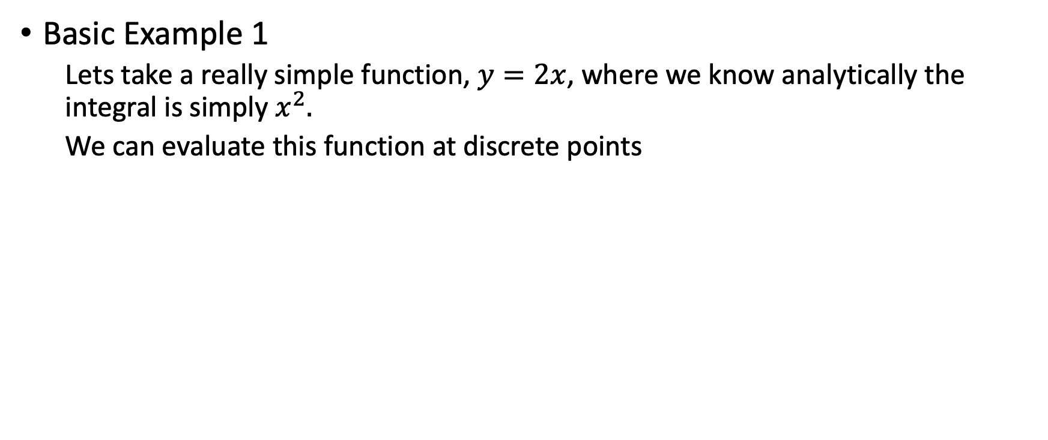
Numerical methods: Integration
Basic Example 1
  Lets take a really simple function, $y=2x$, where we know analytically the integral is simply $x^{2}.$
  We can evaluate this function at discrete points

Slide 13
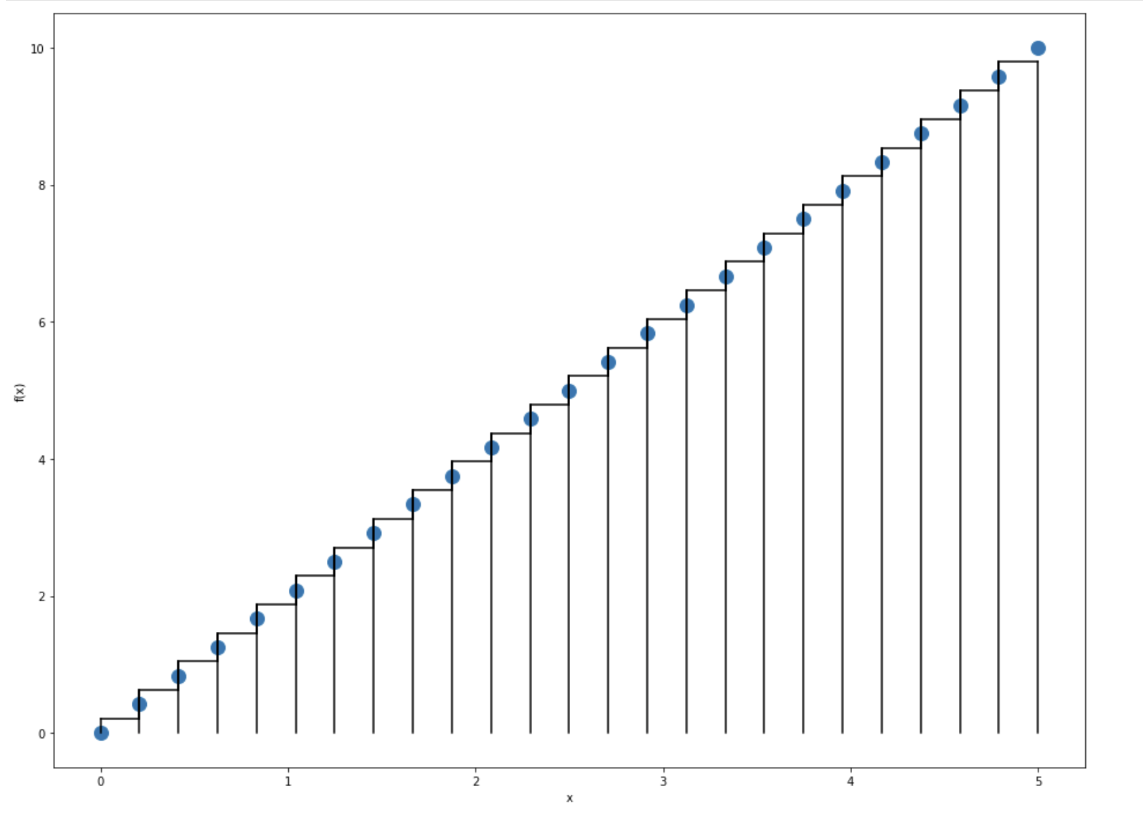
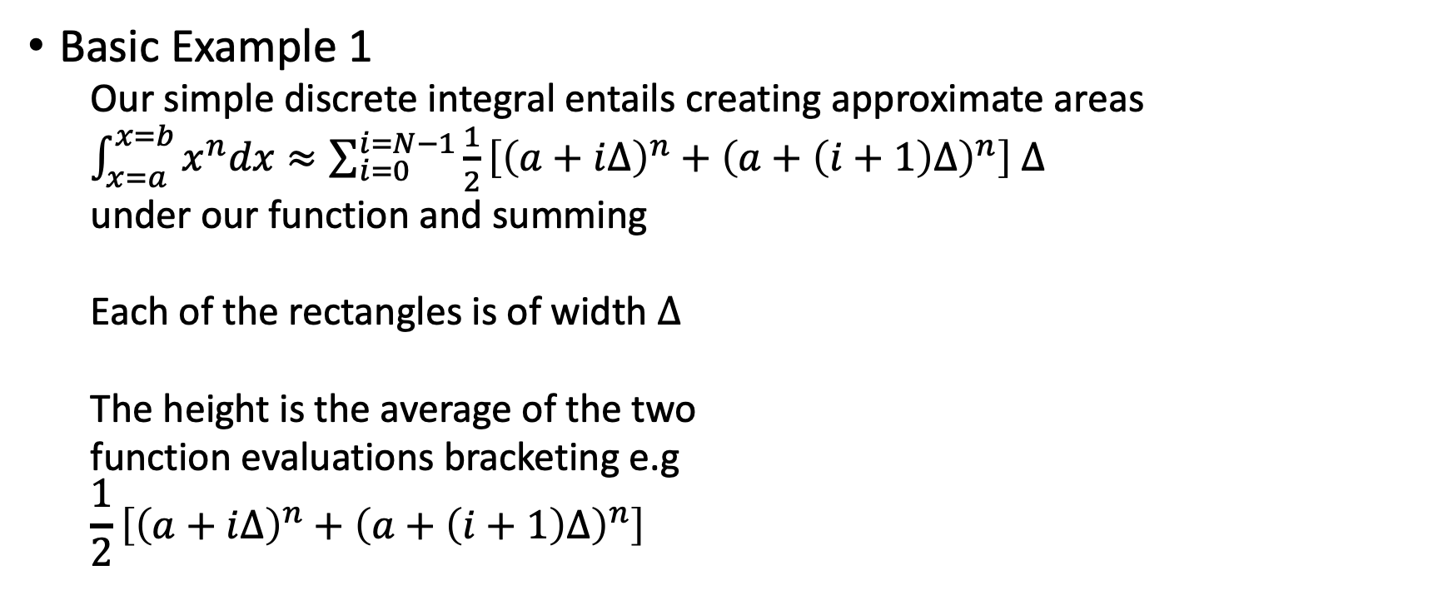
Numerical methods: Integration
Basic Example 1
  Our simple discrete integral entails creating approximate areas
  $\int_{x=a}^{x=b}{x^{n}dx}≈\sum_{i=0}^{i=N−1}{\frac{1}{2}\left[{\left(a+i∆\right)}^{n}+{\left(a+\left(i+1\right)∆\right)}^{n}\right]}$ $∆$
  under our function and summing
  Each of the rectangles is of width $∆$
  The height is the average of the two
  function evaluations bracketing e.g
  $$\frac{1}{2}\left[{\left(a+i∆\right)}^{n}+{\left(a+\left(i+1\right)∆\right)}^{n}\right]$$

Slide 14
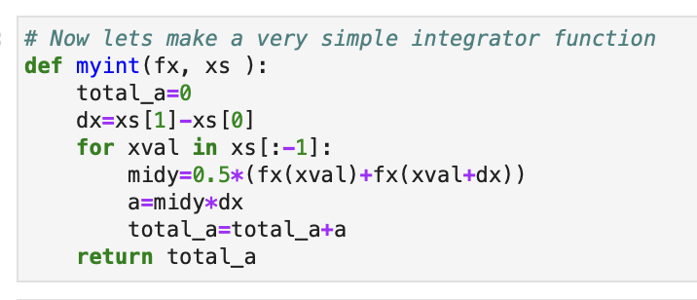
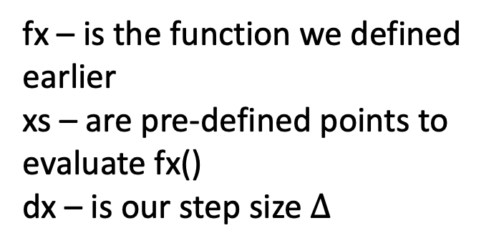
Numerical methods: Integration
Basic Example 1
  A simple integrator function would be
fx – is the function we defined earlier
xs – are pre-defined points to evaluate fx()
dx – is our step size $∆$

Slide 15
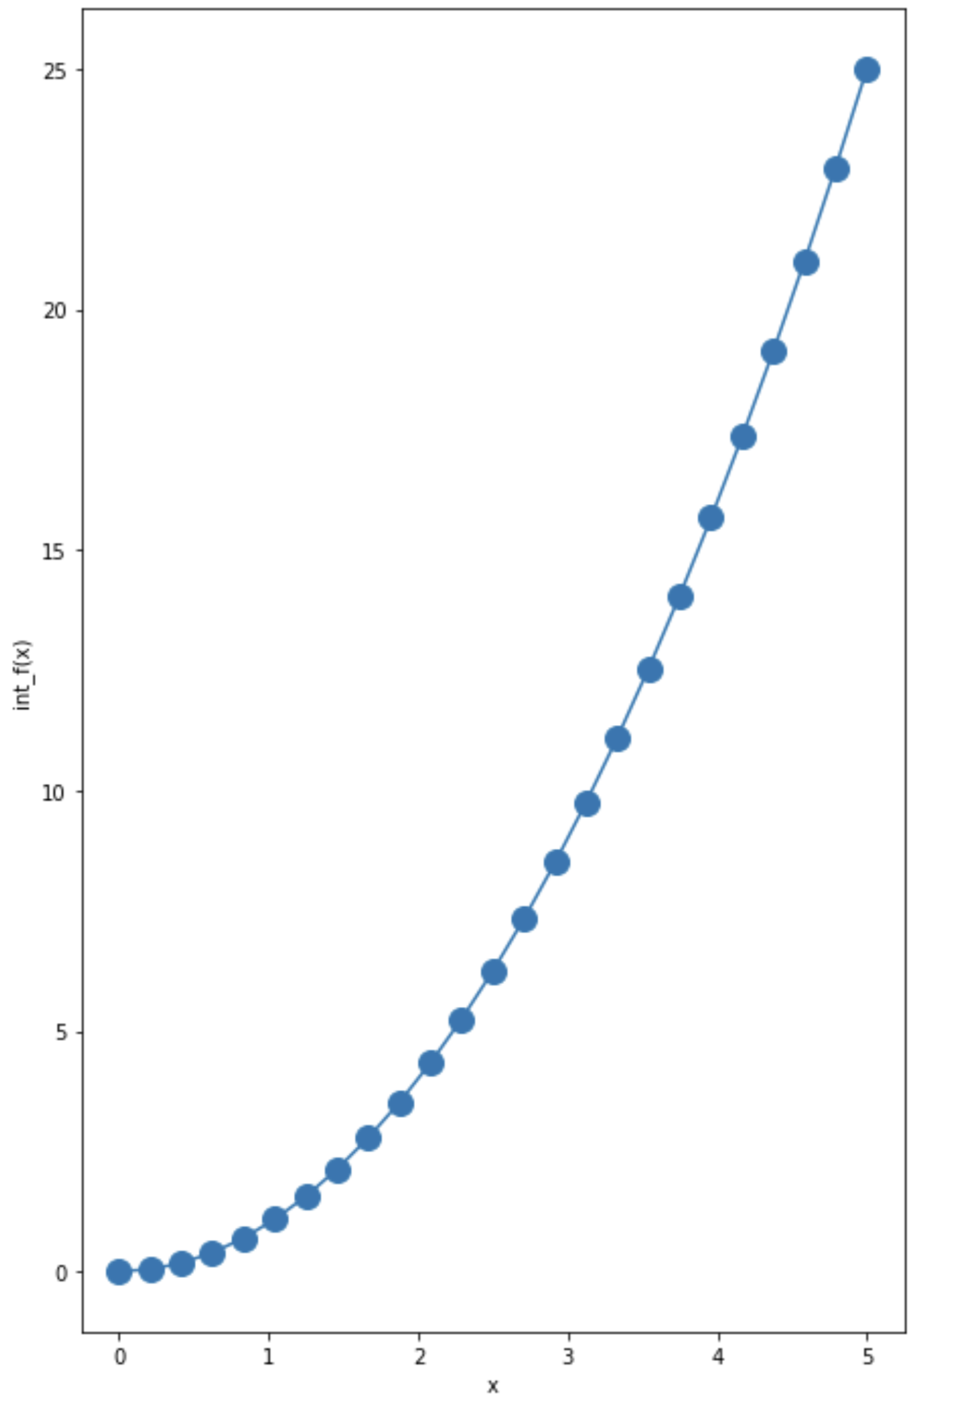

Numerical methods: Integration
Basic Example 1
  Lets see how it works for f(x)=2x!
  We know the indefinite integral in this case, so we can create a function for that too and plot it.

Slide 16
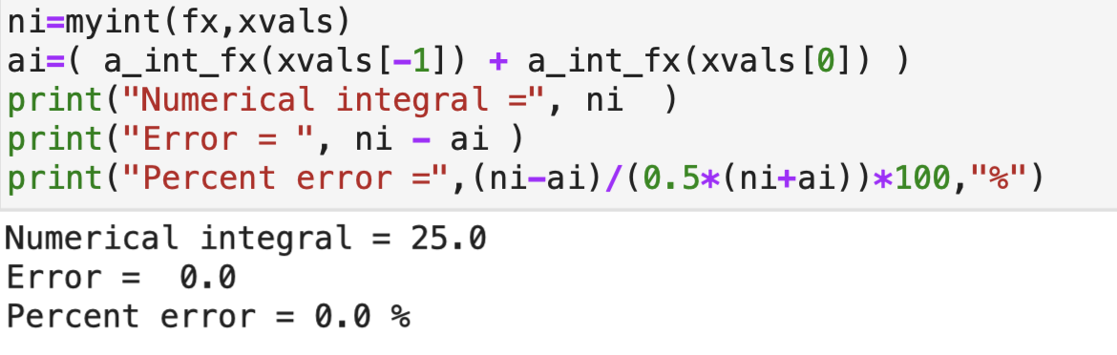
Numerical methods: Integration
Basic Example 1
  Lets compare numerical and analytic integral
  Works perfectly – is that odd?
ni – is the numerical integral
ai – is the analytic integral (the first value,
a_int_fx(xvals[0]),
is the constant of integration – 0 in this case)

Slide 17
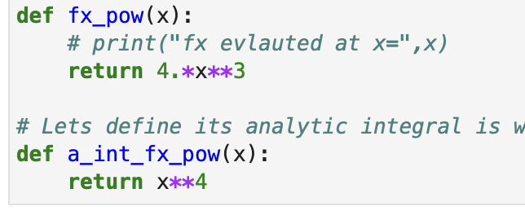
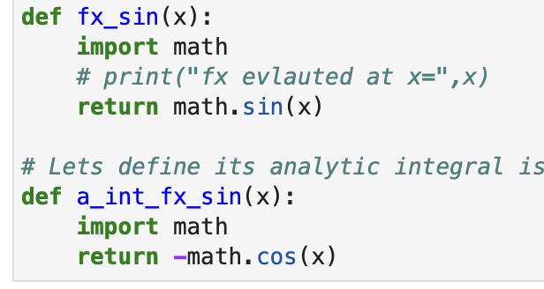
Numerical methods: Integration
Basic Example 1
  We can apply to different functions by redefining fx() e.g.
  these are not straight lines – how do they work

Slide 18
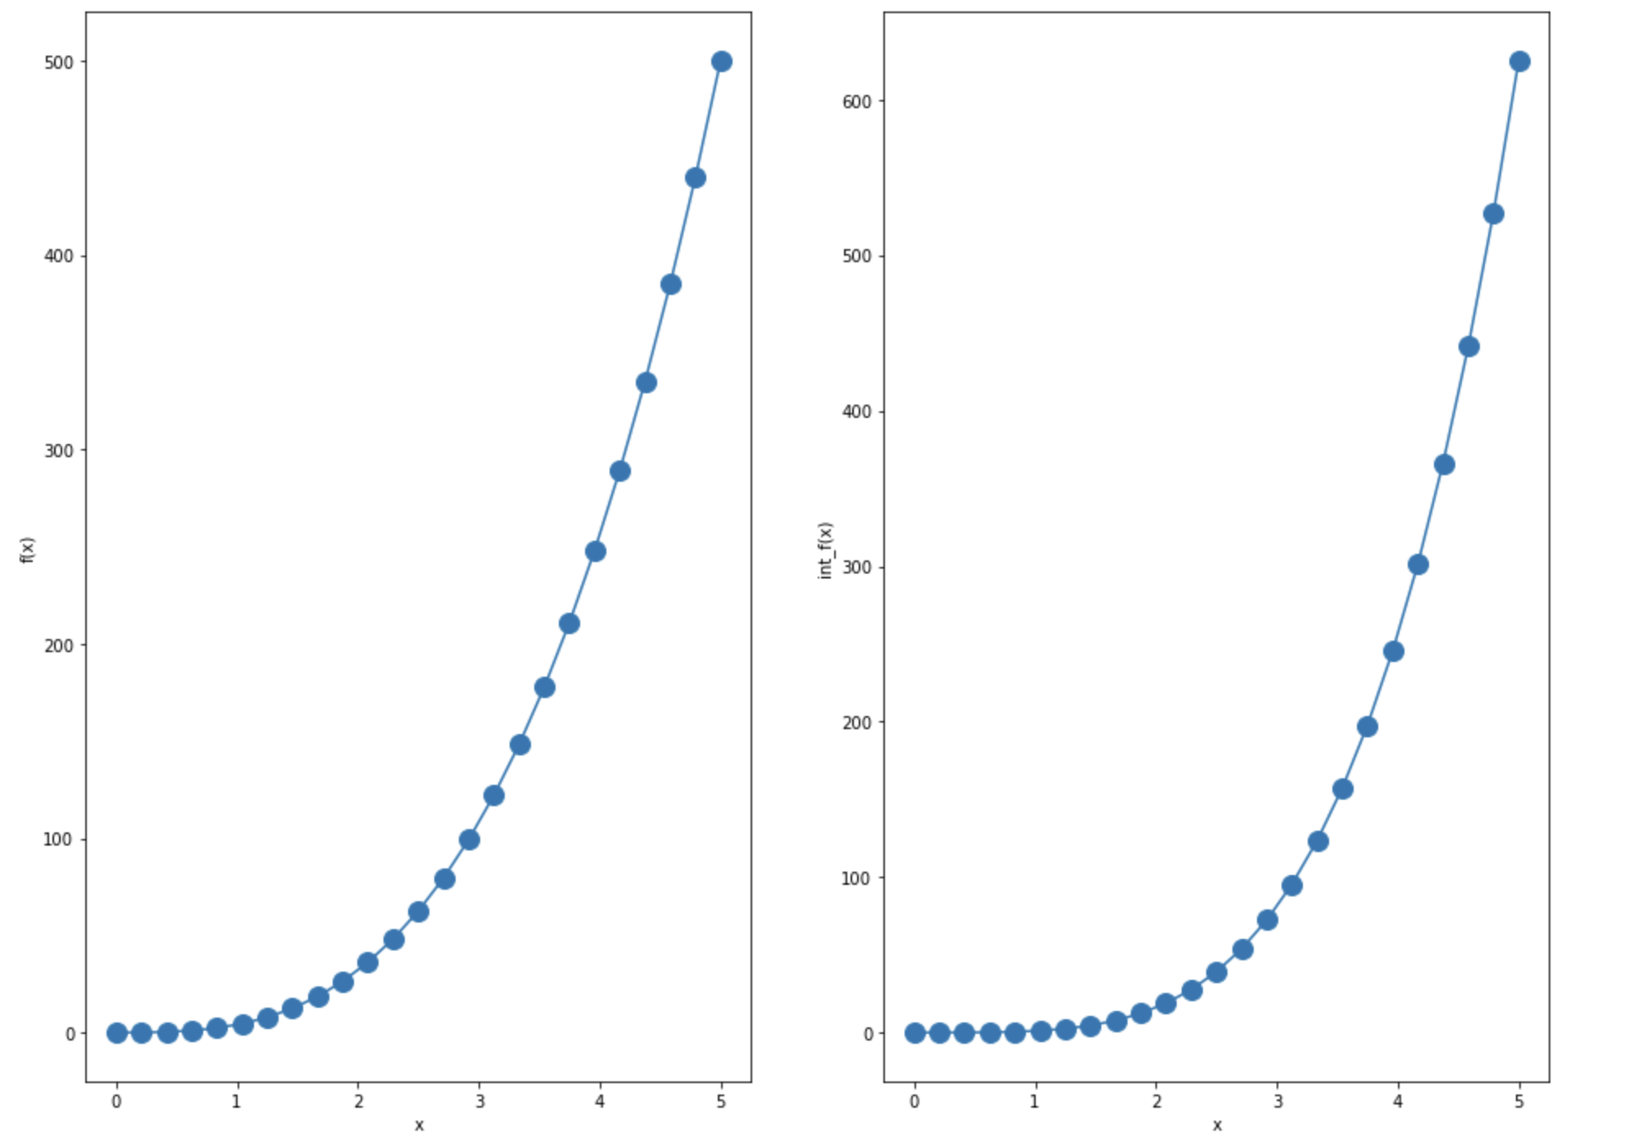
Numerical methods: Integration
function
integral
f(x) = 4x³
4x³
x⁴

Slide 19
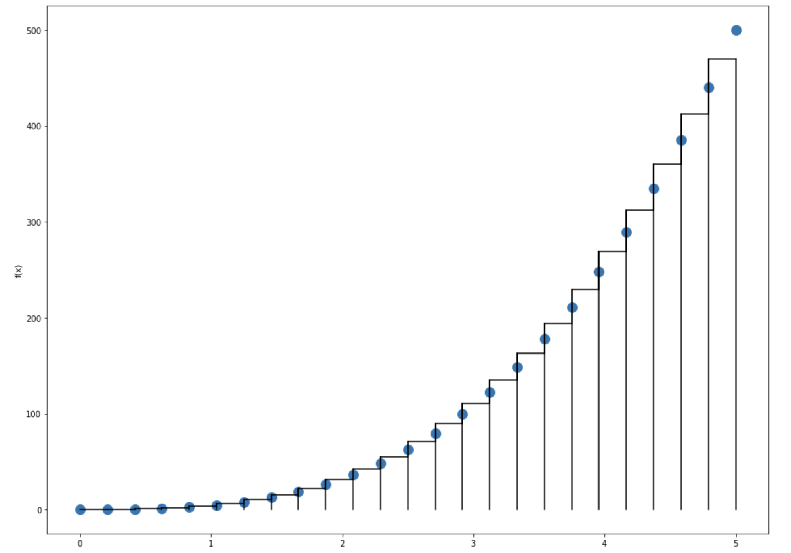
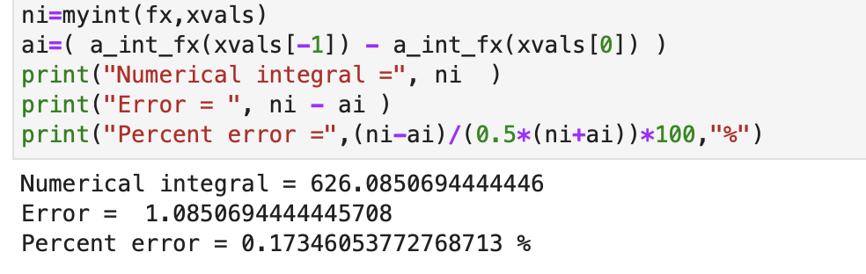
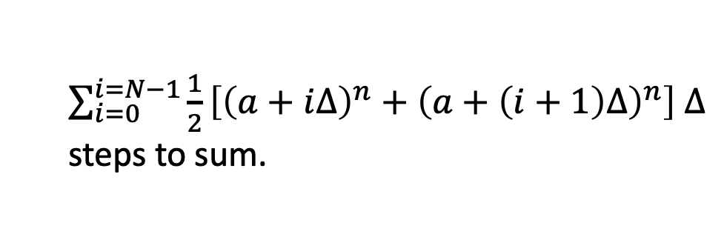
Numerical methods: Integration
f(x) = 4x³
$\sum_{i=0}^{i=N−1}{\frac{1}{2}\left[{\left(a+i∆\right)}^{n}+{\left(a+\left(i+1\right)∆\right)}^{n}\right]}$ $∆$
steps to sum.

Slide 20
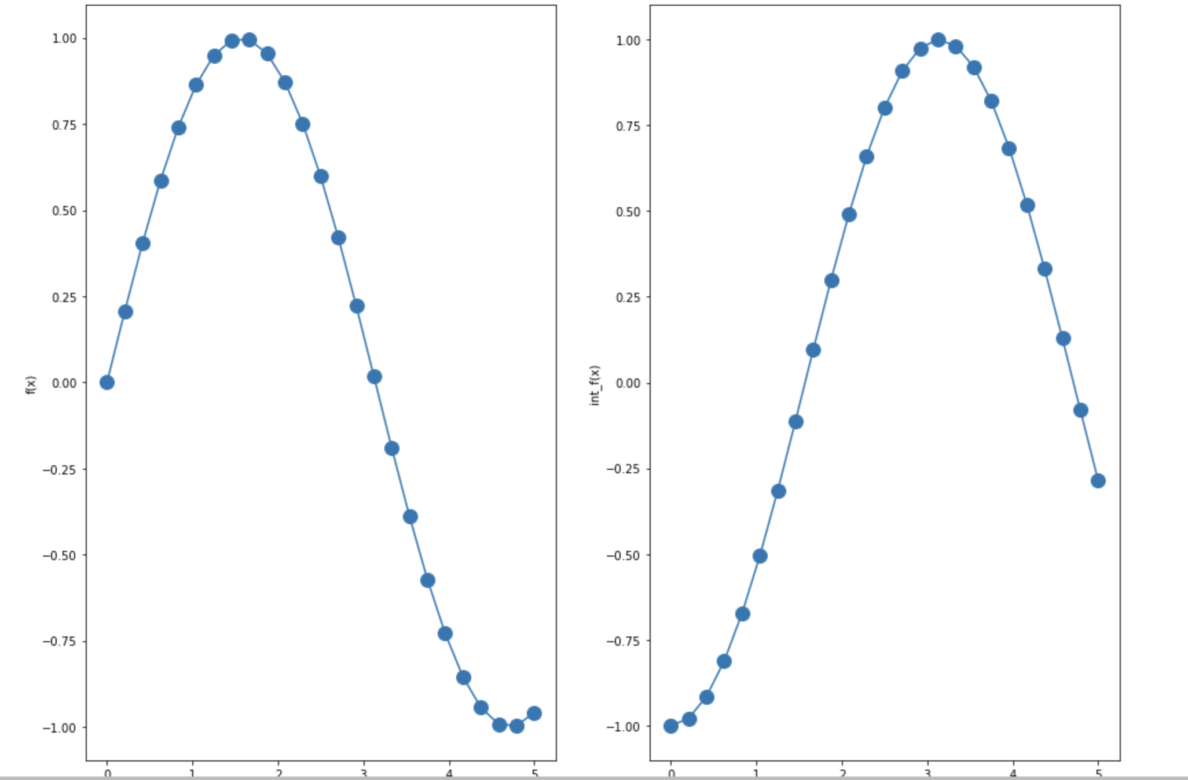
Numerical methods: Integration
function
integral
f(x) = sin(x)
sin(x)
-cos(x)

Slide 21
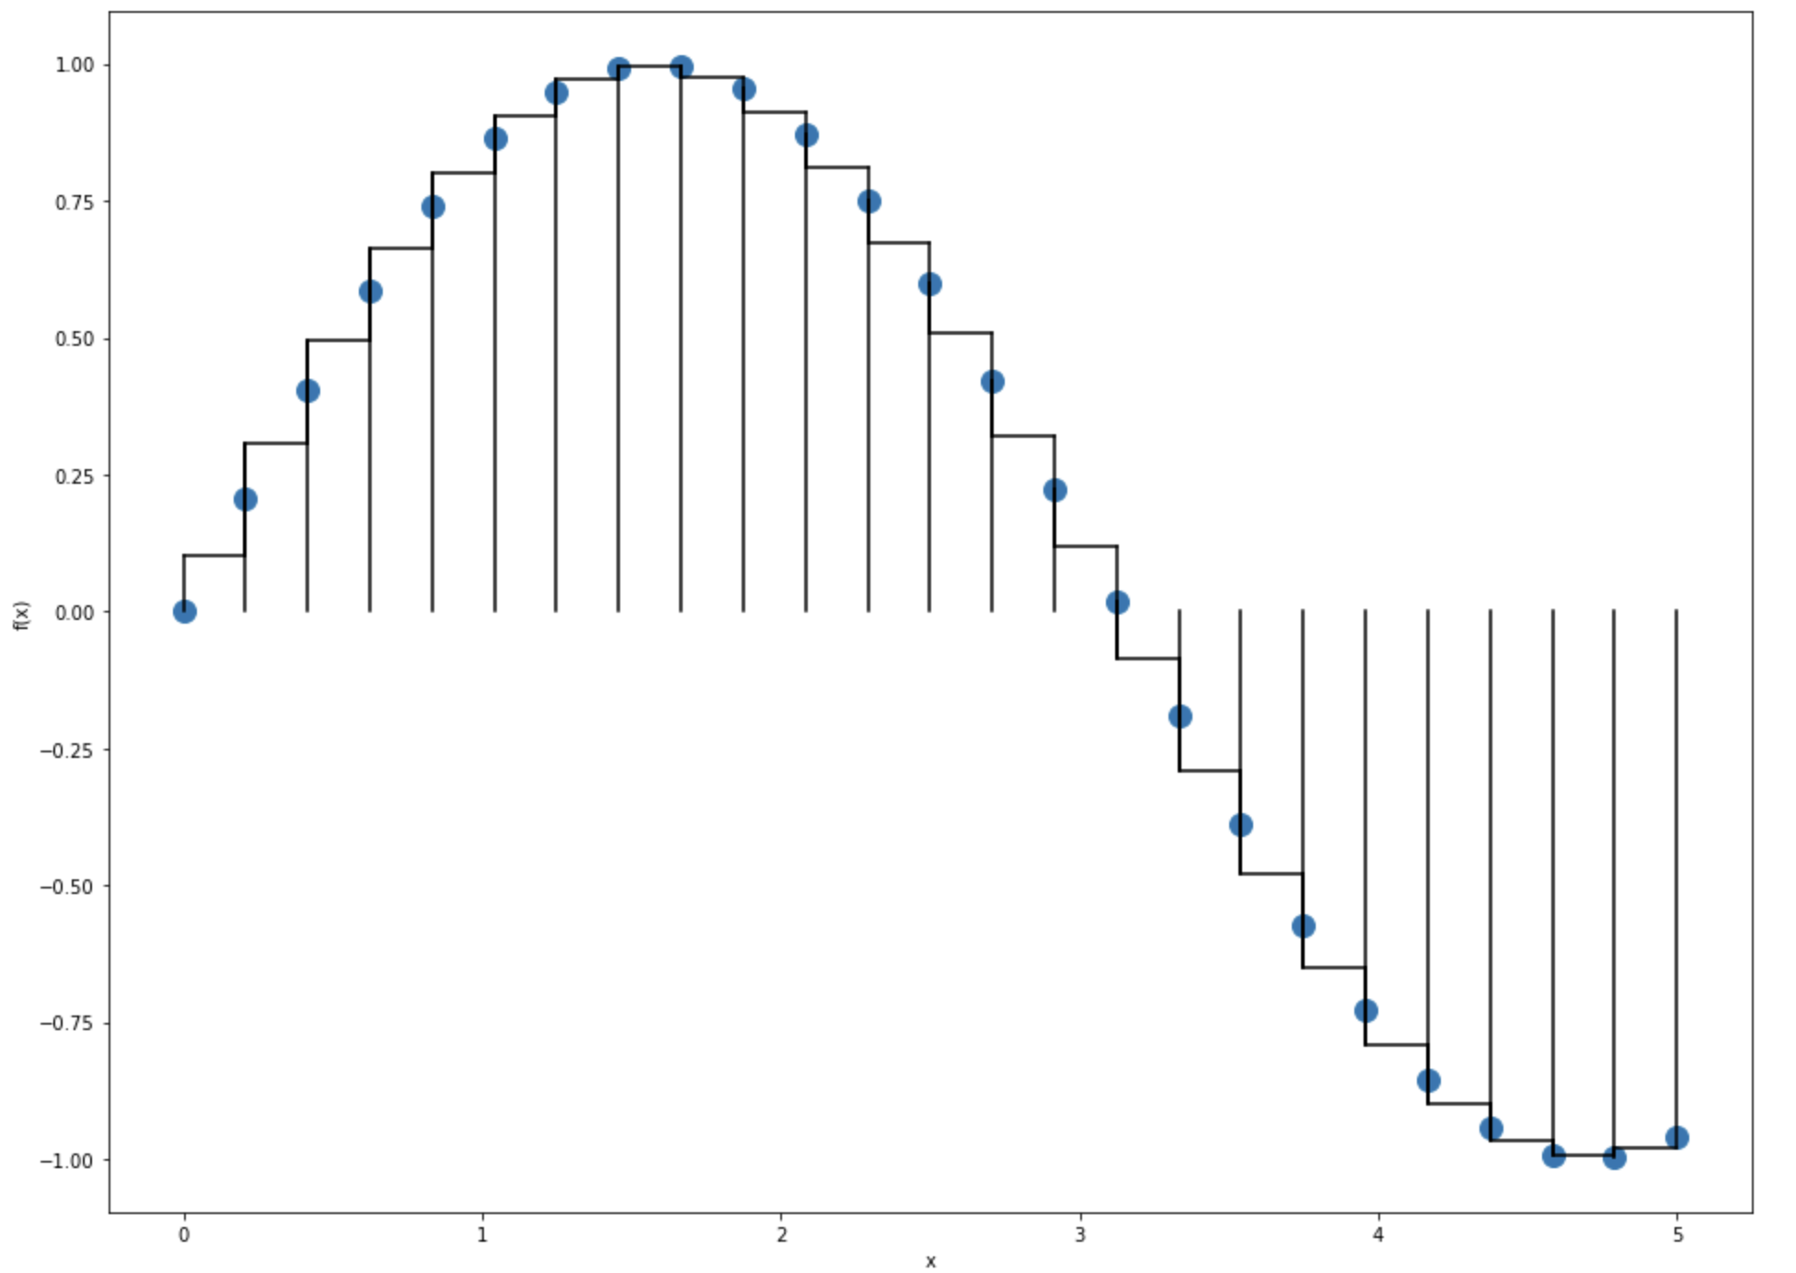
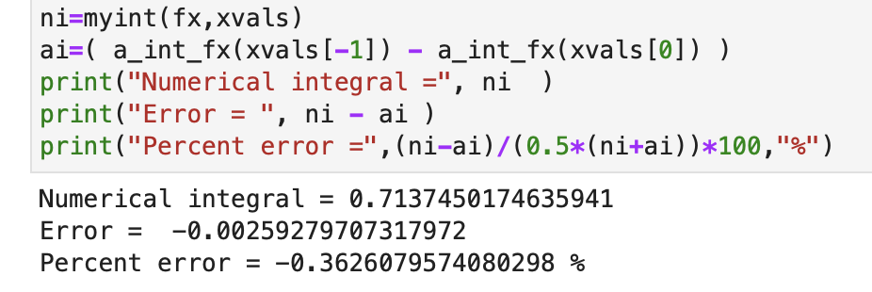
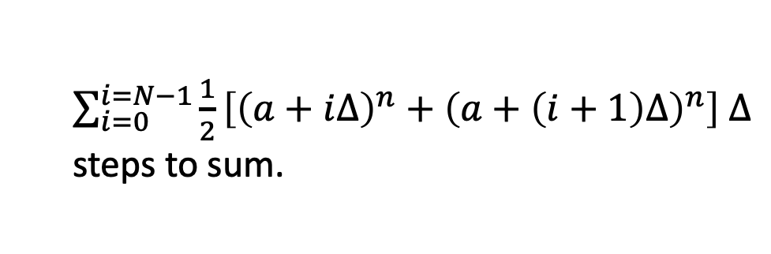
Numerical methods: Integration
$\sum_{i=0}^{i=N−1}{\frac{1}{2}\left[{\left(a+i∆\right)}^{n}+{\left(a+\left(i+1\right)∆\right)}^{n}\right]}$ $∆$
steps to sum.
f(x) = sin(x)

Slide 22
Numpy/Scipy modules
The Python Scipy package ( https://docs.scipy.org/doc/scipy/index.html ) contains advanced functions for numerical integration (and differentiation) working on Numpy arrys.
These operate similarly to the basic examples shown
  define some function f(y,t) that evaluates a function at points y, t (y can be vector of values)
  invoke a “control” function to evaluate the derivative or integral over some domain
The Scipy functions have many sophisticated features built-in to adjust step sizes and select where to evaluate functions and how to combine evaluations. These can reduce error relative to simple approaches.
Notes:
To here 10/5/2023 (lecture 9!)

Slide 23
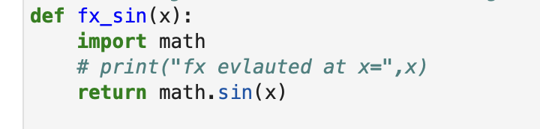

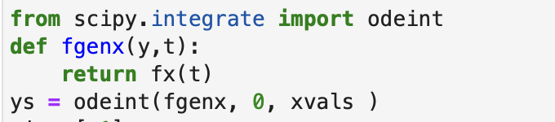
Numpy/Scipy modules - odeint
To fit sin(x) function, define container function
Treat x as the t variable in odeint.
Invoking odeint will integrate our function and return estimated values of integral at xvals locations.
Notes:
To here 10/05/2023

Slide 24
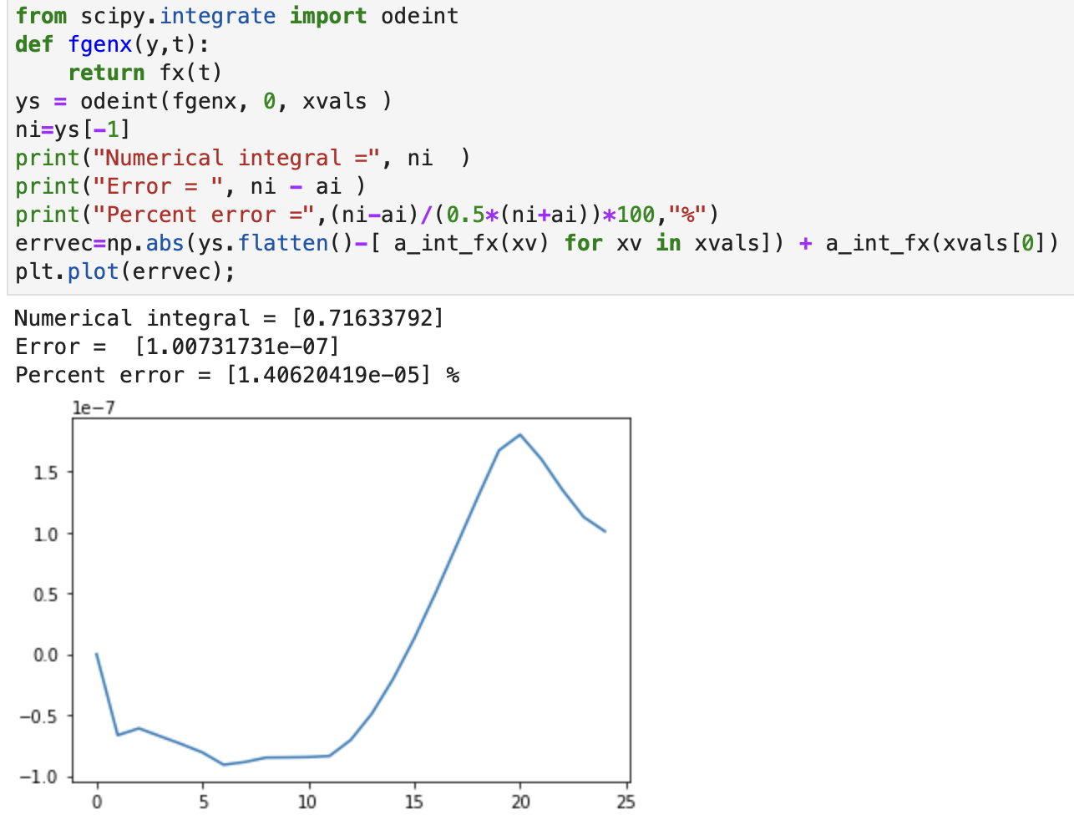
Numpy/Scipy modules - odeint
odeint is usually quite accurate without any optional parameters.

Slide 25
Numerical Integration and Numpy/Scipy modules
try with notebook Lec06-integration.ipynb
Notes:
To here 9/23/21

Slide 26
MIT OpenCourseWare
https://ocw.mit.edu
12.010 Computational Methods of Scientific Programming, Fall 2024
For more information about citing these materials or our Terms of Use, visit https://ocw.mit.edu/terms.

