Slide 1
12.010 Computational Methods of Scientific Programming 2021
Tom Herring, tah@mit.edu
Chris Hill, cnh@mit.edu
Lecture 4: Algorithms and common problems

Slide 2
Topics
Numpy arrays
Pandas Data frames: An advancement on simple arrays
Functions

Slide 3
Python Data types
  Numpy arrays are the most useful of the basic data types for collecting things
    Try Lec04_numpy.ipynb

Slide 4
Python Dataframes
  To do more beyond primitive types (float, array etc…), we need to introduce more concepts (functions, classes, objects)
  First, look at Dataframes from Pandas () module.
    Pandas Dataframes use functions, classes, and objects to work and show some nice things that can be encapsulated in a library this way.
  Pandas Data frames – (https://pandas.pydata.org )
    Provides an intuitive table-like representation of data with column headings and rows
    Provides a Python-style interface to the table

Slide 5
Python Dataframes try
  Lec04_DataFrames.ipynb
Notes:
To here 2023/09/21.

Slide 6
Python Functions, Classes and Object
With arrays and existing libraries like Dataframes (and also for example, Scipy) can do a lot.
Can do even more by learning about other core programming concepts
  Functions – a way to create generic “operations” that can be applied to different instances of similar things.
  Classes – way to group variables with functions to create more advanced function behaviors
  Objects – “instances” of classes that are variables with functions and internal variables all grouped together. A Pandas dataframe is an example of an object
Functions, classes, and objects, together with variables, data types, and control structures (if, for etc…) are the key elements of programming in Python.

Slide 7
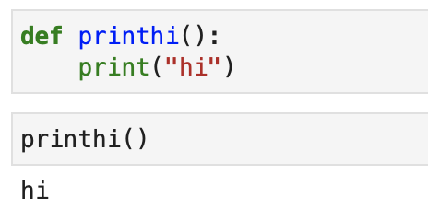
Python Functions*
  A basic function is a way to encapsulate some set of steps into a special collection of code
  Like in a recipe – a separate step might be “make a cheese sauce,” which might be the same for several recipes.
  Simplest form syntax
    def printhi():
    print(hi)
    def - says this is a function
    : - starts function body
    everything indented is part of the function e.g.

Slide 8
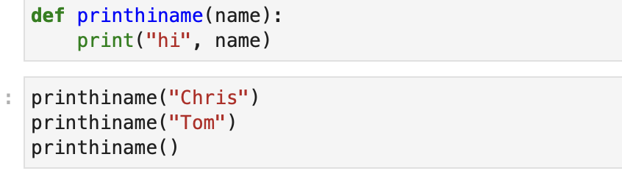
Python Functions
  Most things about functions are best tried with examples
  Some key aspects are
  Functions can take arguments, e.g.
  the last example will give an error because the argument does not have a default setting.

Slide 9
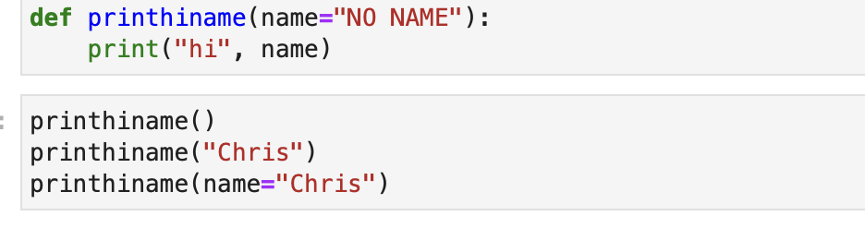
Python Functions
  Adding a default for an argument is easy!

Slide 10
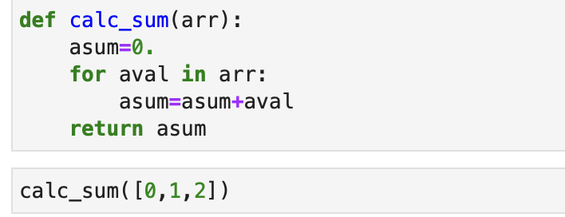
Python Functions
  Functions can return a result
Notes:
To here 9/26/2023 but 30 minutes earlier.

Slide 11
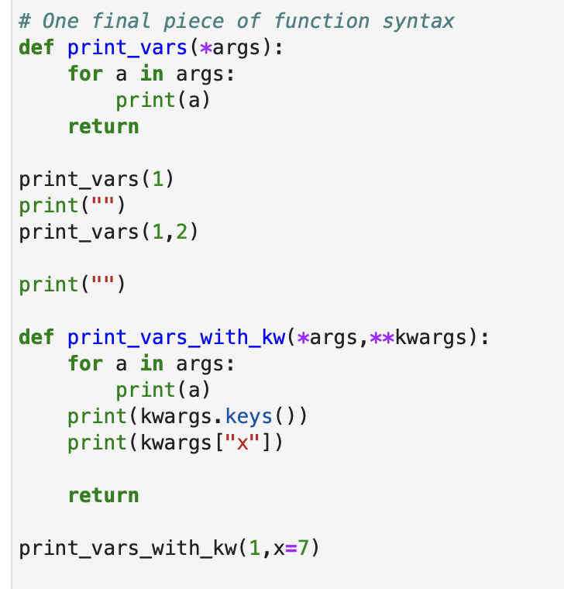
Python Functions
  Special syntax allows for variable numbers of arguments

Slide 12
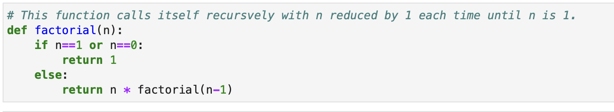
Python Functions
  Functions can “call” themselves (recursion)

Slide 13
Python Functions
  Lab exercises
Lec04_functions.ipynb

Slide 14
Summary
Input/Output: Simply first, more later
Programming approach: Algorithm development
  Example of how to think about the process: Speed of coding versus speed of execution
Example with polyarea.ipynb
Verification of code. Expecting the unexpected.
Common problems that can occur.
Notes:
Finished 10/03/2023

Slide 15
MIT OpenCourseWare
https://ocw.mit.edu
12.010 Computational Methods of Scientific Programming, Fall 2024
For more information about citing these materials or our Terms of Use, visit https://ocw.mit.edu/terms.

