Slide 1
12.010 Computational Methods of Scientific Programming
Tom Herring, tah@mit.edu
Chris Hill, cnh@mit.edu
Lecture 3: Array storage, data structures

Slide 2
Topics
Continue looking at operators
Suites and looping structures in Python.
Logical branching – concept of decisions in code.
Data Types
Numbers
Casting
Strings
Multi-element structures
  Lists
  Tuples
  Sets
  Dictionaries
Arrays
Data handling

Slide 3
Comparison operators
Available: (not equal symbols vary by language e.g., MATLAB)
Operator | Name | Example
== | Equal | x == y
!= | Not equal | x != y
> | Greater than | x > y
< | Less than | x < y
>= | Greater than or equal to | x >= y
<= | Less than or equal to | x <= y

Slide 4
Logical operators
Allows combinations of comparison operators
Operator | Description | Example
and | Returns True if both statements are true | x < 5 and x < 10
or | Returns True if one of the statements is true | x < 5 or x < 4
not | Reverse the result, returns False if the result is true | not(x < 5 and x < 10)

Slide 5
Identity operators*
Identity operators are used to compare the objects, not if they are equal, but if they are actually the same object, with the same memory location
Class of function typically used in functions to test inputs to functions
Operator | Description | Example
is | Returns True if both variables are the same object | x is y
is not | Returns True if both variables are not the same object | x is not y

Slide 6
Membership operators*
Membership operators are used to test if a sequence is presented in an object.
Operator | Description | Example
in | Returns True if a sequence with the specified value is present in the object | x in y
not in | Returns True if a sequence with the specified value is not present in the object | x not in y

Slide 7
Bitwise operators
Bitwise operators are used to compare (binary) numbers
Operator | Name | Description
& | AND | Sets each bit to 1 if both bits are 1
| | OR | Sets each bit to 1 if one of two bits is 1
^ | XOR | Sets each bit to 1 if only one of two bits is 1
~ | NOT | Inverts all the bits
<< | Zero fill left shift | Shift left by pushing zeros in from the right and let the leftmost bits fall off
>> | Signed right shift | Shift right by pushing copies of the leftmost bit in from the left, and let the rightmost bits fall off

Slide 8
Boolean (logical) operations*
Truth tables: A and B are input; OR is (inclusive) OR; XOR is exclusive OR
F false is 0; T true is non-zero.
Python has function bool that evaluates to True or False (can be a function return).
AND and OR gates are used to add bits (AND gate generates carry bit).
A | B | AND | OR | XOR
F | F | F | F | F
T | F | F | T | T
F | T | F | T | T
T | T | T | T | F

Slide 9
Suites/Indentation
Python uses indentation to delimit blocks of code e.g., if and for loops; function definitions.
This approaches clearly allows the structure of the code to be seen. Good programming practice in other languages is to indent code to but it is not required.
Other languages use keywords like “end” or “endif” to denote end if blocks (MATLAB, Fortran) or all blocks are enclosed in specific symbol e.g., C, C++ all code and blocks are enclosed in {} except for the header lines.
Header line for Python suites end with :

Slide 10
Branching operations*
If statements:
In Python ‘if’ statement lines end in : and the True block is an indented suite.
The ’else if’ keyword is elif:
The else keyword is else:
Not code validity is not checked after a logical statement is false. (This can lead to errors that occur only in some cases).

Slide 11
Iteration operations*
Iteration operations are of two forms: ‘for’ and ‘while’ loops
Loops can be broken with ‘break’ statements (allows loops to be ended before there natural end).
Syntax
  for x in <something>:
    Code (indented until end of statements
  while <logical expression>:
    Code (indented until end of statements
  break (with no colon) to break e.g., maybe searching for something in list and break to exit for loop when found.

Slide 12
Python Data types
Python data typing happens mostly automatically but can set in code as well (referred to as casting)
Types
  Text Type: str
  Numeric Types: int, float, complex
  Sequence Types: list, tuple, range
  Mapping Type: dict
  Set Types: set, frozenset
  Boolean Type: bool
  Binary Types: bytes, bytearray, memoryview
Determine what something is with the type function e.g., type(x)

Slide 13
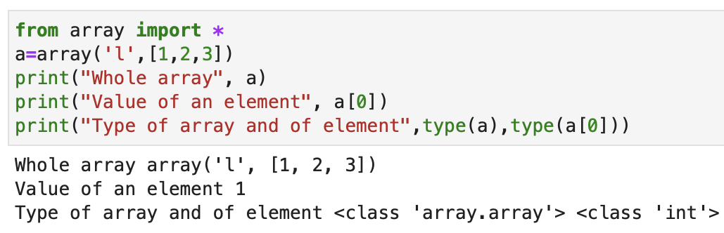
Python Data types*
Arrays – indexed collection of values.
  Python 3 added Arrays as part of standard library. Prior to that arrays were in Packages.
  Numpy package (originates in part from MIT graduate student work!) is still the primary tool for Arrays in scientific computing with Python
  Standard library form

Slide 14
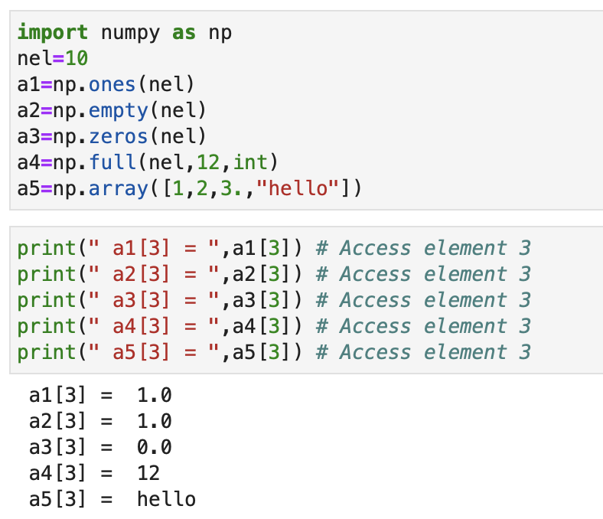
Python Data types
Arrays – indexed collection of values.
  Numpy form

Slide 15
Python Data types*
Arrays – indexed collection of values.
  Numpy form
Can have an array hold several different types. These arrays will have lower performance than simple arrays with primitive type elements (float, int etc…)

Slide 16
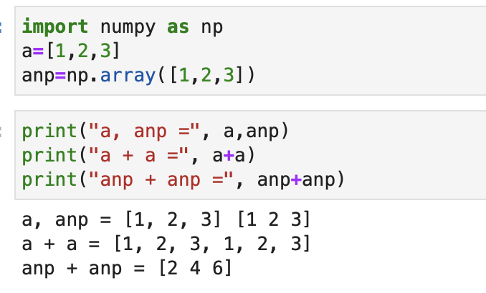
Python Data types
Arrays – indexed collection of values.
  Arrays using lists.
    Initially Python did not have an array standard library. So, sometimes see Python lists used as arrays.
    Arrays based on lists and the “array” type v numpy arrays behave differently, and we will mostly use Numpy arrays as arrays!

Slide 17
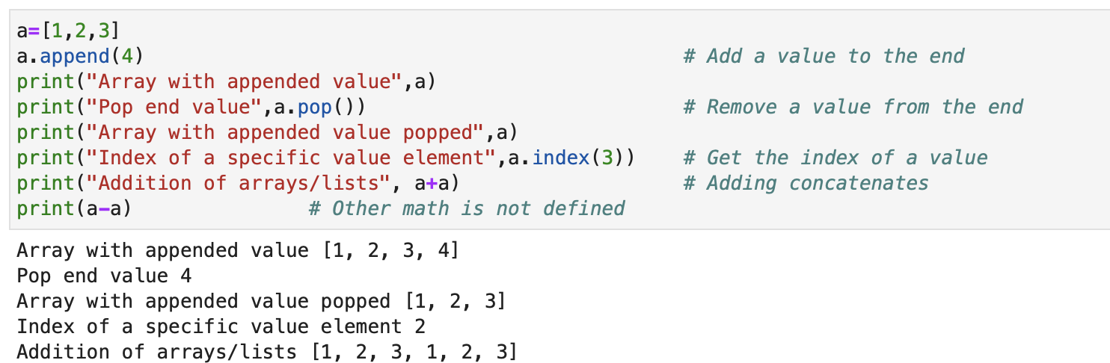
Python Data types*
  Lists are a basic type for storing indexed series of values in Python. They are a bit like arrays, but the meaning of operators is different. They are more useful for managing queues of values or things to work on than they are for mathematical/scientific formulas e.g.

Slide 18
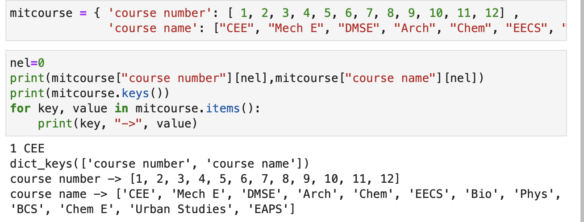
Python Data types*
  Dictionaries are a way to collect keys and values. Syntax is
    D = { “key1”: values1, “key2”: values2 }
    Note – use of { and } and : e.g.

Slide 19
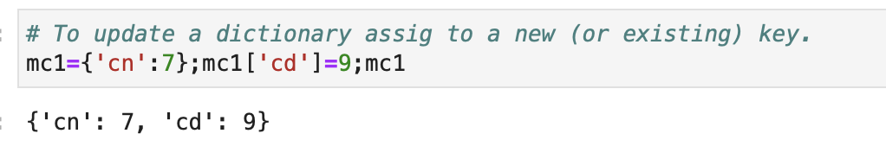
Python Data types
  Dictionaries do not have add or append operations. Instead, add a new value to a new ley (or update an existing key), e.g.

Slide 20
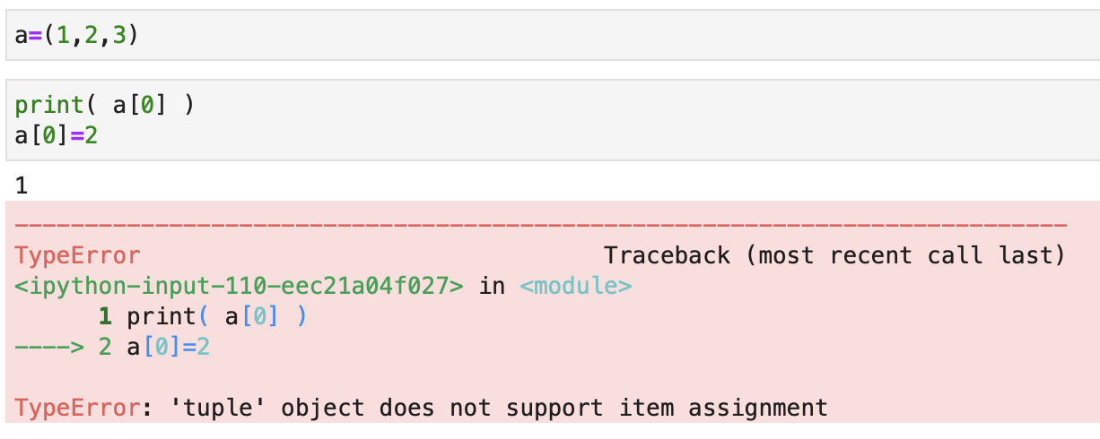
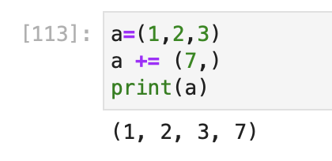
Python Data types*
  Tuples like array/list, except they can’t be modified! Not that useful in scientific programming
  you can add

Slide 21
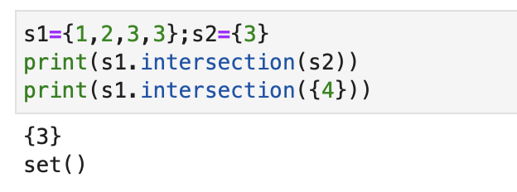
Python Data types*
  Sets are like mathematical sets. Only one entry for each value, no indexing, e.g
Notes:
To Here 2023/09/19: Start on numpy in the following lecture.

Slide 22
Summary
Continue looking at operators
Suites and looping structures in Python.
Logical branching – concept of decisions in code.
Data Types
  Arrays
  Lists
  Tuples
  Dictionary
Next class: Numpy arrays which behave like linear algebra arrays

Slide 23
MIT OpenCourseWare
https://ocw.mit.edu
12.010 Computational Methods of Scientific Programming, Fall 2024
For more information about citing these materials or our Terms of Use, visit https://ocw.mit.edu/terms.

