Slide 1
12.010 Computational Methods of Scientific Programming 2023
Tom Herring, tah@mit.edu
Chris Hill, cnh@mit.edu
Lec 01: Getting started and setup

Slide 2
About 12.010 - I
Introduces programming from perspective of physical science use. Programming examples are taken from simple physics and mathematics problems.
Classes introduces programming languages a researcher in a lab might encounter – Python, Julia, R, Matlab/Octave, C, C++, Fortran.
Two main parts to class
  Homeworks – 3 (due Fridays, at least 3+ weeks apart).
  Project and presentation - individual or group (due end of class).
Goal is that by end of class you will feel more confident that
  you could work in a research project involving programming
  you would know where to start to try and understand an unfamiliar program
  you know how to write, tested and run some interesting scientific computing programs by yourself

Slide 3
About 12.010 - II
Homeworks
  Each has 2-3 parts, involve writing some code, based on some example covered in class and available online.
  Graded on written answer and working code.
Projects
  Topic can be related to any science/math problem of interest.
  Can be based in major, another domain research course etc…
  Usually involve writing new code from scratch, including find and understanding algorithm, developing some core compute piece, developing some input and output piece.
  Graded on presentation, working and documented code.
  Group projects, with work divided across several people, or individual projects are fine.

Slide 4
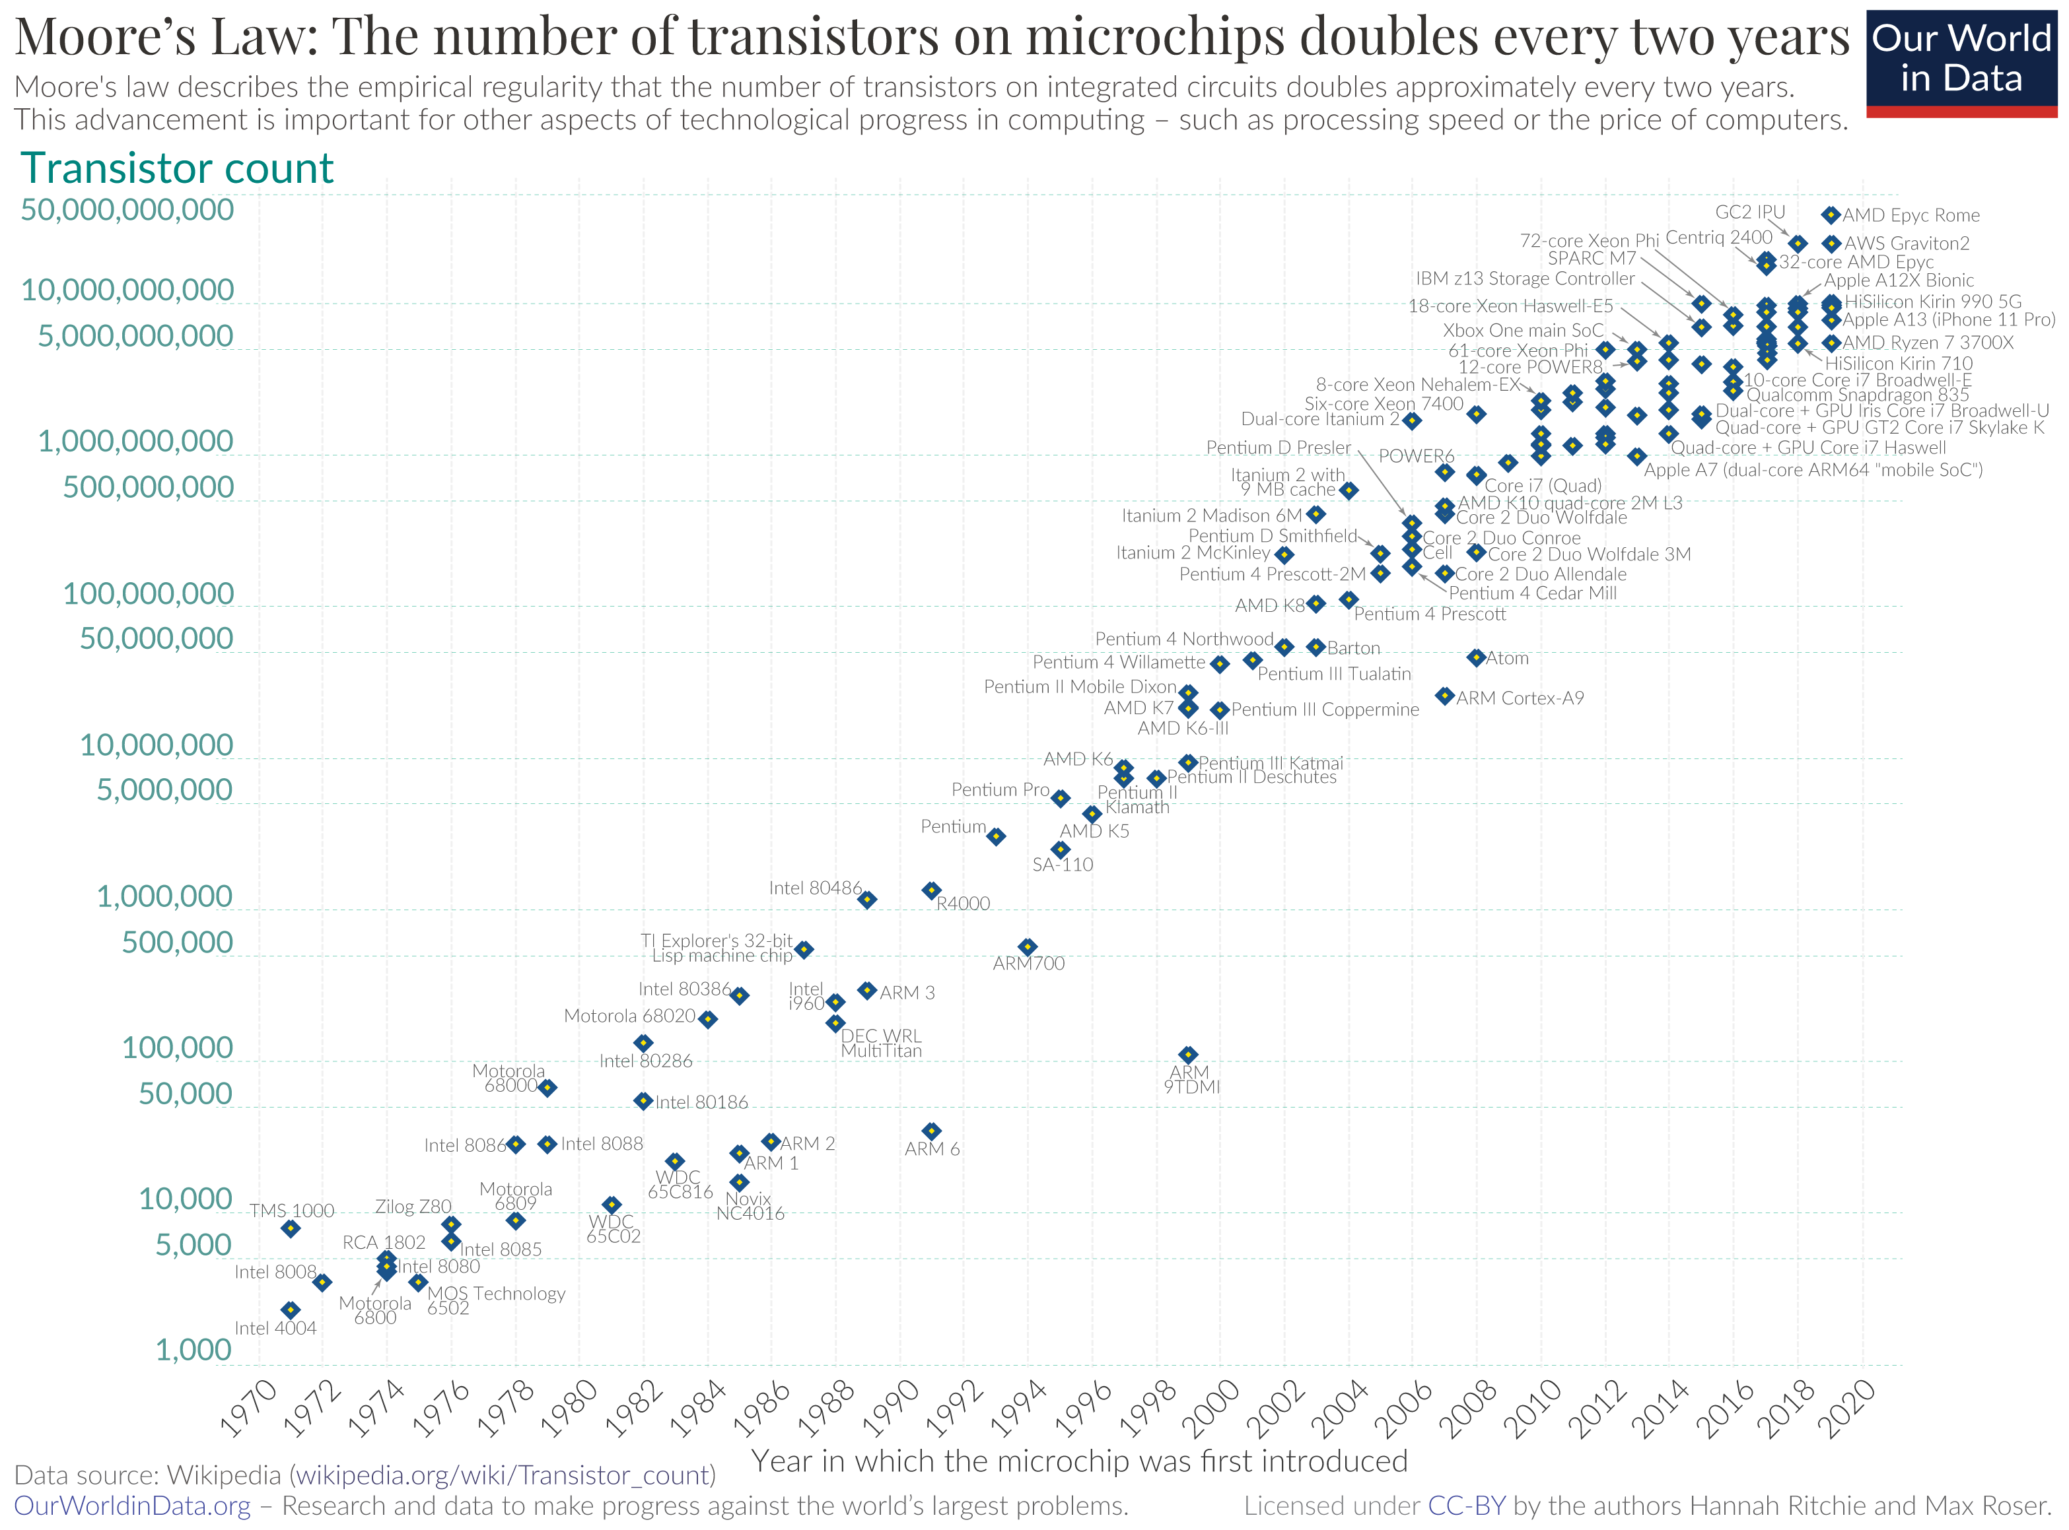
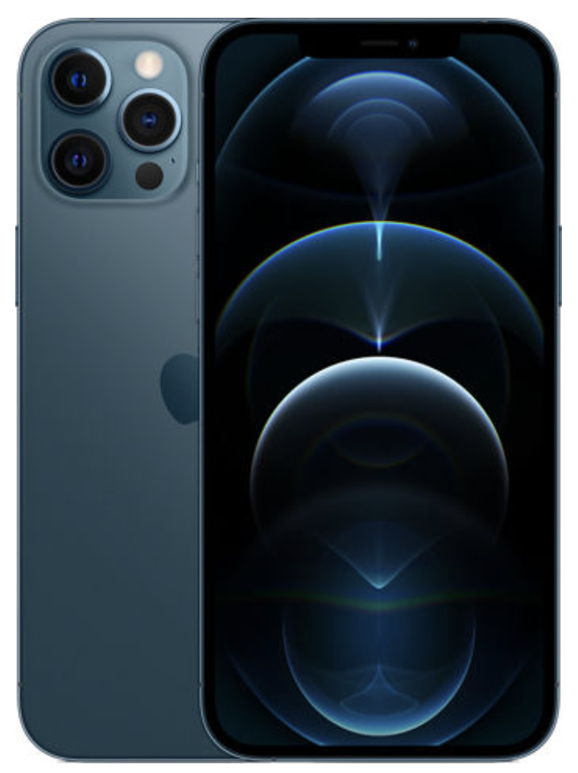

About computers
A modern computer contains a CPU with multiple cores and billions of transistors.
Number of transistors in CPU x 10⁵ in 30 years. Increases projects and fields that can make useful use of software in all walks of life, including science and engineering.
Programming is about getting those billions of transistors to act in some way to solve a problem.
11x10⁹ transistors,
up to 3x10⁹ Hz switching frequency.
Programming languages like Python, Julia, R, Matlab, C, Fortran etc… provide high-level “abstractions” that mask the underlying complexity.
Image courtesy of Hannah Ritchie and Max
Roser on Our World in Data. License: CC BY.

Slide 5
Programming languages
In scientific computing/computational science there are multiple programming languages
Some of the most common ones include
  Python, R, Julia, Matlab/Octave, C, C++, Fortran
The languages have different strengths, but also have a lot of ideas and concepts in common.
Practices around how to develop programs, how to test and check, how to formulate problems are similar too.
In 12.010 we introduce programming in Python, but then
  explore how basic programs look in all the languages listed
  illustrate different features that are found in different languages

Slide 6
Getting started
Programming can only be learned hands-on experience
  Computers are not that smart
  Programming involves puzzling
    over how to express a problem in a way a computer can solve it,
    following rules about how to instruct the computer,
    methodically trying to understand whether program is behaving as expected,
    building up more complete and complex programs step-by-step.
The first “puzzle” is configuring a ”programming environment” to work in.
  In this class we will begin by using Jupyter Notebooks as our common programming environment
  Jupyter Notebooks are widely used in teaching programming and data science
  They are not the only programming environment, and have some limitations, but they are very useful and common starting point.

Slide 7
First notebooks
Start by trying cloud resource – see ”Launch Jupyterhub Class Exercise” in Assignments
Then install locally – see “Install Jupyter Notebook Locally Class Exercise” in Assignments.
There are example Notebooks in the Week 1 section we will try. Not all of these cases will be covered today.

Slide 8
MIT OpenCourseWare
https://ocw.mit.edu
12.010 Computational Methods of Scientific Programming, Fall 2024
For more information about citing these materials or our Terms of Use, visit https://ocw.mit.edu/terms.

