Slide 1
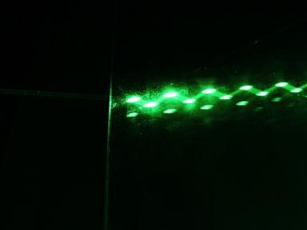
Lasers
Stimulated Emission
Lasers: Trapping Photons
Terahertz Lasers
Course Overview

Slide 2
P-N Junctions and LEDs
Emitted Light
Beams
Terminal Pins
Diode
Transparent
Plastic Case
High energy electrons (n-type) fall into low energy holes (p-type)

Slide 3
Energy Conservation
W_{stored} = __________
W_{heat}
W_{light}
W_{electrical}

Slide 4
Energy Conservation
W_{stored} = __________
W_{light}

Slide 5
Through and Across Variables
W_{stored} = electron energy
W_{heat}
W_{light}
W_{electrical}
 | THROUGH | ACROSS
ELECTRICAL
LIGHT

Slide 6
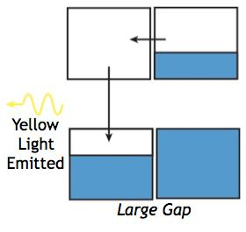

Atomic Transitions
r
2p
1s
photon

Slide 7
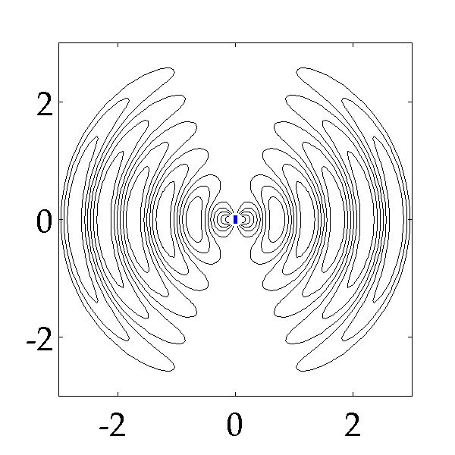
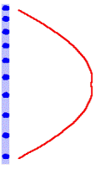
Light Emission from Magnets
Maxwell’s Equations couple H and E fields..
Radiation was missing
from our quasi-static approximation
http://juluribk.com/2010/01/14/
radiation-from-dipole/
Image in the Public Domain
Courtesy of Bala Krishna Juluri and Sophocles Orfanidis. Used with permission.

Slide 8
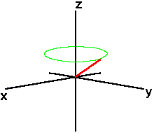


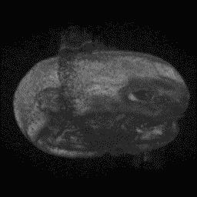
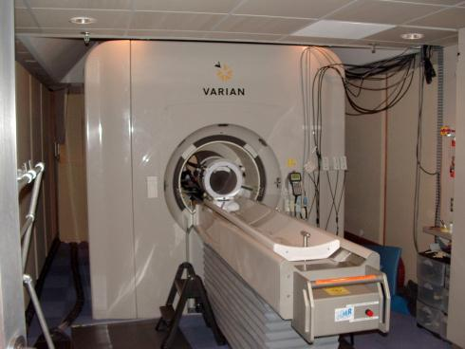
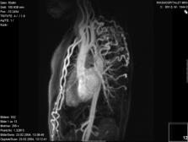
Light Emission from Magnets
high energy
Superposition state = oscillating magnet
external field
low energy
Images in the Public Domain

Slide 9
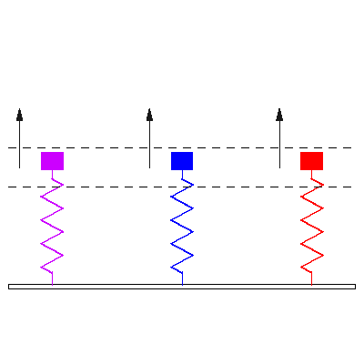
Solar Cells and Photodetectors
r
2p
1s
Emission
photon
Classical: Oscillating electric field drives charge oscillation
Quantum: Electric field creates superposition of energy states
– which have an oscillating charge density

Slide 10
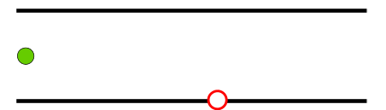
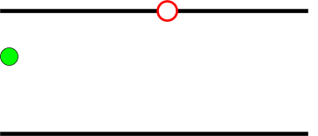
Reverse Absorption: Stimulated Emission
ABSORPTION
STIMULATED EMISSION
How do you choose the color, direction, and phase
of the generated photon ?
GENERATED PHOTON IS
AN EXACT DUPLICATE OF THE INCOMING PHOTON

Slide 11

Quantum Mechanics and Stimulated Emission
Pauli Exclusion and electrons (fermions)
Stimulated emission and photons (bosons)
‘Two is a crowd !’
‘The More the Merrier !’
boson
fermion
also
boson
fermion!
also
boson
Boson
also
boson
Fermion
boson !
also
boson
fermion
Boson
FERMIONS GO TO DIFFERENT STATES
BOSONS PREFER TO BE IN THE SAME STATE

Slide 12
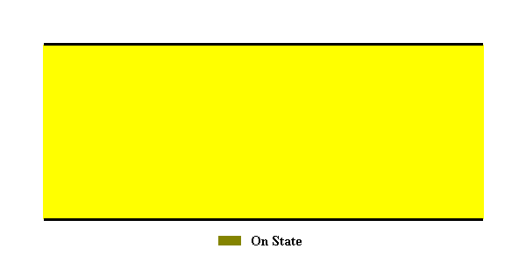

Quantum Mechanics and Stimulated Emission
1
0.8
0.6
0.4
(z,t)
0.2
+
E
x
0
-0.2
-0.4
-0.6
-0.8
-1
0
0.5
1
1.5
2
2.5
3
3.5
4
4.5
5
z/
λ
0

Slide 13
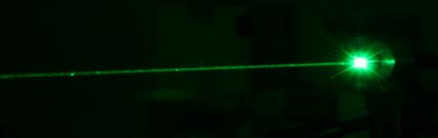
Lasers
The astounding phenomenon is “Stimulated Emission”
– a purely quantum phenomenon !
Identical photons with the same frequency moving in the same direction –
Result is a
coherent light source with a highly directional beam !
Stimulated Emission: If one photon is present it is more likely that an atom will emit a second identical photon! In a laser there is a cascade that causes emission of many identical photons!
Two identical photons!
Photon emitted by some other atom

Slide 14
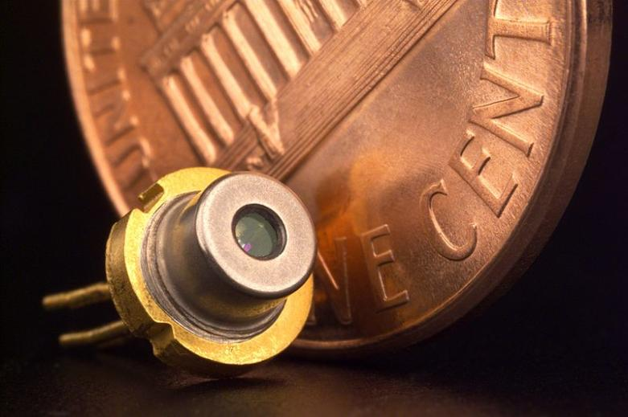
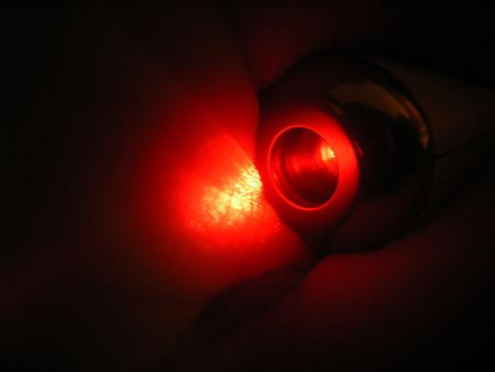
Semiconductor Lasers
All images are in the public domain

Slide 15
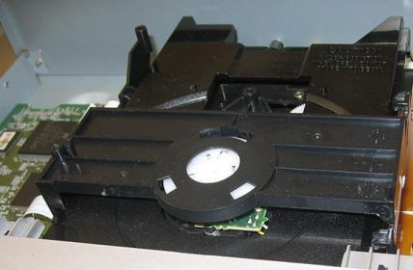

Active Devices for DVD Players
2-axis Device
¼ Wave Plate
Collimator Lens
Cylindrical Lens
Detector
Polarizing Prism
Diffraction Grating
Laser
strained QW at 655 nm
All images are in the public domain

Slide 16

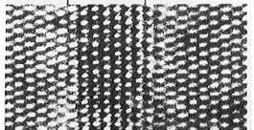
Quantum Well Lasers
n-type semiconductor
p-type semiconductor
CONDUCTION
BAND
electron
METAL
CONTACT
VALENCE
BAND
METAL
CONTACT
NARROW GAP
ACTIVE REGION
hole
V

Slide 17

Trapping Photons: Mirrors and Waveguides
How do we keep photons around for long enough time
so they have a chance to stimulate an emission ?
also
boson
also
boson
boson
Boson
boson !
Boson
resonators
waveguides

Slide 18
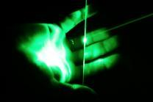
Longest Wavelength Semiconductor Lasers
INTERBAND LASER:
set by bandgap
Bipolar: electron-hole recombination
Opposite band dispersion
Conduction Band
Valence Band
INTERSUBBAND LASER:
chosen by design
Unipolar: electrons make intraband transitions
Same subband dispersion
Conduction Band

Slide 19
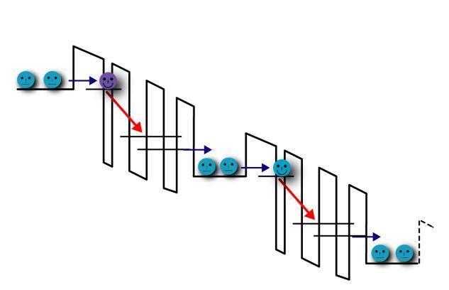
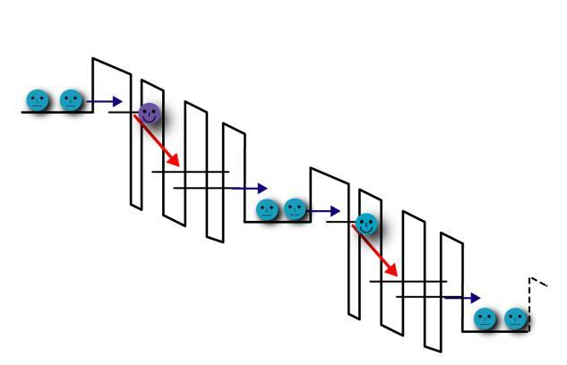
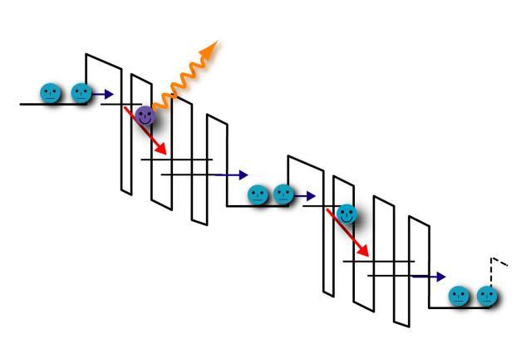
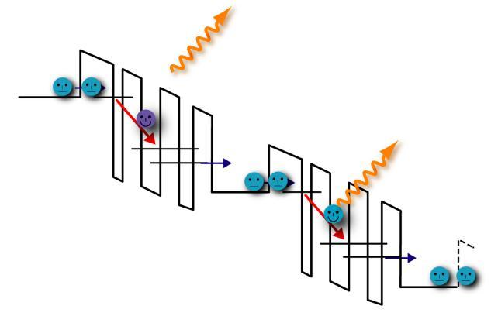
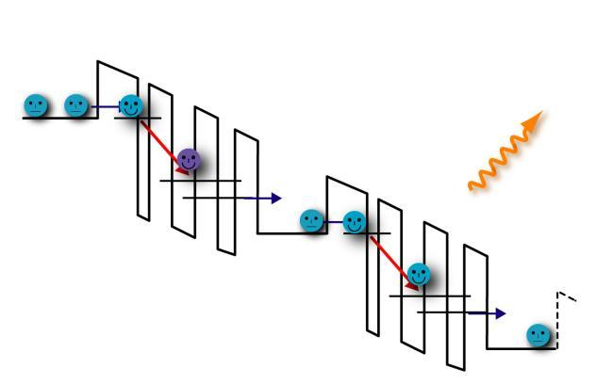
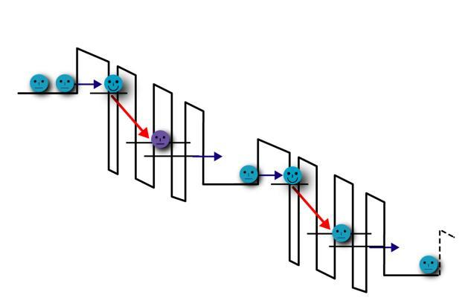
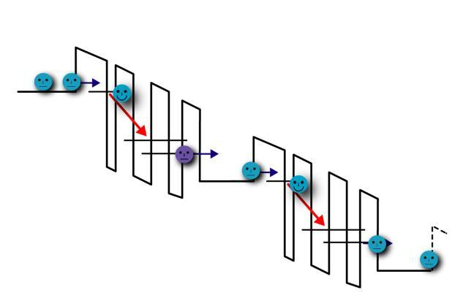
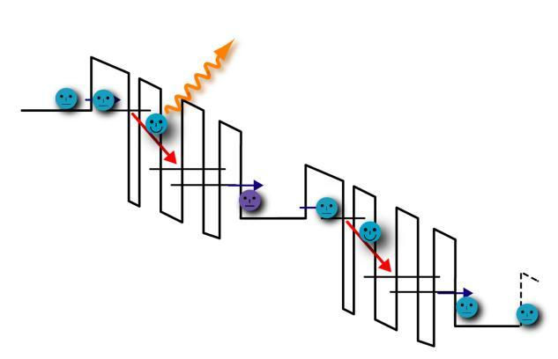
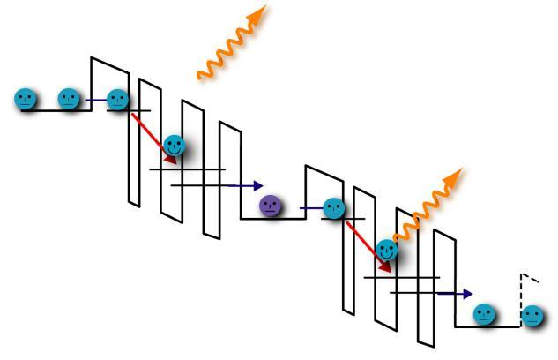
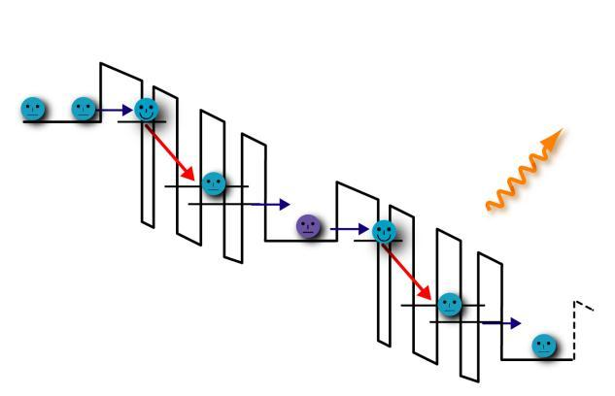
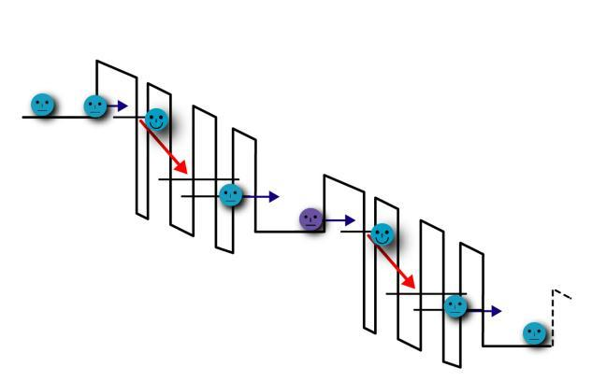
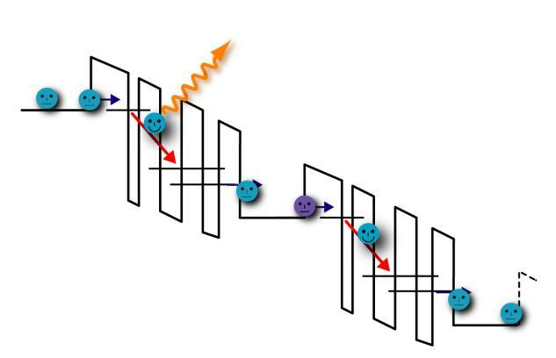
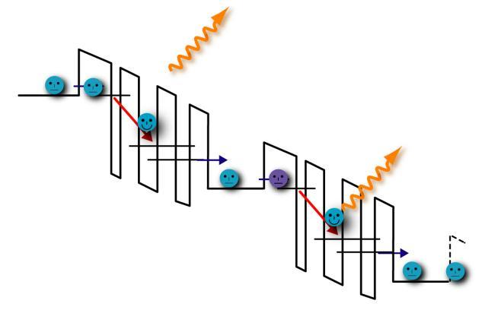
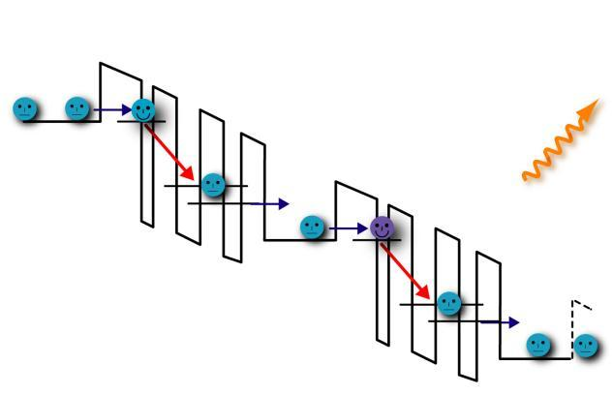
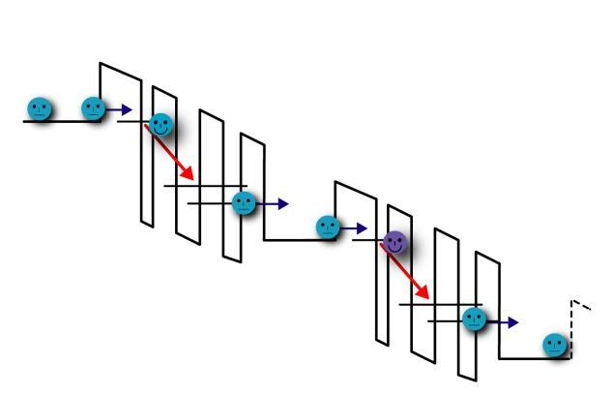
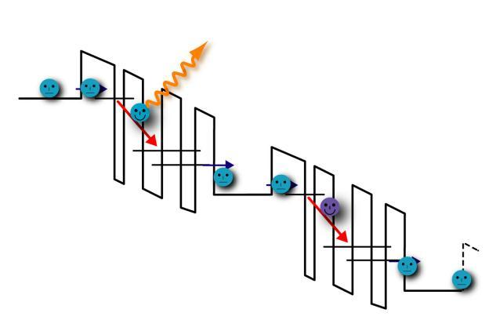
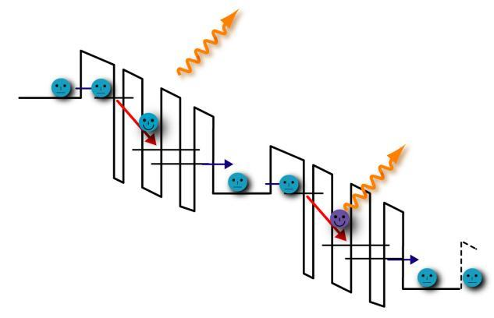
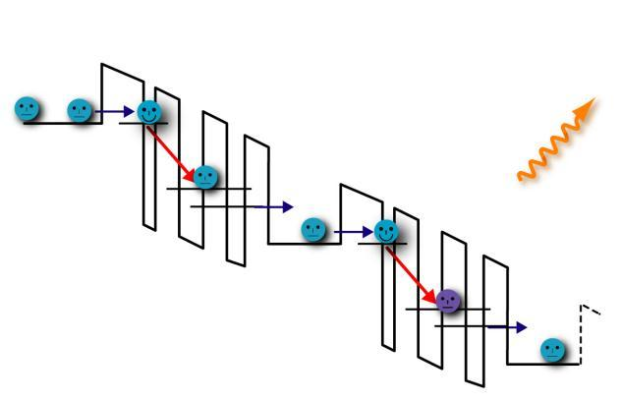
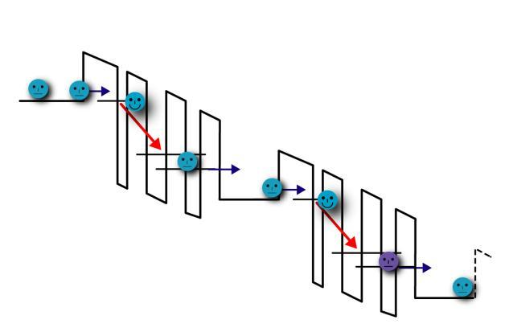


Quantum-Cascade Lasers
(slide courtesy of Prof. Jerome Faist at Univ. Neuchâtel)
Courtesy of Jerome Faist. Used with permission.
Cascade: N repetitions of a period
→ 1 electron traveling through this structure may generate N photons
Groupe de physique mésoscopique
Institut de physique,
Université de Neuchâtel

Slide 20
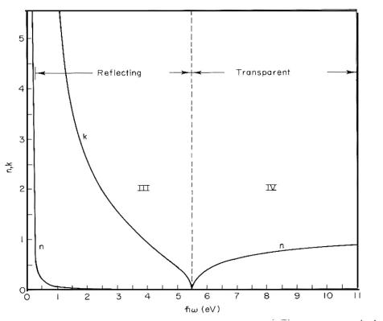

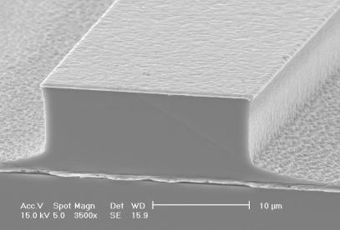
Metal Mirror Waveguides
metal
Courtesy of Qing Hu, Millimeter-wave and Terahertz Devices Group at MIT. Used with permission.
Quantum wells
Metals are excellent reflectors at THz frequencies
Courtesy of Qing Hu, Millimeter-wave and Terahertz Devices Group at MIT. Used with permission.

Slide 21
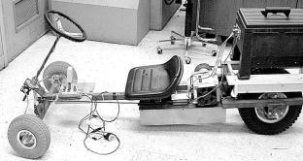
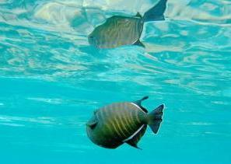

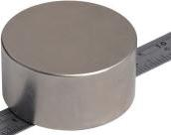
6.007 – Applied E&M – From Motors to Lasers
The course encompassed THREE THEMES with FIVE related LABS
WORK AND ENERGY
ELECTRODYNAMICS
QUANTUM MECHANICS

Slide 22
6.007 – Applied E&M – From Motors to Lasers
The course encompassed THREE THEMES with FIVE related LABS
EM WAVES
Wave Equation
- Energy in the EM Waves
Polarized Light
MATERIALS RESPONSE
- Lorentz Oscillator
- Reflection, Absorption
- Complex Refractive Index
- Evanescent Waves
•• LAB ••
LIQUID CRYSTAL DISPLAY
DEVICES AND PHYSICS
Polarizers/Birefringence
•• LAB: FIBEROPTICS ••
- Photon as a
Quantum of Energy
MEASUREMENT AND UNCERTAINTY
- Photon Momentum
- Heisenberg Microscope
ELECTRON EIGENSTATES
- Calculating Wavefunctions
Particle in a Box
- Atoms and Quantum Dots
QUANTUM ELECTRONICS
- Tunneling (STM, Flash)
Energy Bands/ Conduction
- Energy Band Transitions
Photodetectors, Solar Cell
LED and Lasers
•• LAB ••
TUNNELING TOUCHPAD
WORK AND ENERGY
ELECTRODYNAMICS
QUANTUM MECHANICS
ENERGY CONVERSION and STORAGE
- Energy Conservation
- Across and Through Vars.
- Energy Storage
•• LAB: MOTORS ••
ENERGY/POWER/WORK in
BASIC CIRCUIT ELEMENTS
- Electric/Magnt Materials
- Energy Method for Motors
- Magnetostatic / Electrostatic Machines
- Micro-Electro Machines
•• LAB: COIL GUN ••
- Limits of Statics

Slide 23
MIT OpenCourseWare
http://ocw.mit.edu
6.007 Electromagnetic Energy: From Motors to Lasers
Spring 2011
For information about citing these materials or our Terms of Use, visit: http://ocw.mit.edu/terms.

